Slide 1
Teachers wanting to edit this slideshow should click “File” then “Make a Copy”
This lesson plan and corresponding materials were created by Matt Daniel of Pitt County Schools as part of the 2021-2022 UNC World View Global Fellows Program. For more information about the program, please visit http://worldview.unc.edu/.
Artifact images are used with permission from the UNC Research Laboratories of Archaeology/ https://ancientnc.web.unc.edu
This lesso plan was created by Matt Daniel of Pitt County Schools as part of the 2021-2022 UNC World View Global Fellows Program. For more information about the program, please visit http://worldview.unc.edu/.

Slide 2
NAME THAT ARTIFACT!
Be sure you are working on your assigned slide and your assigned slide ONLY!

Slide 3
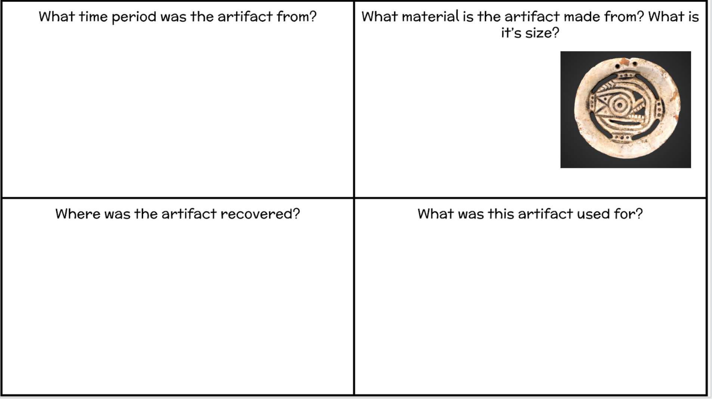
Type Here
Type Here
Type Here
Type Here

Slide 4
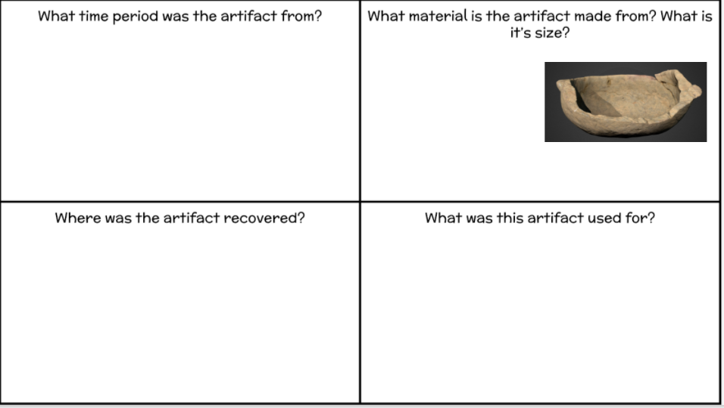
Type Here
Type Here
Type Here
Type Here

Slide 5
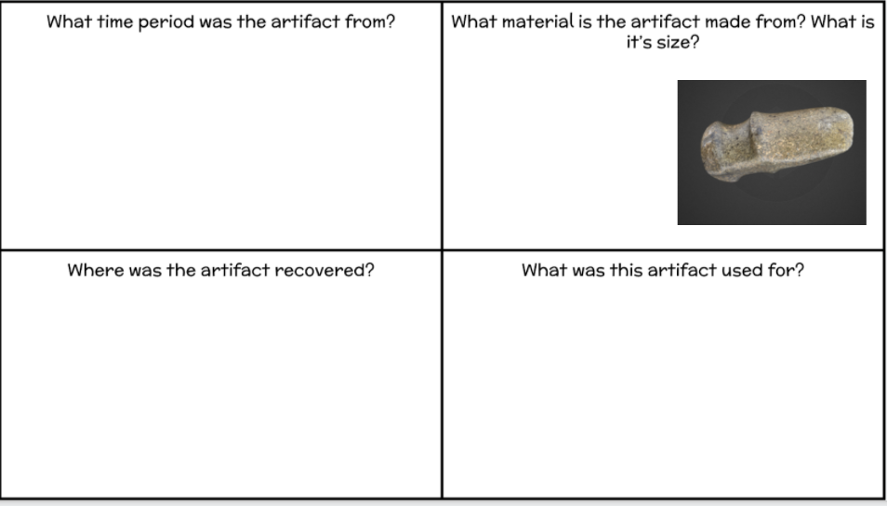
Type Here
Type Here
Type Here
Type Here

Slide 6
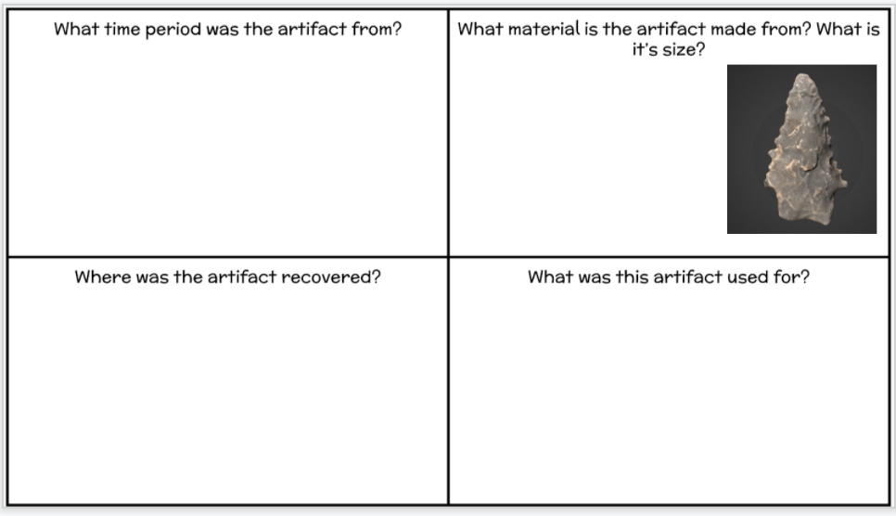
Type Here
Type Here
Type Here
Type Here

Slide 7
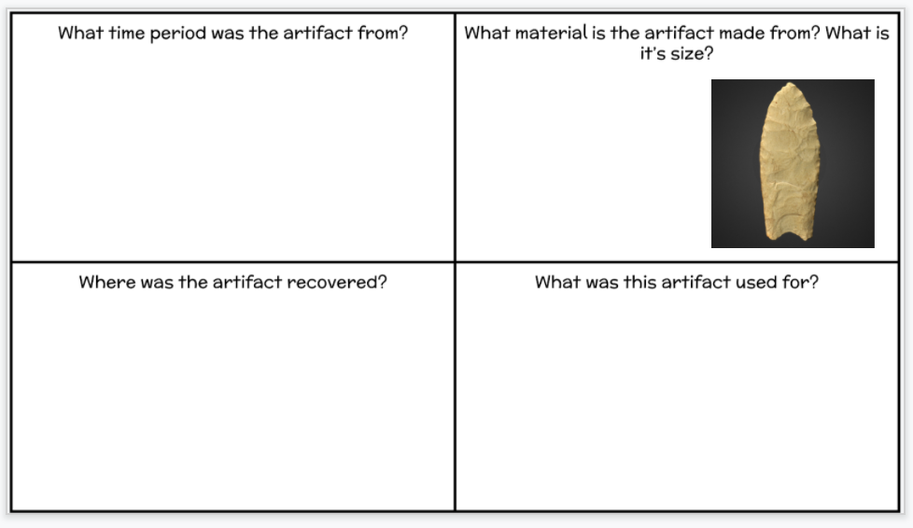
Type Here
Type Here
Type Here
Type Here

Slide 8
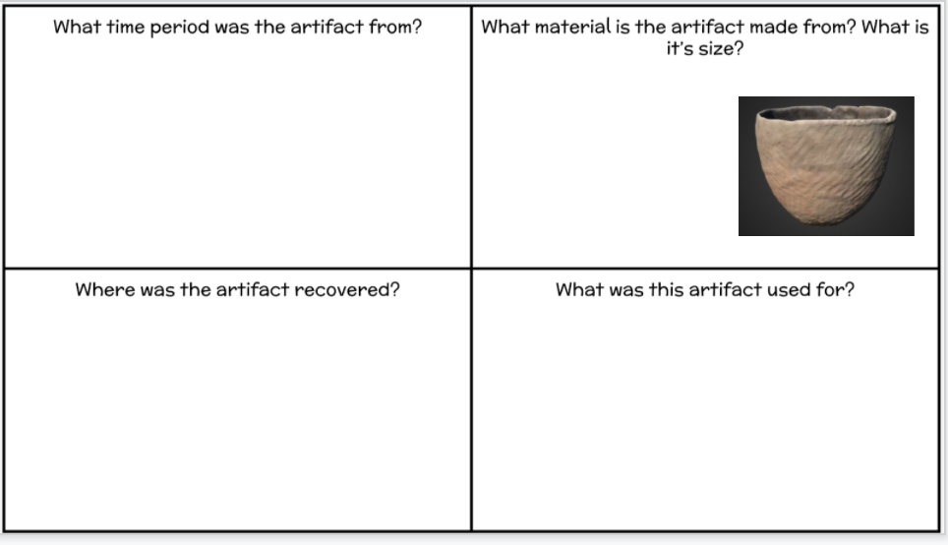
Type Here
Type Here
Type Here
Type Here

Slide 9
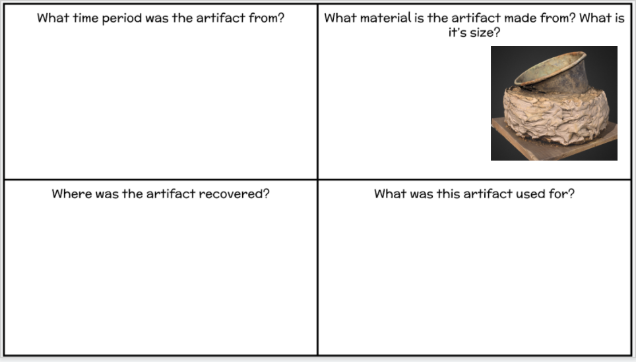
Type Here
Type Here
Type Here
Type Here

Slide 10
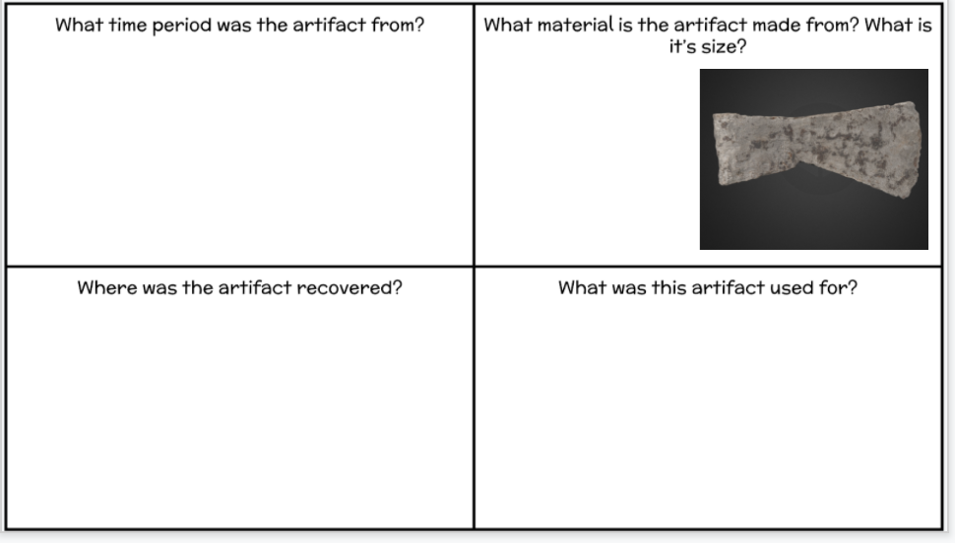
Type here
Type here
Type here
Type here

