Slide 1
Exploring Indigenous Cultures
of North Carolina
Part I
THE PAST
Created by
Sierra Roark (RLA UNC 2022)
Notes:
Exploring Indigenous Cultures of North Carolina: Part I, THE PAST
This brief 10-15 minute slide deck and associated text provides background information for teachers using any of the lesson plans developed as part of the 2021-2022 UNC World View Fellows Program, Exploring Indigenous Cultures: Ancient North Carolinians, Past and Present. Fellows created the lessons for K-12 schools and community colleges to help students learn about the ancient peoples that lived here and those who represent today’s vibrant American Indian populations. Lessons connect past to present day by exploring multiple resources within the Ancient North Carolinians: A Virtual Museum of North Carolina Archaeology website to examine how communities changed over time and what influenced these changes. Understanding past indigenous lifeways—their complexity, resiliency, and vitality—allows for a greater appreciation of the contributions American Indians made to the past and continue to make to the present and future of North Carolina.
• Exploring Indigenous Cultures: Ancient North Carolinians, Past and Present (https://worldview.unc.edu/resources/world-view-fellows-resources-2021/)
• Ancient North Carolinians: A Virtual Museum of North Carolina Archaeology (https://ancientnc.web.unc.edu/)
Slide deck and text by Sierra Roark, Public Outreach Coordinator, Research Laboratories of Archaeology, University of North Carolina at Chapel Hill.

Slide 2
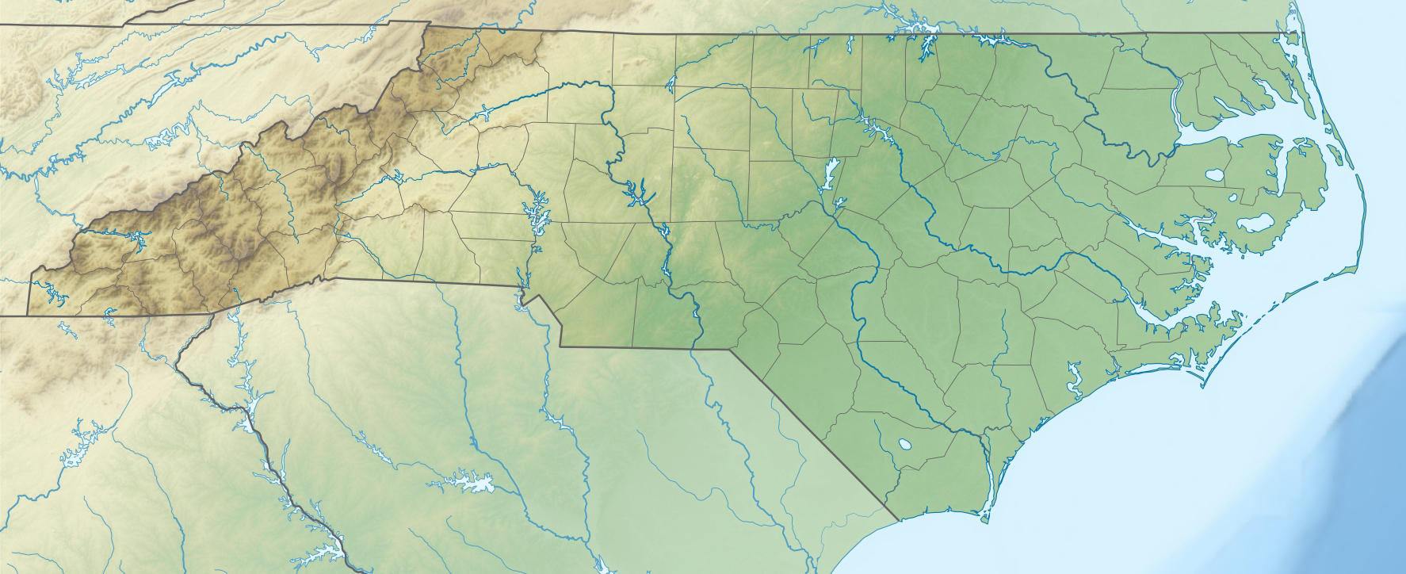
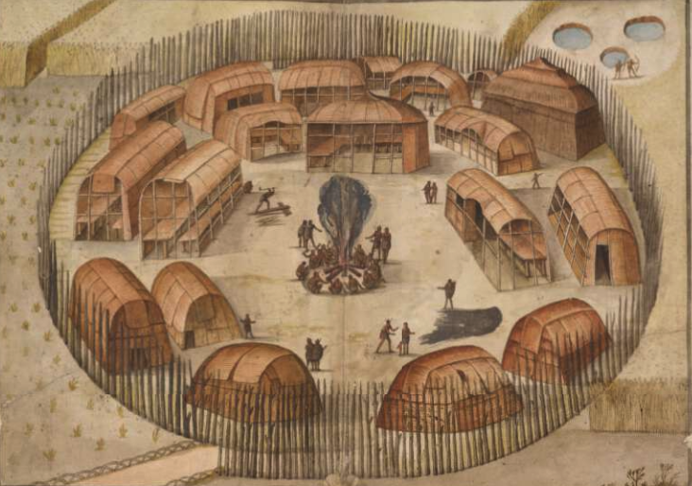
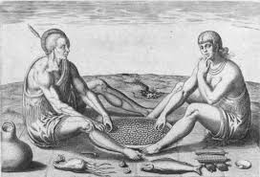
Figure 1.
Figure 2.
Figure 3.
Notes:
American Indians have lived in the area we now call North Carolina for at least 15,000 years. The boundaries we recognize today are largely political and were not the same as in the past. Archaeologists study the remnants of their communities to learn who these people were and how they lived and prospered for thousands of years. By collecting pieces of the archaeological puzzle, we know more about past indigenous lifeways and how people and cultures changed over time.

Slide 3
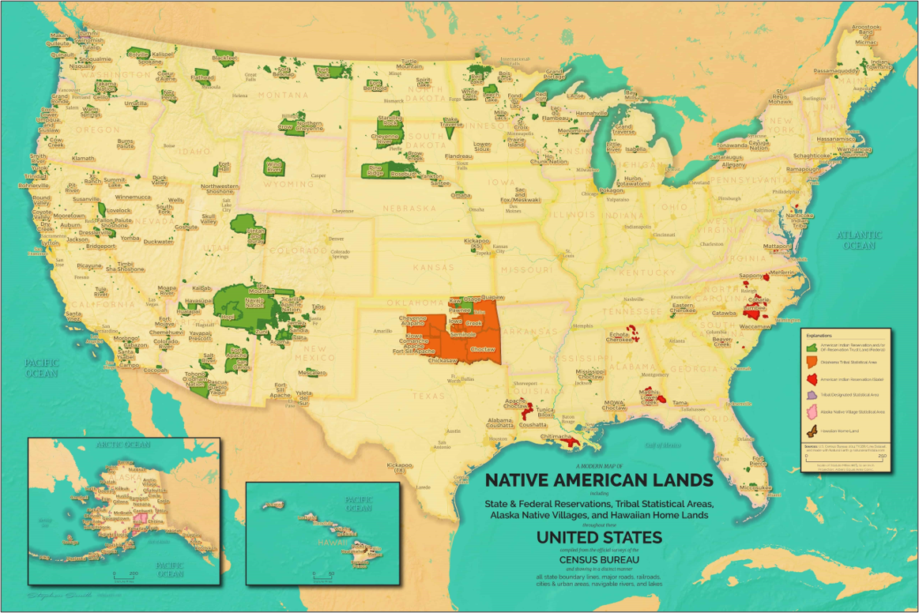
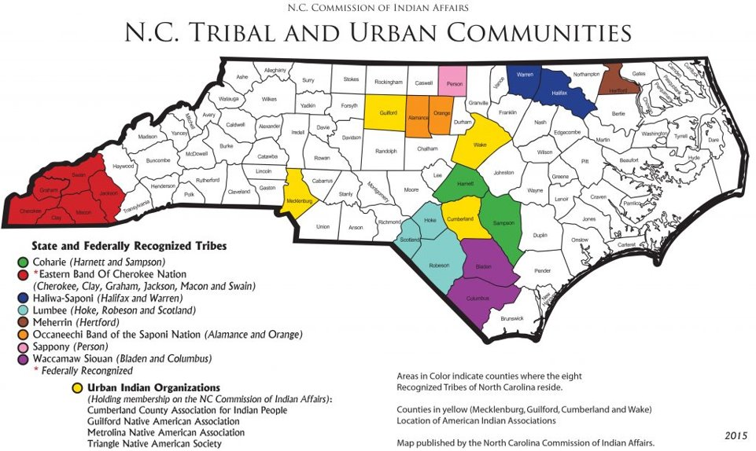
NC
Figure 4.
Notes:
Today, North Carolina is actually home to the largest population of American Indians east of the Mississippi River, totaling as of 2021 more than 184,000 people with eight state-recognized tribes and four urban Indian organizations. Notice that west of the Mississippi has significantly more land marked as federal-recognized reservations (green). While the east has more state-recognized American Indian reservations (red).
Color break down:
Green: American Indian Reservation (federal)
Orange: Oklahoma Tribal statistical area
Red: American Indian Reservation (state)
Purple: Tribal designated statistical area
Pink: Alaska Native village statistical area
Brown: Hawaiian Home Land

Slide 4
How do we know about the past?
Notes:
Ask students how they know about the past. Answers may reference books, movies, oral family histories, etc.

Slide 5
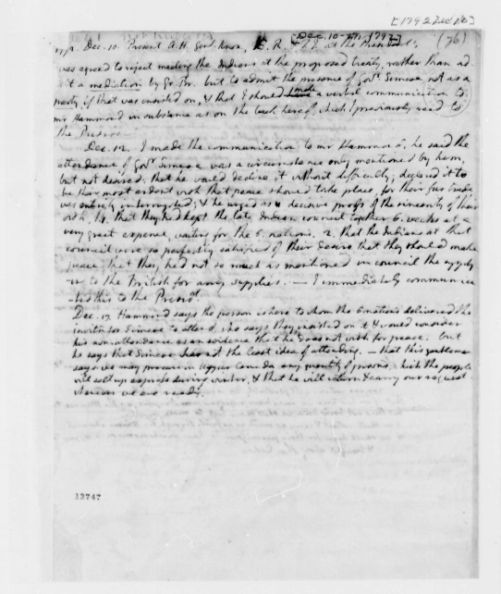
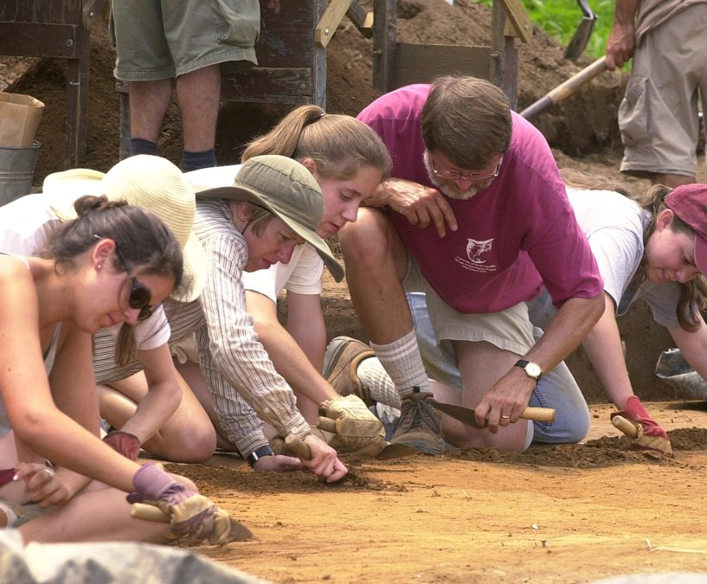
We know about the past through…
Oral History | Historical Documents | Archaeology
Figure 5.
Figure 7.
Figure 6.
Notes:
Today we will be discussing archaeology, but these other lines of inquiry are important. Oral history is the collection and study of historical information typically using sound recordings of interviews with people having personal knowledge of past events. Historical document research involves studying written records, but not everyone in the past could read or left behind records that were saved. Each method has its pros and cons and no single method will pick up every detail. By combining methods a more detailed portrait of the past can be formed.

Slide 6
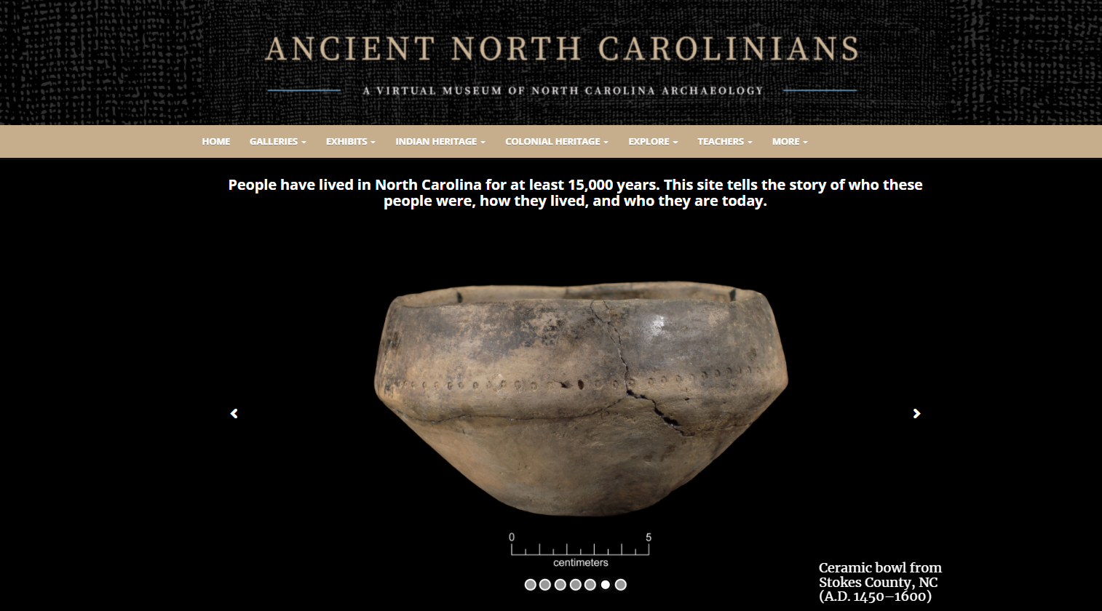
Figure 8.
Notes:
A great place to learn about American Indians and archaeology in North Carolina is through the Ancient North Carolinians: A Virtual Museum of North Carolina Archaeology website (https://ancientnc.web.unc.edu/). This website, developed by UNC’s Research Laboratories of Archaeology, tells the story of the people who lived in North Carolina from 15,000 years ago to the early eighteenth century—the ancestors of today’s American Indians. Educators and students can discover archaeology in their part of the state, learn about American Indian and colonial heritage, explore driving trails of archaeological and historical sites, and much more. Galleries feature videos on a variety of topics and 3D models of ancient objects, from stone spearheads and knives, to ceramic pots, to animal bone tools and ornaments. This virtual museum is a valuable resource for anyone interested in North Carolina’s past.

Slide 7
Fact or Fiction?
Archaeologists dig up dinosaurs.
Picking up artifacts when you see them outside is okay.
All archaeologists work outside.
Archaeologists look at trash.
FALSE ‒ That would be a paleontologist!
FALSE ‒ Archaeologists need to know where things came from so picking up artifacts removes its context which gives archaeologists important information!
FALSE ‒ Only some archaeological work happens outside. Archaeologists often spend more time in the lab analyzing and interpreting what they found.
TRUE ‒ There is lots of important information that can be learned from someone's trash. For instance, what you eat, use, and then discard.
https://ancientnc.web.unc.edu
Notes:
Both you and your students may have misconceptions regarding American Indians or archaeology. Conversations on these topics should be had in a respectful manner and can emphasize that over time much has changed in how this topic has traditionally been discussed. This is also a good starting place to test students’ knowledge. Archaeology is quite different from much of what is shown on tv.

Slide 8
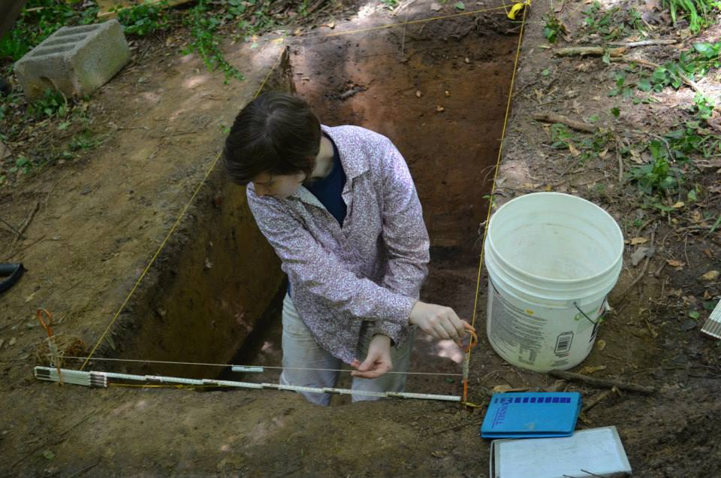
Archaeology is…
The study of people through their things, also known as artifacts
There are many types of archaeologists who specialize in studying certain topics and materials (i.e., plants, animals)
Archaeologists often look for changes across time and space
Figure 9.
Notes:
Archaeology allows to study people by analyzing their belongings. There are different types of archaeologists, many have specialties, meaning they investigate a particular subject or type of artifact. Archaeologists often look to identify changes across time and space.

Slide 9
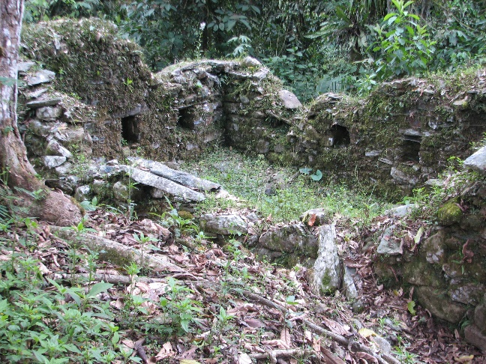
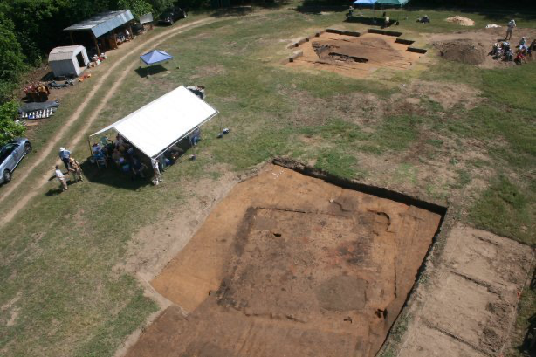
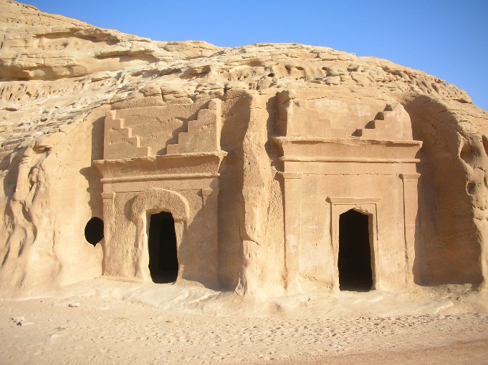
Archaeological sites come in
all shapes and sizes.
Archaeological site: Any place where there are physical remains of past human activities.
Figure 10.
Figure 11.
Figure 12.
Notes:
Archaeological sites come in all shapes and sizes; sites can be large or small, well-hidden or obvious. All that is required is physical remains of human past activities.

Slide 10
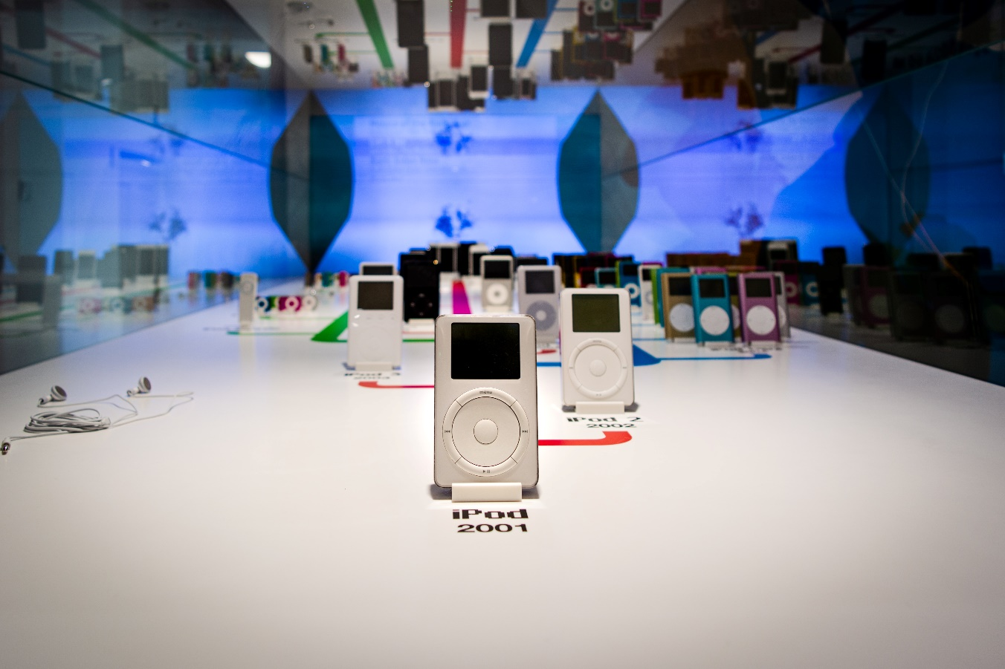
Change Over Time ‒ Modern Examples
Figure 13.
https://ancientnc.web.unc.edu
Notes:
This example should resonate with those unfamiliar with archaeology. IPods and technology have changed drastically since the original iPod was released in 2004. Ask students what changes or trends they can detect from this image. Examples for answers are listed below.
Trends in size
Trends in abilities (camera, photos/video, memory, buttons)
What are the earliest and latest dates?
Are any of these devices still in use despite now being 10+ years old? (maybe an elder relative like a grandparent still uses older tech)

Slide 11
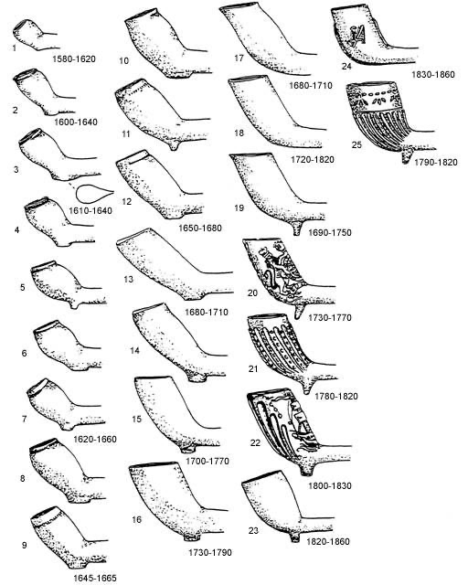
Change Over Time ‒ Historical Examples
1580-1620
1830-1860
1690-1750
1780-1820
1645-1665
1820-1860
1730-1790
o
Figure 14. Noël Hume (2001)
Notes:
Like the iPod, other items have changed in shape, size, and design over time. Archaeologists who work in the historic period (c. 1540-1850) can use pipes to figure out dates. Try asking students again what changes or trends they can detect from this image.
The shape of European tobacco pipes changes over time reflecting social and economic trends…
-When is tobacco the most expensive? Answer: when is the pipe bowl the smallest
-When did different designs emerge? How do they change over time?

Slide 12
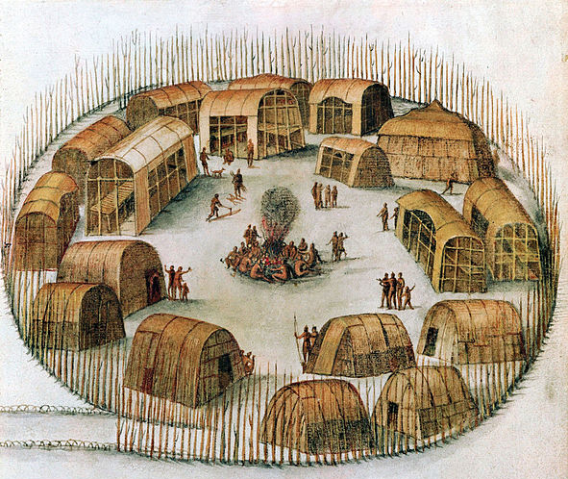
Most American Indians lived in small villages.
https://ancientnc.web.unc.edu
Figure 15.
Notes:
Most American Indians lived in small villages. Notice that American Indians didn't all live in tee-pees. Most of the American Indians in North Carolina lived in small structures made of wood and reeds. The frame of the house was made from wooden poles that were tied together. The walls and roof were made from reed mats or sheets of tree bark.

Slide 13
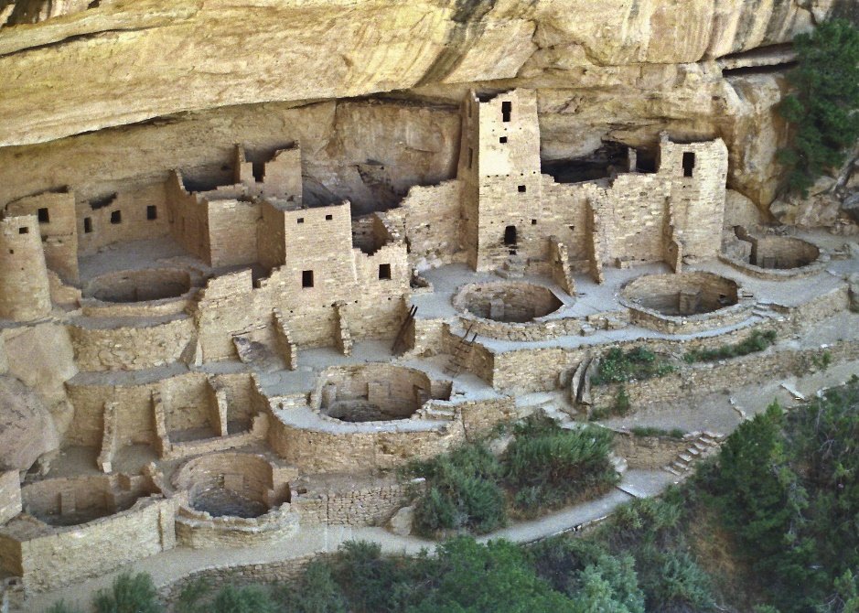
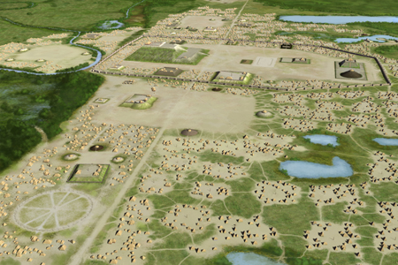
But some American Indians lived in more densely
populated communities (towns, cities).
Below: An artist’s conception of the aerial view of the Cahokia villages located near present-day St. Louis, Missouri
Figure 16.
Above: Cliff dwelling of Mesa Verde, Colorado
Figure 17.
Notes:
In other parts of North America, American Indians lived in more densely populated communities.

Slide 14
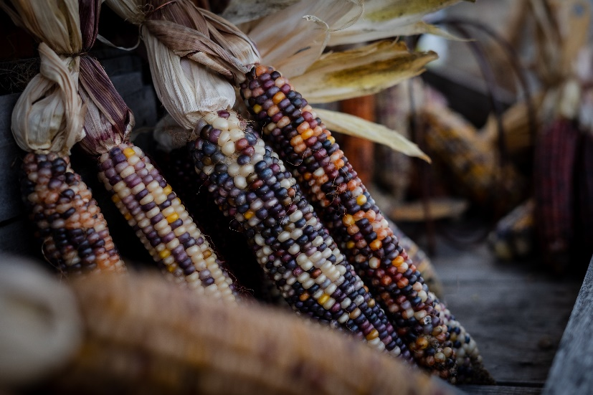
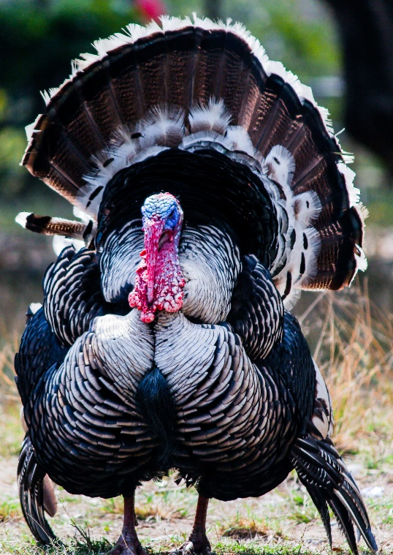
They ate plants and animals.
v
(and sometimes raised)
Figure 18.
Figure 20.
https://ancientnc.web.unc.edu
Figure 21.
Figure 19.
Notes:
Like people living in other parts of the world, American Indians had long-term relationships with plants and animals. Some plants and animals were domesticated. Domestication is a multi-generational relationship where an organism becomes easier to harvest or train because of the care it receives. Animals are domesticated to be tamer/friendlier (dogs) or to grow larger and produce more meat (turkeys). Note that turkeys were domesticated in the American Southwest and Mesoamerica, not North Carolina. Plants are domesticated to produce more fruits or have seeds that can grow easier.

Slide 15
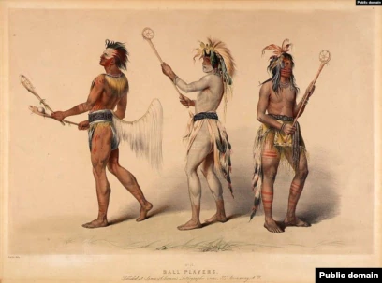
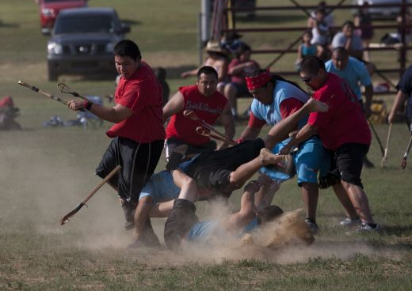
They played games and sports.
Stickball is similar to lacrosse.
Figure 22.
https://ancientnc.web.unc.edu
Figure 23.
Notes:
American Indians played games and sports. Some of these sports were similar to basketball and lacrosse, but there was significantly less emphasis on safety. Sometimes these games were used to settle disputes or bestow social prestige.

Slide 16
Timeline of Human Occupation in North Carolina
Paleoindian
(14,000-8000 B.C.)
Archaic
(8000-1000 B.C.)
Woodland
(1000 B.C.- A.D. 1600)
Mississippian
(A.D. 1000-1700)
Contact & Historic
(A.D. 1540-1850)
https://ancientnc.web.unc.edu
2022
https://ancientnc.web.unc.edu
Notes:
Humans have lived in North Carolina for a very long time! Notice how long previous periods have been especially compared to the Contact and Historic period.

Slide 17
Archeologists have found artifacts and occupations from all of these time periods…
Figure 24.
https://ancientnc.web.unc.edu
which provide insights into lives of the
first North Carolinians.
Notes:
Descriptions and artifacts from all of these time periods can be found on the Ancient North Carolinians virtual museum website (https://ancientnc.web.unc.edu/).

Slide 18
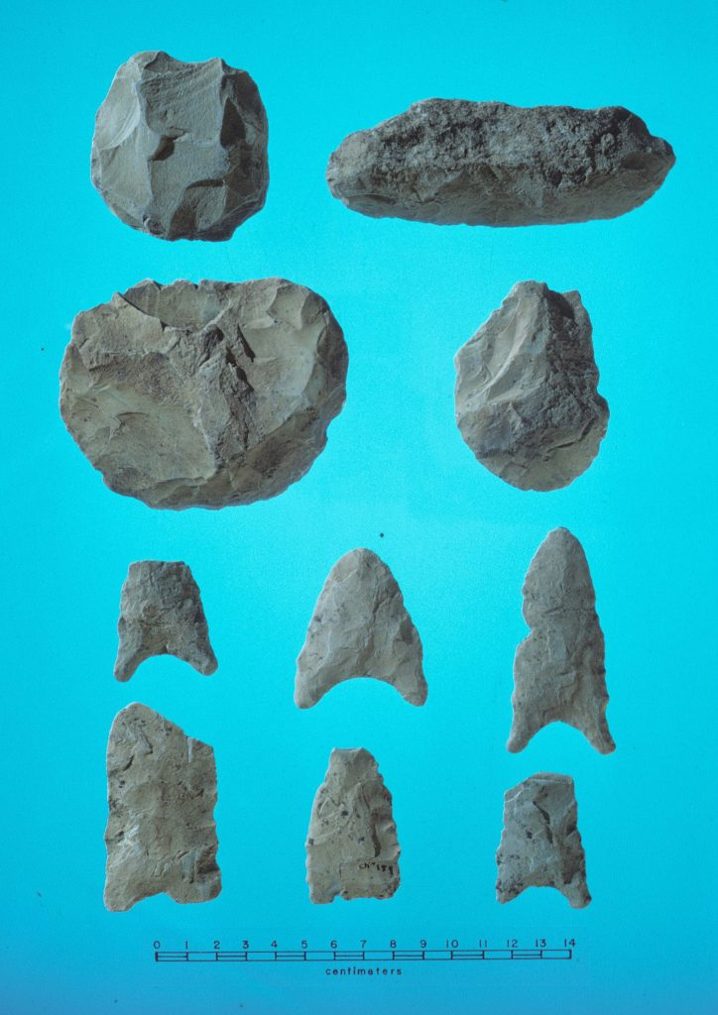
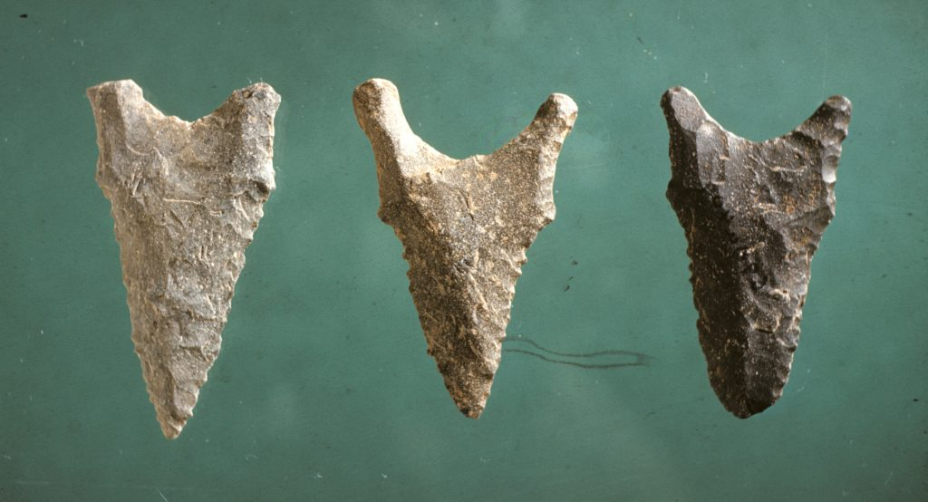
Paleoindian (14,000 - 8000 BC)
Arrival of people in the southeastern North America
Nomadic lifestyle
Hunting and gathering
Figure 26.
Figure 25.
Late Paleoindian spear points and scrapers | New Hope Reservoir | Chatham Co., NC
Hardaway-Dalton spear points | Hardaway site | Stanly Co., NC
https://ancientnc.web.unc.edu
Notes:
The first North Carolinians arrived to the region during the Paleoindian period. They spent their time hunting and gathering and moved to follow game herds and better weather.

Slide 19
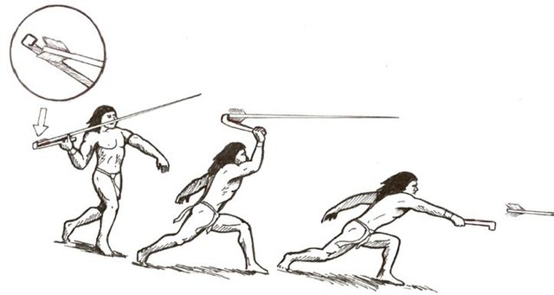
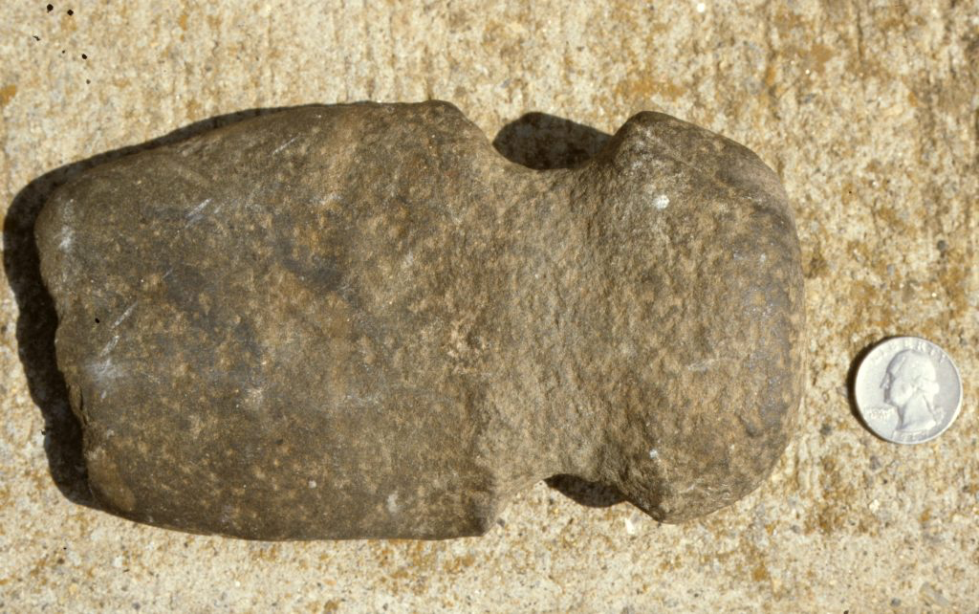
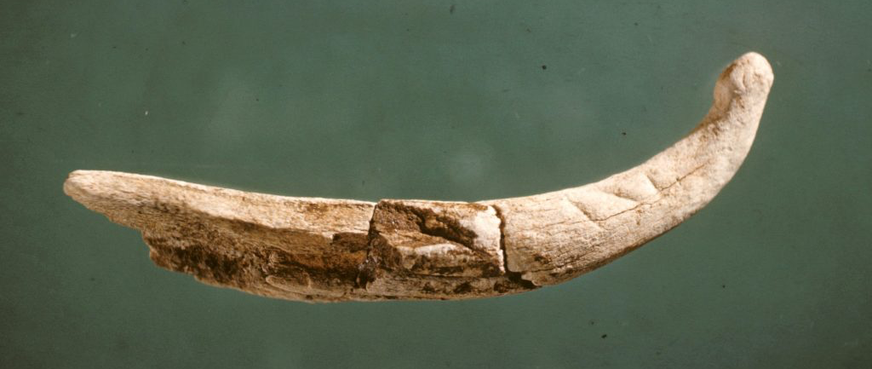
Archaic (8000 - 1000 BC)
Nomadic to Semi-nomadic lifestyle (small groups)
Moved seasonally (hunting and gathering)
Population increased
Many new tool types (Atlatl)
Figure 29.
Figure 27.
Figure 28.
Figure 30.
Grooved axe | Yancey Co., NC.
(Handle and binding did not preserve)
Soapstone pot | Warren Wilson site | Buncombe Co., NC
Antler atlatl | Hardaway site | Stanly Co., NC
https://ancientnc.web.unc.edu
Notes:
The Archaic period follow the Paleoindian period. People still moved frequently and spent their time hunting and gathering resources. The population increased and new technologies were developed. For instance, the invention of the atlatl and soapstone vessels. Soapstone is the precursor to pottery. An atlatl is a device that allows uses leverage to achieve greater velocity when throwing a spear, meaning the spear has more force and can be thrown faster and farther.

Slide 20
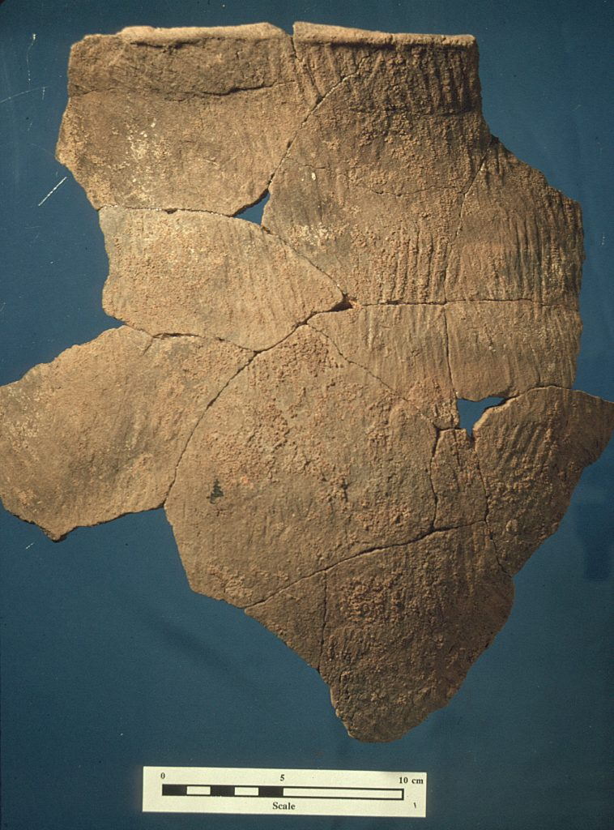
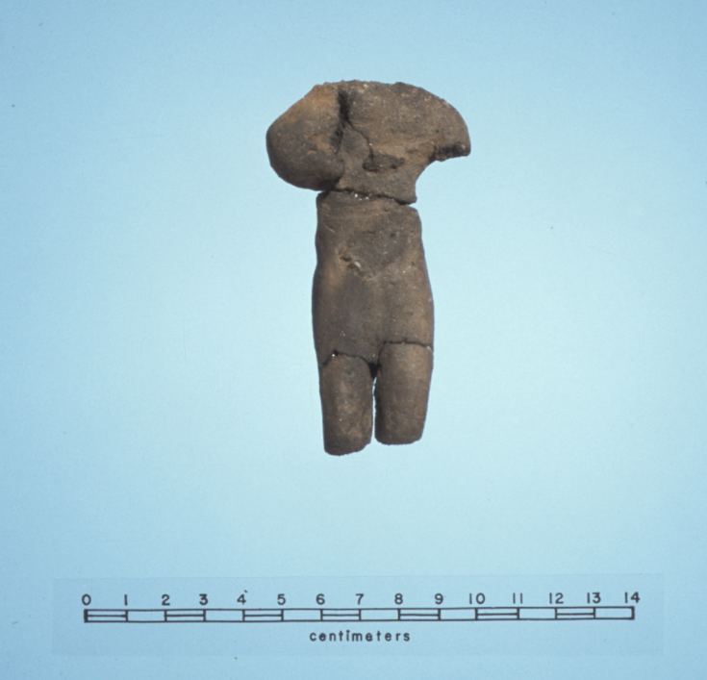
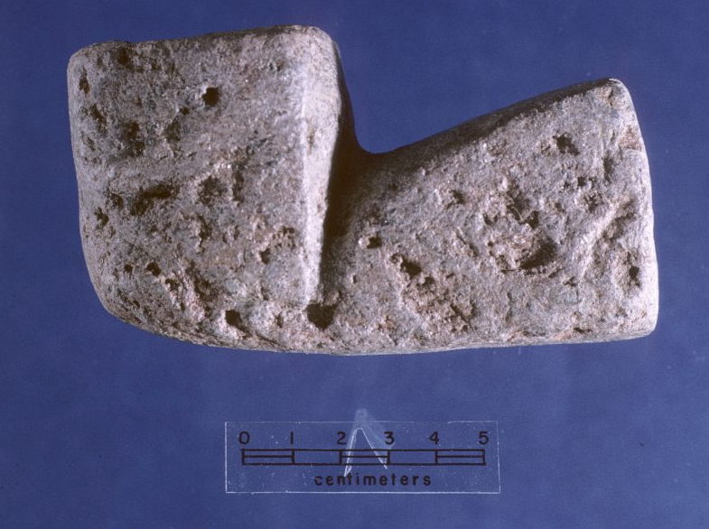
Woodland (1000 BC - AD 1600)
Semi-sedentary to sedentary villages
Horticulture
Pottery-making
Bow & arrow
Figure 33.
Hillsboro Simple Stamped jar Edgar Rogers site
Alamance Co., NC
Figure 31.
Figure 32.
Ceramic figurine
Garden Creek mound Haywood Co., NC
Soapstone pipe | Tuckasegee site
Jackson Co., NC
https://ancientnc.web.unc.edu
Notes:
The Woodland period followed the Archaic period. People were living more sedentary lifestyles, meaning they stayed in one place longer. Not only were people making pottery but they were growing plants and using bows and arrows in this period. The widespread appearance of pottery-making is viewed as going hand in hand with an increasing reliance on seed crops and more permanent settlements.

Slide 21
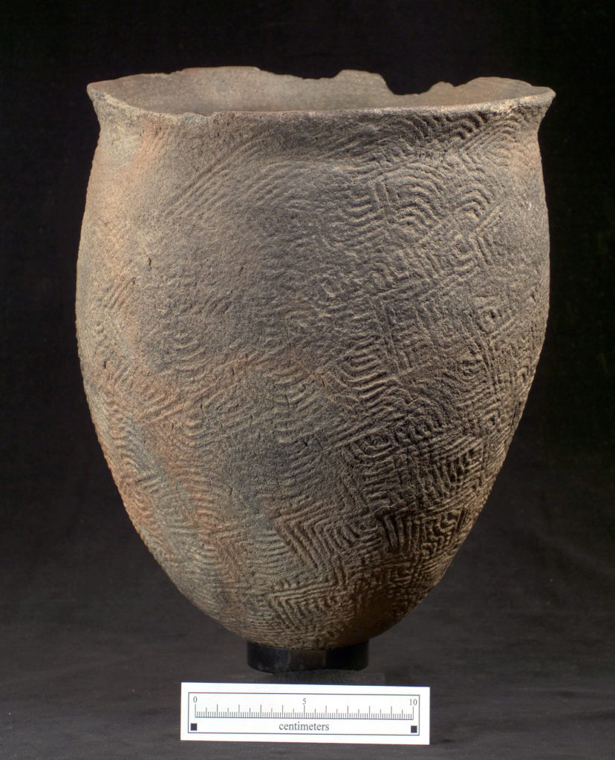
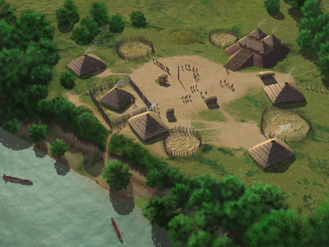
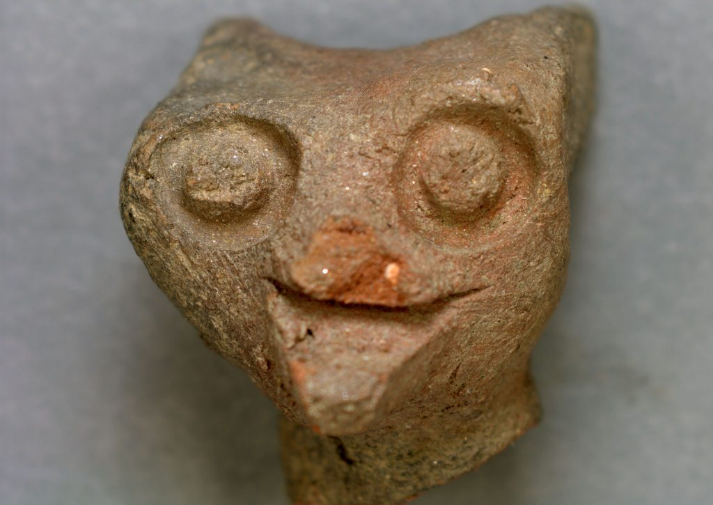
Mississippian (AD 1000 - 1700)
Politically complex cultures
Earthen mound construction
Agricultural economies
Western North Carolina and Southern Piedmont
Figure 35.
Figure 36.
Clay animal effigy Warren Wilson site
Buncombe Co., NC
Pee Dee Complicated Stamped jar | Leak site Richmond Co., NC
Figure 34.
https://ancientnc.web.unc.edu
Notes:
The Mississippian period is defined by more politically-complex cultures, earthen mound construction, agricultural economies as well as complicated-stamped ceramics. This era is recognized in western North Carolina (Appalachian Summit) and the southern Piedmont, while the Woodland period continued longer in other regions of North Carolina such as the central Piedmont, Coastal Plain, and Coast.

Slide 22
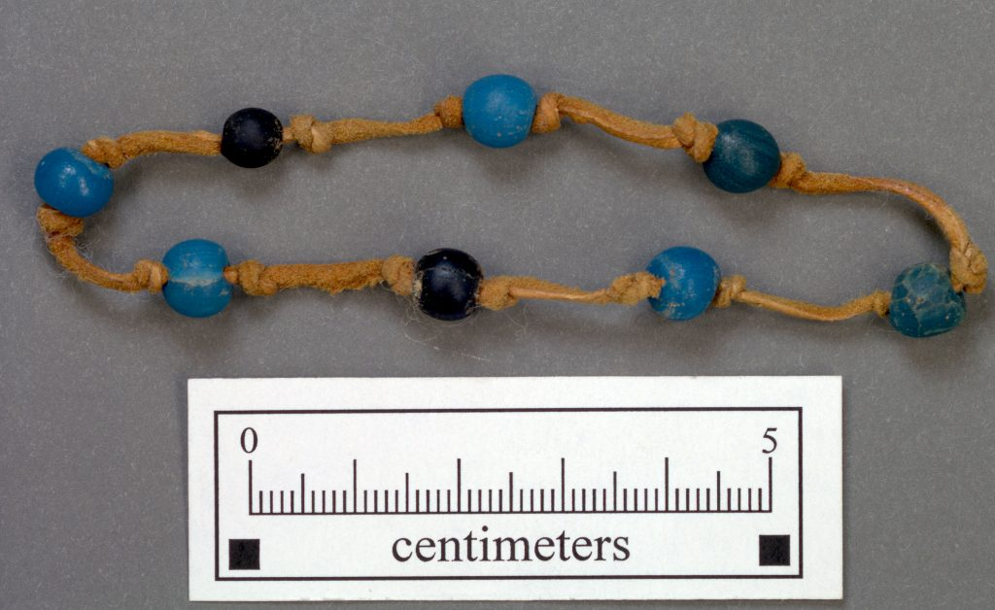
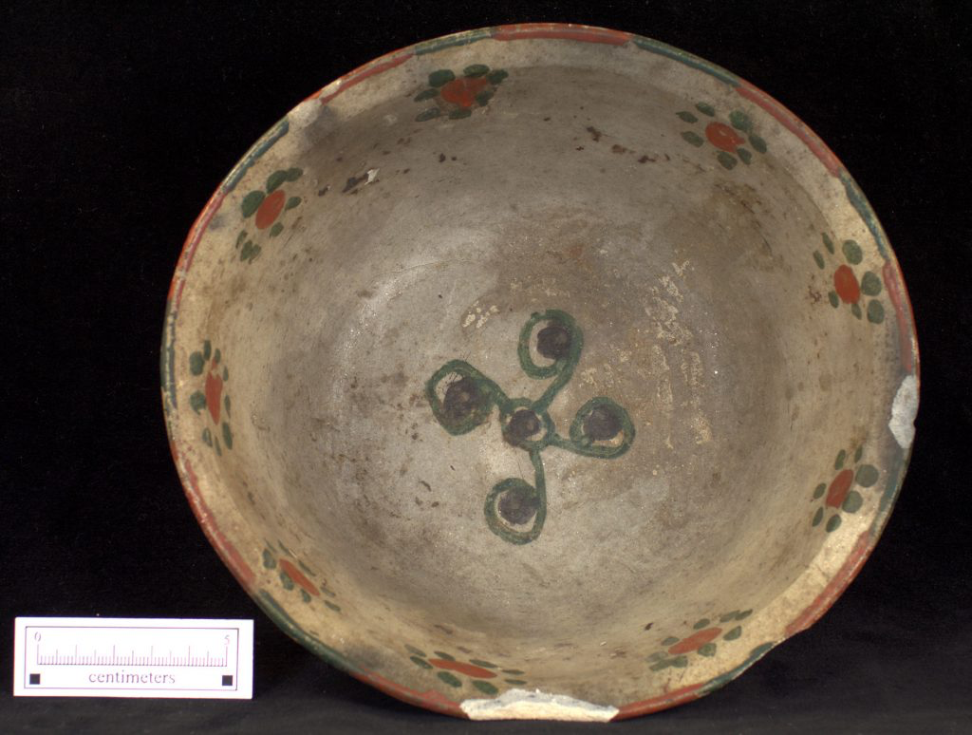
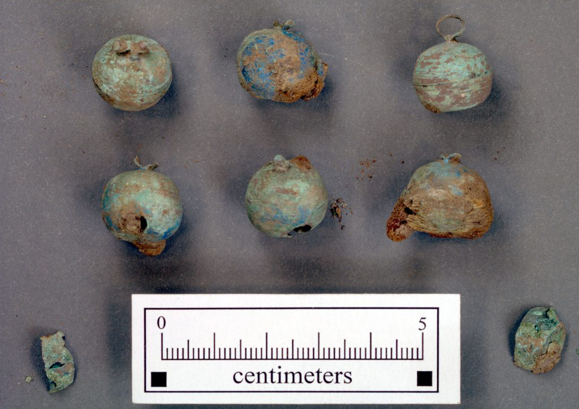
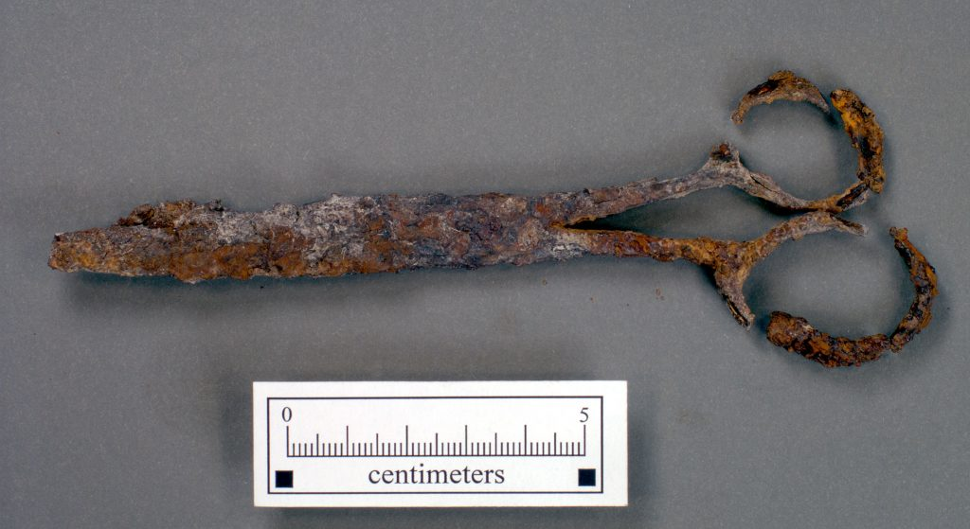
Contact & Historic (AD 1540 – c. 1850)
Begins with earliest contact between American Indians and Europeans
Exchange of goods, plants, animals, and ideas
Significant changes in American Indian lifeways
Figure 39.
Glass beads | Madison site Rockingham Co., NC
Figure 37.
Figure 38.
Figure 40.
Late 19th century Catawba burnished bowl | Swain Co., NC
Copper bells | Mitchum site Chatham Co., NC
Scissors | Fredricks site Orange Co., NC
https://ancientnc.web.unc.edu
Notes:
Following the Woodland and Mississippian periods, the Contact and Historic periods covers the time of earliest contact between Indians and Europeans through to about 1850. When American Indians met Europeans they exchanged goods, plants and animals, and ideas.

Slide 23
“We are still here.”
v
[American Indians]
Notes:
This brief lesson has mainly touched on the ancient peoples that lived here and who represent today’s vibrant American Indian populations. Understanding past indigenous lifeways—their complexity, resiliency, and vitality—allows for a greater appreciation of the contributions American Indians made to the past and continue to make to the present and future of North Carolina.

Slide 24
https://ncadmin.nc.gov/public/american-indians/map-nc-tribal-communities
Notes:
In North Carolina, there are currently eight state-recognized American Indian tribes: Coharie Tribe, Eastern Band of Cherokee Indians, Haliwa-Saponi Tribe, Lumbee Tribe of North Carolina, Meherrin Nation, Occaneechi Band of the Saponi Nation, Sappony, and Waccamaw Siouan and four urban Indian organizations. The Eastern Band of Cherokee Indians also is a federally-recognized tribe.

Slide 25
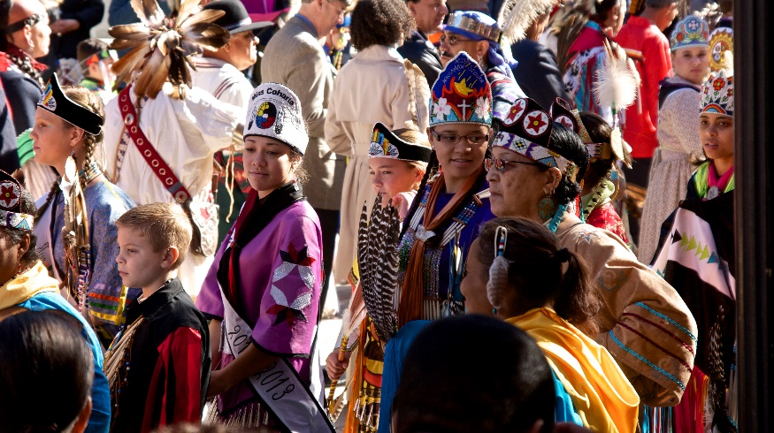
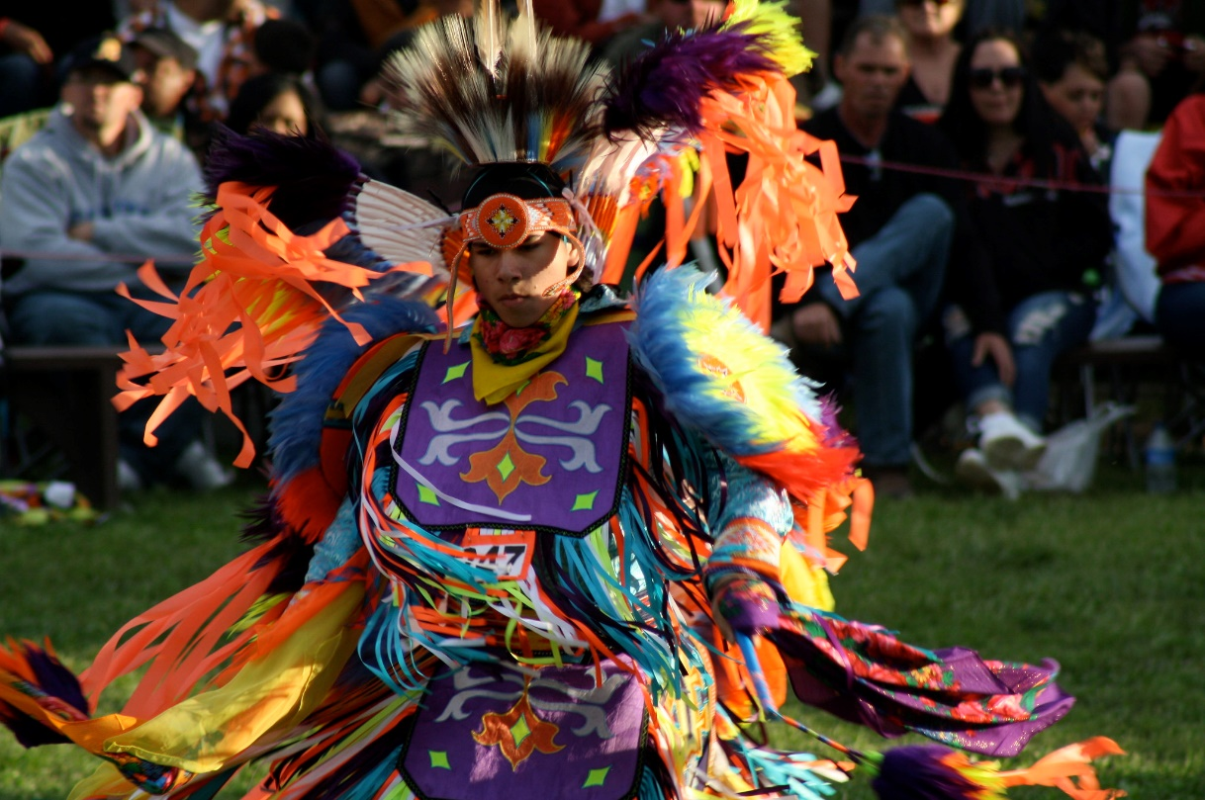
November is American Indian
Heritage Month.
Figure 42.
https://ancientnc.web.unc.edu
Figure 41.
Notes:
You can learn more about American Indians at cultural events hosted in November during American Indian Heritage Month.
Upper right image: Miss Coharie at the American Indian Celebration in 2012
Lower left image: A Haliwa-Saponi man in regalia at the 2013 Haliwa-Saponi pow wow

Slide 26
Image Credits
Figure 1: http://www.naturalearthdata.com/downloads/10m-raster-data/10m-cross-blend-hypso/ Terms of Use All versions of Natural Earth raster + vector map data found on this website are in the public domain. Full terms of use »
Figure 2: John White, The Village of Pomeiooc, c. 1585
Figure 3: John White, Theire Sitting at Meate, c. 1585
Figure 4: https://mapsmith.net/work/a-modern-map-of-native-american-lands/ (author provided free download to any and all and “hassle-free”)
Figure 5: https://unsplash.com/photos/KieCLNzKoBo Free to use under the Unsplash License
Figure 6: Thomas Jefferson, Notes on Indian Treaty. -12-10, 1792. Manuscript/Mixed Material. https://www.loc.gov/item/mtjbib006689/.
Figure 7: Research Laboratories of Archaeology, University of North Carolina
Figure 8: Research Laboratories of Archaeology, University of North Carolina
Figure 9: Research Laboratories of Archaeology, University of North Carolina
Figure 10: “File:Espiritu Pampa Archaeological site - overgrown house.jpg" by AgainErick is marked with CC BY-SA 3.0
https://ancientnc.web.unc.edu

Slide 27
Image Credits
Figure 11: , "File:Al-Hijr Archaeological Site (Madâin Sâlih)-114607.jpg" by Véronique Dauge is marked with CC BY-SA 3.0
Figure 12: "Spanish house at the Berry site, 2008" by University of Michigan News is marked with CC BY 2.0.
Figure 13: https://unsplash.com/photos/SdeQU6rp2X4 Free to use under the Unsplash License
Figure 14: Noël Hume, Ivor. A Guide to Artifacts of Colonial America. University of Pennsylvania Press: Philadelphia. 2001.
Figure 15: https://commons.wikimedia.org/wiki/File:The_village_of_Pomeioc,_North_Carolina,_1885,_color_-_NARA_-_535753.jpg The National Archives and Records Administration provides images depicting American and global history which are public domain or licensed under a free license.
Figure 16: “Cliff dwellings Mesa Verde" by Sue Cantan is marked with CC BY- 2.0
Figure 17: https://commons.wikimedia.org/wiki/File:Cahokia_Aerial_HRoe_2015.jpg by Herb Roe, 2018. Creative Commons Attribution-Share Alike 4.0

Slide 28
Image Credits
Figure 18: https://www.pexels.com/photo/food-wood-agriculture-farm-5641203/ Terms: https://www.pexels.com/license/
Figure 19: https://www.pexels.com/photo/sunflower-1229023/ Terms: https://www.pexels.com/license/
Figure 20: https://www.pexels.com/photo/white-siberian-husky-puppy-on-green-grass-field-3812207/ Terms: https://www.pexels.com/license/
Figure 21: https://www.pexels.com/photo/wild-turkey-917595/ Terms: https://www.pexels.com/license/
Figure 22: http://digitalcollections.nypl.org/ Creative Commons CC0 1.0 Universal Public Domain Dedication ("CCO 1.0 Dedication")
Figure 23: https://commons.wikimedia.org/wiki/File:Kullihoma_Stickball_Tournament.jpg This file is in the public domain because It is on a public Choctaw Nation website and was published in a newspaper. CC0
Figure 24: Research Laboratories of Archaeology, University of North Carolina
Figure 25: Research Laboratories of Archaeology, University of North Carolina
Figure 26: Research Laboratories of Archaeology, University of North Carolina

Slide 29
Image Credits
Figure 27: Research Laboratories of Archaeology, University of North Carolina
Figure 28: Research Laboratories of Archaeology, University of North Carolina
Figure 29: https://commons.wikimedia.org/wiki/File:Nativo_do_Novo_Mundo_lan%C3%A7ando_flecha_com_o_propulsor_ou_est%C3%B3lica.jpg by Sebastião da Silva Vieira. This file is licensed under the Creative Commons Attribution 3.0 Unported license.
Figure 30: Research Laboratories of Archaeology, University of North Carolina
Figure 31: Research Laboratories of Archaeology, University of North Carolina
Figure 32: Research Laboratories of Archaeology, University of North Carolina
Figure 33: Research Laboratories of Archaeology, University of North Carolina
Figure 34: https://commons.wikimedia.org/wiki/File:Town_Creek_Mound_Aerial_HRoe_2019_380px.jpg by Herb Roe, 2019. This file is licensed under the Creative Commons Attribution-Share Alike 4.0 International license.
Figure 35: Research Laboratories of Archaeology, University of North Carolina
Figure 36: Research Laboratories of Archaeology, University of North Carolina

Slide 30
Image Credits
Figure 37: Research Laboratories of Archaeology, University of North Carolina
Figure 38: Research Laboratories of Archaeology, University of North Carolina
Figure 39: Research Laboratories of Archaeology, University of North Carolina
Figure 40: Research Laboratories of Archaeology, University of North Carolina
Figure 41: “IMG_7652” by Allison Fender is marked with CC BY-ND 2.0
Figure 42: "Miss Coharie" by Arne Handt is marked with CC BY-NC-SA 2.0

Slide 31
Please continue to Part II of the presentation…
Exploring Indigenous Cultures
of North Carolina
Part II
THE PRESENT
https://ancientnc.web.unc.edu
Notes:
To learn more about contemporary American Indians in North Carolina, please continue to Part II of this series.

