Slide 1
Exploring Indigenous Cultures
of North Carolina
Part II
THE PRESENT
Created by
Sierra Roark (RLA UNC 2022)
Notes:
Exploring Indigenous Cultures of North Carolina: Part II, THE PRESENT
This brief 10-15 minute slide deck and associated text provides background information for teachers using any of the lesson plans developed as part of the 2021-2022 UNC World View Fellows Program, Exploring Indigenous Cultures: Ancient North Carolinians, Past and Present. Fellows created the lessons for K-12 schools and community colleges to help students learn about the ancient peoples that lived here and those who represent today’s vibrant American Indian populations. Lessons connect past to present day by exploring multiple resources within the Ancient North Carolinians: A Virtual Museum of North Carolina Archaeology website to examine how communities changed over time and what influenced these changes. Understanding past indigenous lifeways—their complexity, resiliency, and vitality—allows for a greater appreciation of the contributions American Indians made to the past and continue to make to the present and future of North Carolina.
• Exploring Indigenous Cultures: Ancient North Carolinians, Past and Present (https://worldview.unc.edu/resources/world-view-fellows-resources-2021/)
• Ancient North Carolinians: A Virtual Museum of North Carolina Archaeology (https://ancientnc.web.unc.edu/)
Slide deck and text by Sierra Roark, Public Outreach Coordinator, Research Laboratories of Archaeology, University of North Carolina at Chapel Hill.

Slide 2
“We are still here.”
v
[American Indians]
Notes:
Contemporary American Indian tribes continue to contribute to the success and vibrancy of North Carolina as they have for thousands of years, all the while emphasizing the sentiment — “We are still here.”

Slide 3
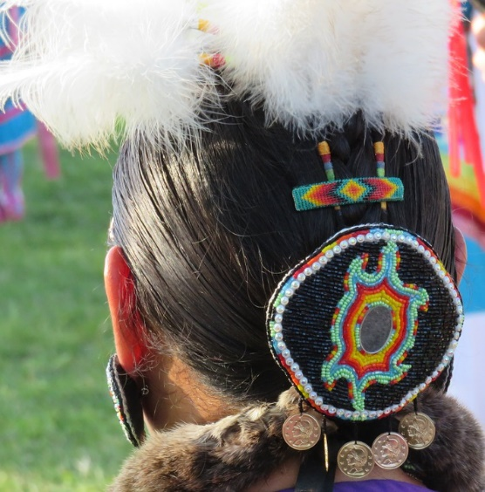
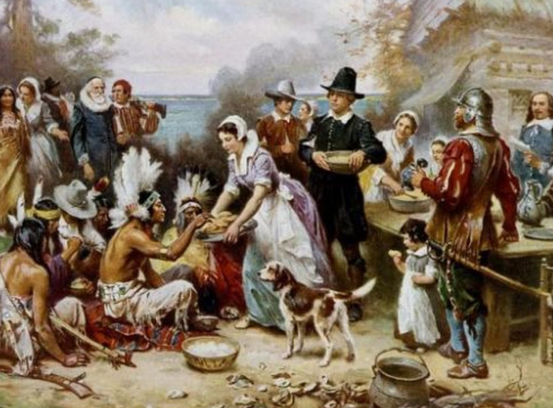
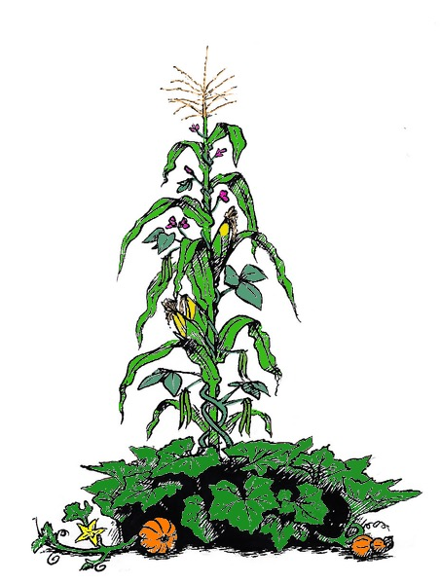
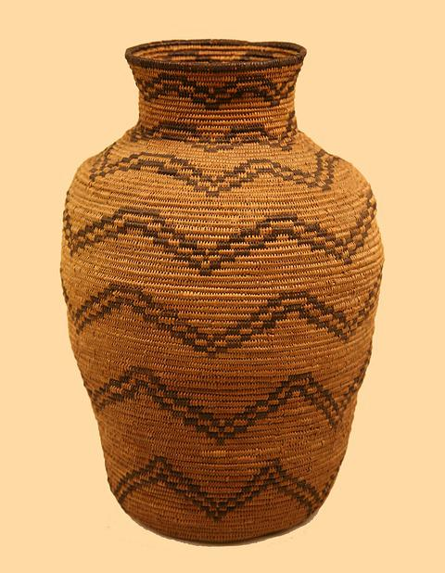
Figure 1.
Figure 2.
Figure 4.
Figure 3.
Figure 5.
Notes:
Preconceived notions of American Indians often include elements of food, crafts, folklore, and other historical narratives. Students may have already been exposed to Thanksgiving stories or three-sisters agriculture (corn, beans, squash), or have knowledge of crafts and beliefs held by some American Indian groups. Emphasize that American Indians are more complex than these representations.

Slide 4
Terminology Matters
Native American and American Indian are often used interchangeably.
In North Carolina, American Indian is the preferred term based on a ruling by the state’s Commission of Indian Affairs.
The word Native refers to Indigenous people from the U.S.
Terminology preferences vary across individuals and tribes.
Notes:
Language matters. Additionally, this terminology is not always straightforward. In North Carolina, American Indian is the preferred term, but that may very in other places. A good rule of thumb is to ask people what they prefer to be called. Some words that were once common are now considered slurs (such as squaw and redskin). Furthermore, note the capitalization of the words Native and Indigenous. Capitalization largely depends on how the word is used.

Slide 5
American Indians are NOT mascots.
Figure 6.
Figure 7.
Notes:
You may know of, or remember, American Indian mascots. Many organizations have shifted away from former American Indian mascots. These mascots and their behavior or sport traditions often included elements that copied American Indian traditions and practices in a demeaning or cartoonish manner. The shift away from American Indian mascots upset many non-indigenous people who felt that their traditions were under attack. Some American Indian groups, like the Seminole Tribe of Florida, have granted institutions permission to use their likeness. However, this was not the case for the majority of American Indian mascots.

Slide 6
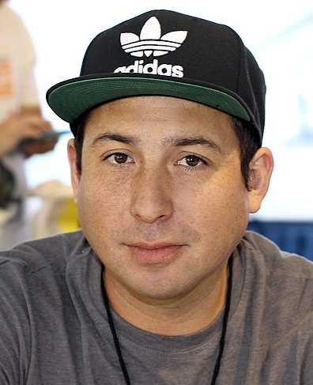
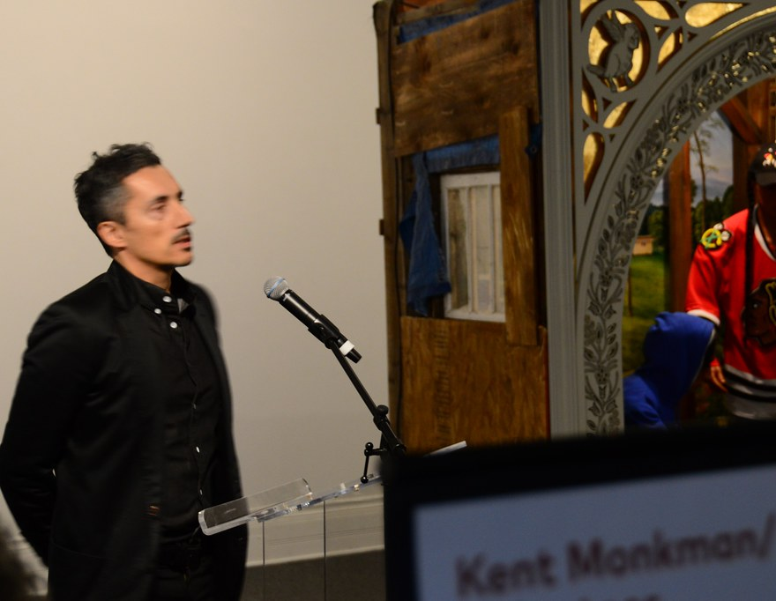
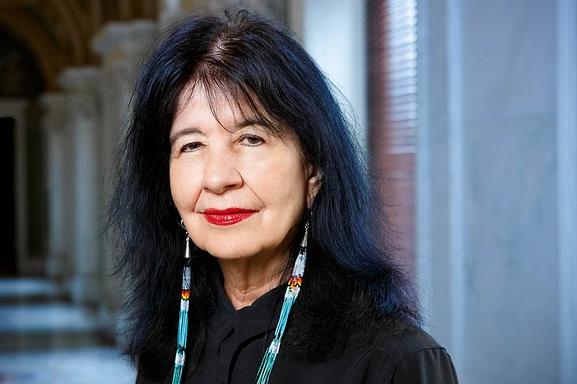
American Indian Artists & Writers
Figure 9.
Figure 10.
Figure 8.
Tommy Orange
Cheyenne & Arapaho
Author
Joy Harjo
Creek & Muscogee
First Native American U.S. Poet Laureate
Poet, Musician, Playwright
Kent Monkman
Cree
Painter
Notes:
American Indians contribute much to our modern society and work in every type of profession. Here are examples of some renowned American Indian authors, poets, and artists.

Slide 7
American Indian Actors & Musicians
Figure 11.
Figure 12.
Figure 13.
Zahn McClarnon
Hunkpapa Lakota
Actor​
Jim Pepper
Kaw & Muscogee Creek
Musician​
Amber Midthunder
Fort Peck Sioux Tribe
Actress
Notes:
There are also famous American Indian actors and musicians.

Slide 8
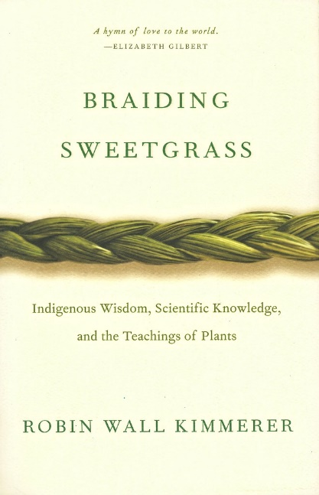
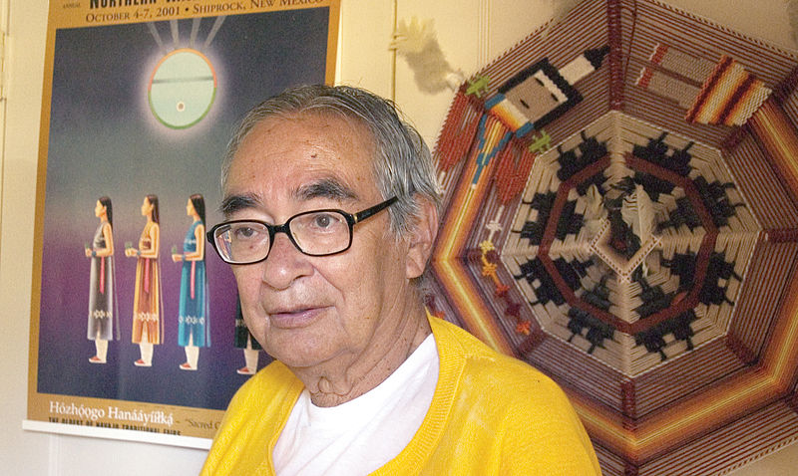
American Indian Scientists
Figure 15.
Figure 14.
Figure 16.
Robin Wall Kimmerer, PhD
Potawatomi
Environmental Scientist
& Professor
Fred Begay, PhD
Navajo & Ute
Nuclear Physicist​
John Herrington
Chickasaw
Astronaut, Naval Aviator,
& Engineer
Notes:
And successful American Indians scientists, academics, and astronauts.

Slide 9
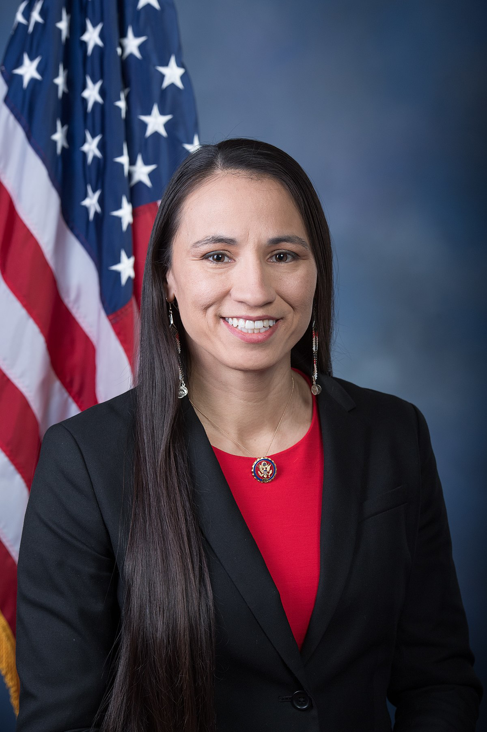
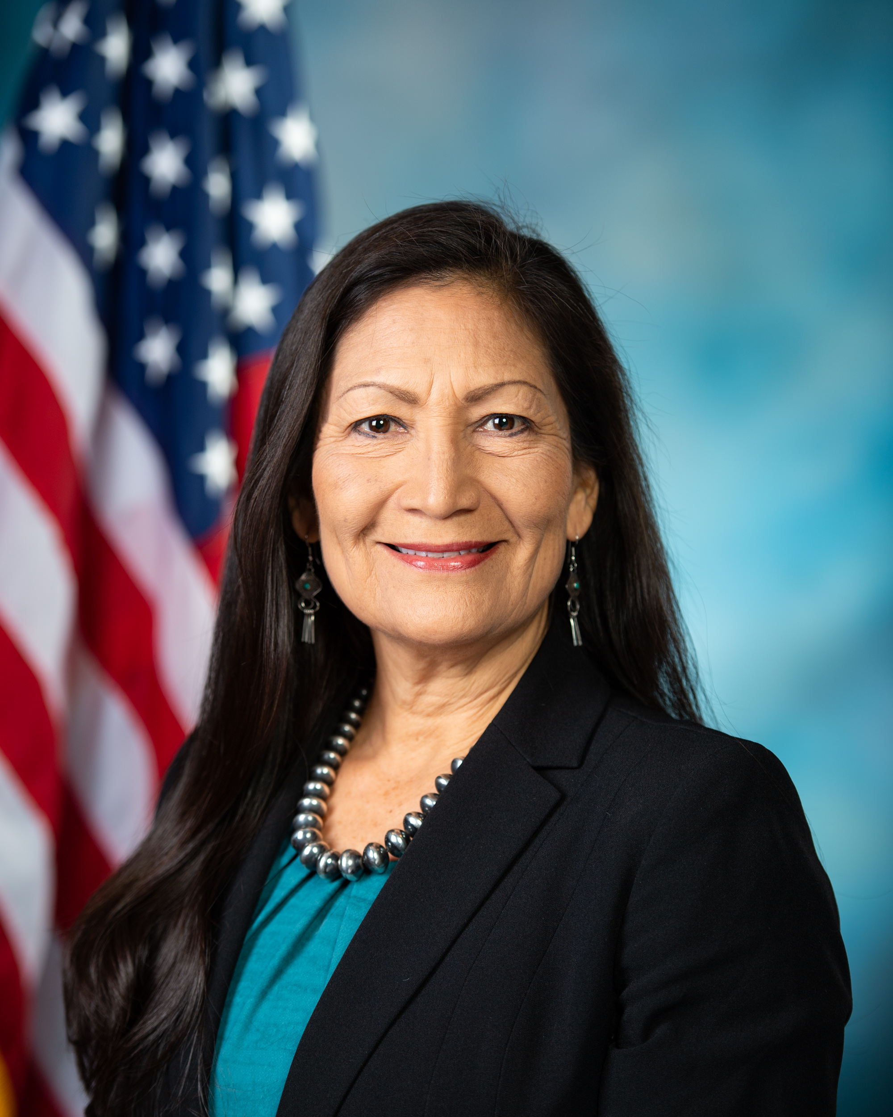
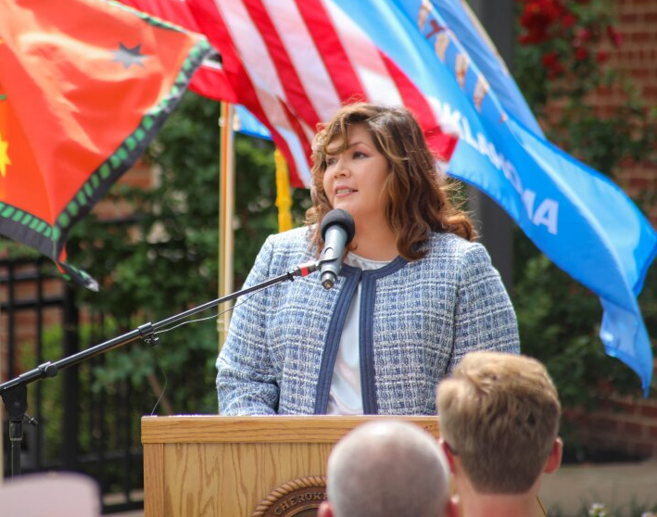
American Indian Politicians
Figure 18.
Figure 19.
Figure 17.
Kimberly Teehee​
Cherokee​
Delegate to the U.S. House of Representatives from the Cherokee Nation
White House Domestic Policy Council Member
Sharice Davids
Ho-Chunk
U.S. Representative of Kansas
Deb Haaland
Laguna Pueblo
U.S. Representative of New Mexico
Current Secretary of the Interior
Notes:
Additionally, the United States government has several American Indian representatives.

Slide 10
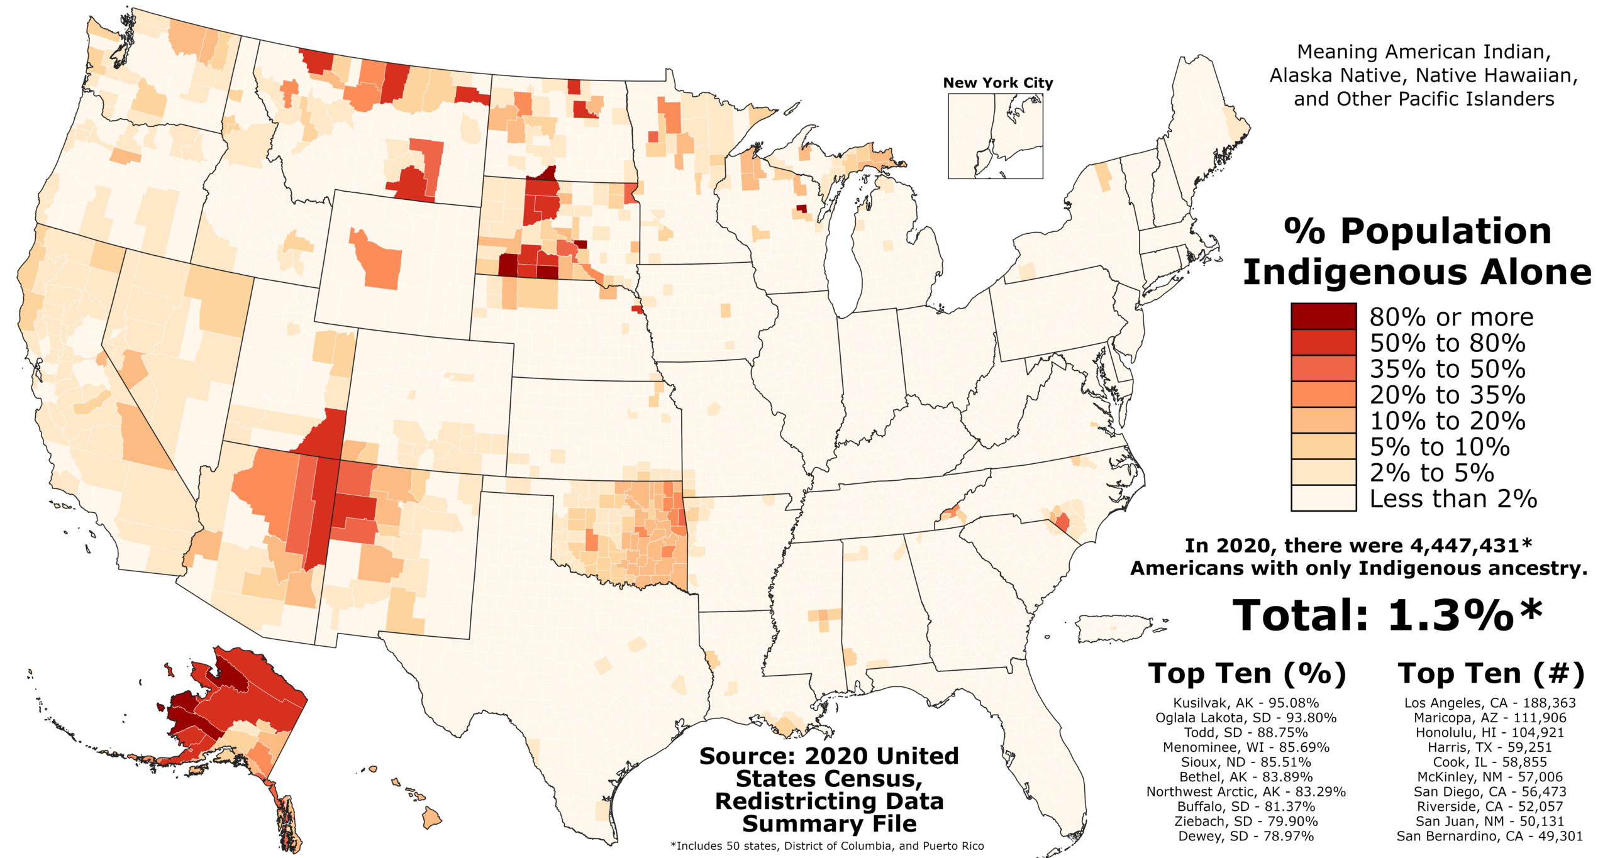
American Indians Today
Figure 20.
Notes:
Currently, the U.S. government recognizes 574 American Indian tribes. In the 2020 census, about 4.5 million U.S. citizens identified as having American Indian or Alaskan Native ancestry.
While this presentation mainly focuses on North Carolina, in Canada there are more than 50 First Nation groups recognized by the Canadian government and more than 1.67 million Canadians identify as Aboriginal.

Slide 11
Types of Tribal Recognition
Federally-Recognized Tribes (n = 574)
Have government-to-government relationships with the U.S Federal government.
Possess certain rights of self-government (i.e., tribal sovereignty) and receive certain federal benefits, services, and protections.
Federal recognition is a complicated and long process.
State-Recognized Tribes (n = 63)
Lack sovereign control over their affairs.
State legislatures acknowledge tribal status within each given state.
Sometimes this recognition qualifies the tribe for state and federal support.
Notes:
State tribal recognition does not offer the same benefits as federal recognition.
Federally-Recognized (574 tribes)
• A federally-recognized tribe has a government-to-government relationship with the U.S.
• These tribes possess certain rights of self-government (i.e., tribal sovereignty) and receive certain federal benefits, services, and protections.
• Federal recognition is a complicated and long process.
State-Recognized (63 tribes)
• State-recognized tribes do not have sovereign control over their affairs.
• These groups are authorized by state legislatures to acknowledge tribal status within the state.
• In some cases, this recognition qualifies the tribe for federal and state support.

Slide 12
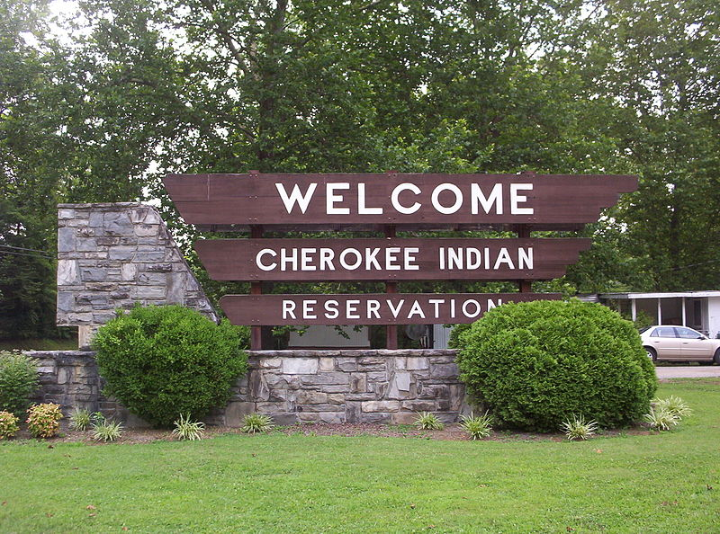
Some tribes have
reservations or tribal lands.
Reservation:
Land set aside for occupation and governance by a recognized tribe.
The result of treaties between a tribal nation of American Indians and the U.S. government.
Figure 21.
Notes:
A reservation is an area of land set aside for occupation and governance by a recognized tribe. Reservations typically resulted from treaties between an American Indian tribal nation and the U.S. government. Historically, reservations have been in areas that have harsh environments, although this is not universally true. American Indians are often concerned with maintaining control over their lands. Historically, land-rights have been a major point of contention. The Eastern Band of the Cherokee Indian (EBCI) have the only federally-recognized and protected territory in North Carolina.
Although the sign pictured in this slide reads “reservation,” the ECBI own their land outright, having purchased the 57,000 acres known as the Qualla Boundary back in the 1800s.

Slide 13
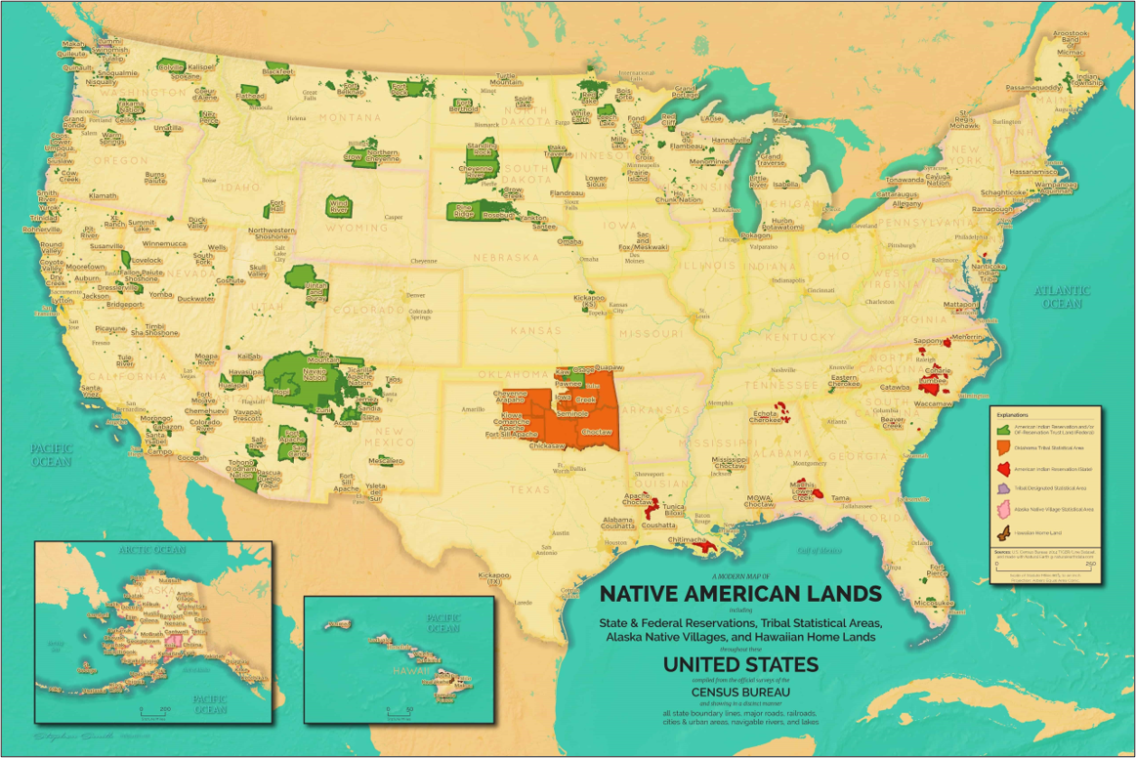
Figure 22.
Notes:
Today, North Carolina is home to the largest population of American Indians east of the Mississippi River, totaling as of 2021 more than 184,000 people with eight state-recognized tribes and four urban Indian organizations. Note the higher frequency of state-recognized reservations (red) in North Carolina, especially compared to surrounding states.
Color break down:
Green: American Indian Reservation (federal)
Orange: Oklahoma Tribal statistical area
Red: American Indian Reservation (state)
Purple: Tribal designated statistical area
Pink: Alaska Native village statistical area
Brown: Hawaiian Home Land

Slide 14
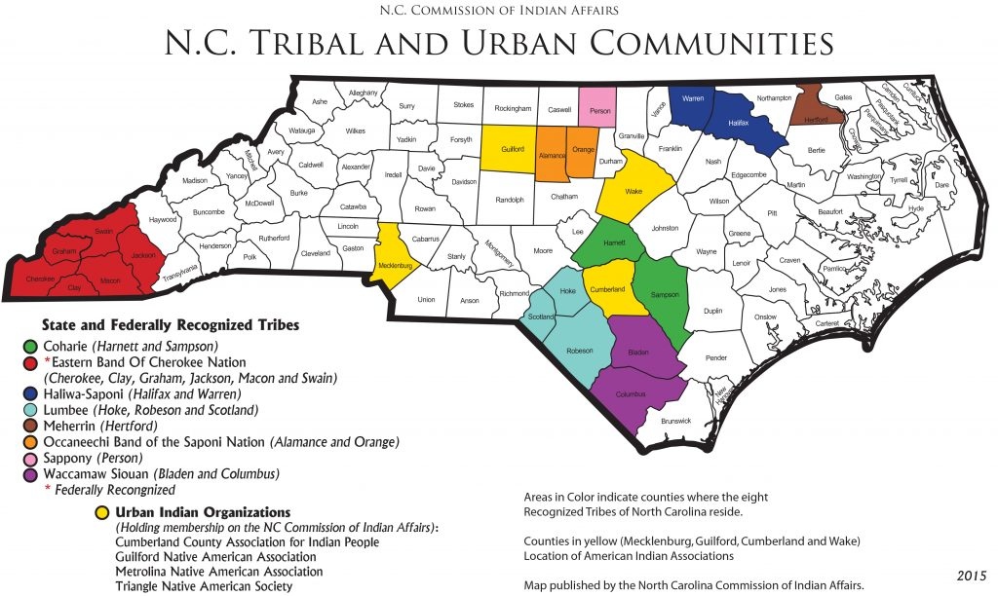
Coharie
https://ncadmin.nc.gov/public/american-indians/map-nc-tribal-communities
Notes:
There are currently eight state-recognized American Indian tribes in North Carolina: Coharie Tribe, Eastern Band of Cherokee Indians, Haliwa-Saponi Tribe, Lumbee Tribe of North Carolina, Meherrin Nation, Occaneechi Band of the Saponi Nation, Sappony, and Waccamaw Siouan. For more information and links to the tribes’ websites, visit Ancient North Carolinians / Indian Heritage / By Modern Tribe (https://ancientnc.web.unc.edu/indian-heritage/by-modern-tribe/). We will begin with the Coharie Tribe.

Slide 15
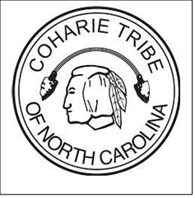
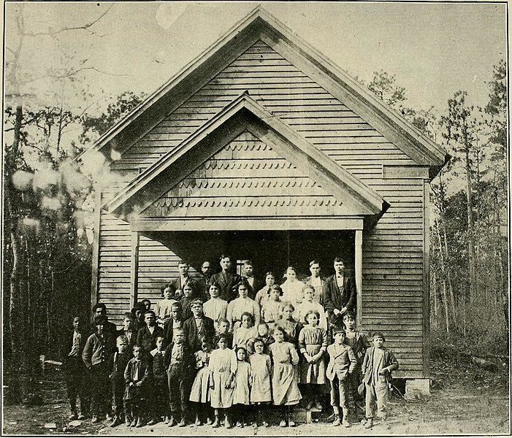
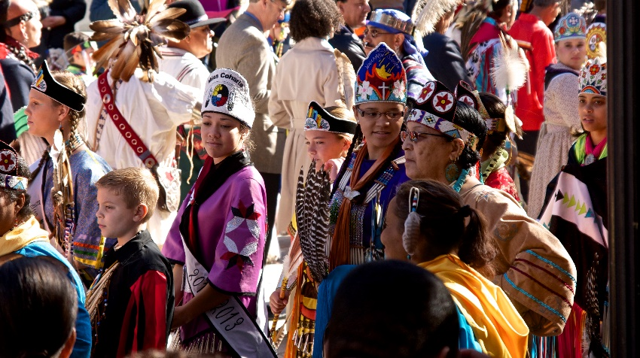
Coharie Tribe
Descended from historic tribe known as the Neusiok, who lived along the lower Neuse River near the coast.
They migrated to the land around the Little Coharie River before 1746 and where they have lived since.
Figure 23.
Figure 24.
Notes:
The Coharie are descended from an historic tribe known as the Neusiok, who lived along the lower Neuse River near the coast.
Historical movements, initiated by intertribal as well as colonial hostilities, caused the Coharie to move to the land around the Little Coharie River before 1746 and where they have lived since.
Upper left image: Coharie Tribe tribal seal
Upper right image: Coharie School, early 1900s
Lower right image: Coharie Pow wow

Slide 16
Eastern Band of Cherokee Indians
https://ncadmin.nc.gov/public/american-indians/map-nc-tribal-communities
Notes:
Next, we will travel west to talk about the Eastern Band of Cherokee Indians.

Slide 17
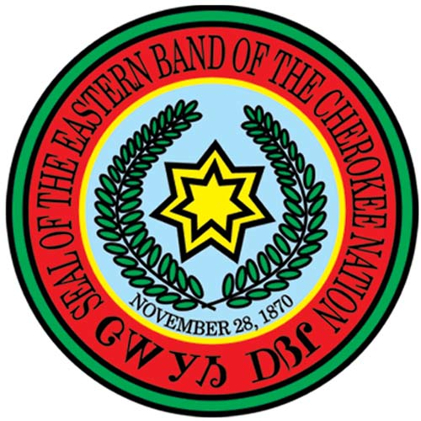
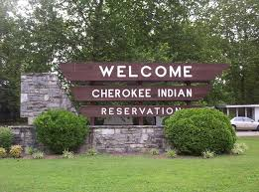
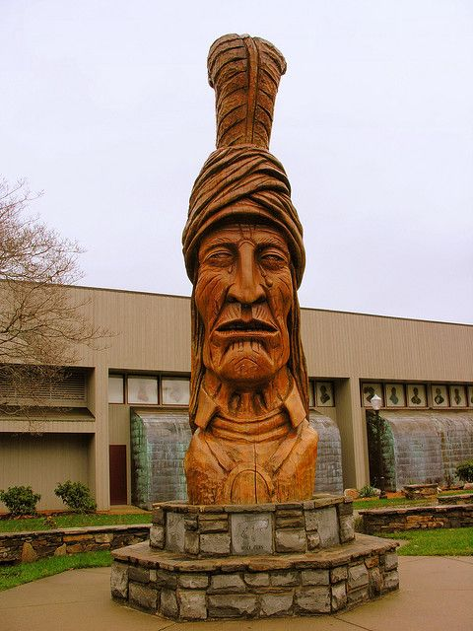
Eastern Band of Cherokee Indians
A sovereign nation and federally recognized tribe.
The Trail of Tears was the forced relocation of Southern American Indians
Some Cherokee maintained land in western North Carolina while others went to Oklahoma.
Figure 25.
Figure 26.
Notes:
The Eastern Band of Cherokee Indians, also known as the EBCI, is a sovereign nation and both state- and federally-recognized. They are currently the only federally-recognized tribe in North Carolina. The Trail of Tears was the forced relocation of southern American Indians; some Cherokee were able to maintain land in western North Carolina, while others went to Oklahoma.
Upper left image: ECBI tribal seal
Upper center image: Sign marking the ECBI reservation entrance, also know as the Qualla Boundary
Right image: Carving at the Museum of the Cherokee Indian

Slide 18
Haliwa Saponi
https://ncadmin.nc.gov/public/american-indians/map-nc-tribal-communities
Notes:
Next, we journey to Warren and Halifax counties, the home of the Haliwa Saponi tribe.

Slide 19
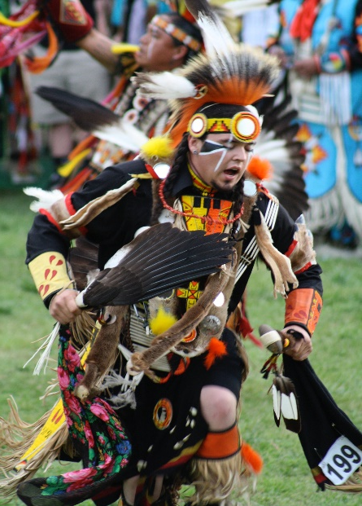
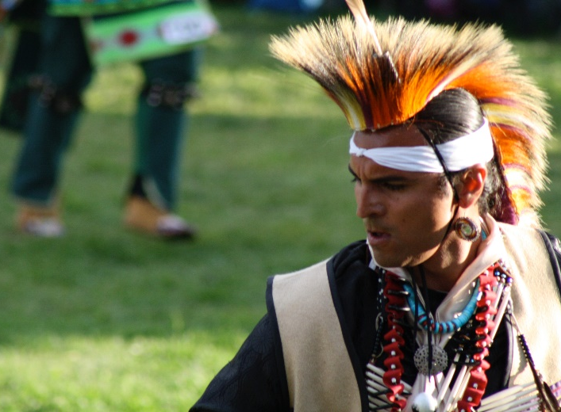
Haliwa Saponi Tribe
Descendants of the Saponi, Tuscarora, Tutelo, and Nansemond Indians.
Haliwa comes from the two counties, Halifax and Warren, in which the majority of the tribe lives.
Figure 27.
Saponi means “Red earth people.”
The only non-reservation, tribally-supported Indian school in the state.
Figure 28.
Notes:
The Haliwa Saponi tribe are descendants of the Saponi, Tuscarora, Tutelo, and Nansemond Indians. The word Haliwa comes from the two counties Halifax and Warren in which the majority of the population of the tribe lives. Saponi means “Red earth people.” The Haliwa Saponi has the only non-reservation tribally supported Indian school in the state. The tribe is culturally active and proud of its many dancers, singers and artists.
Upper left image: The Haliwa Saponi tribal seal
Upper right image: Traditional dancing at the annual pow wow
Lower right image: Traditional dancing at the annual pow wow

Slide 20
Lumbee
https://ncadmin.nc.gov/public/american-indians/map-nc-tribal-communities
Notes:
The next tribe is the Lumbee of Robeson, Scotland, and Hoke counties.

Slide 21
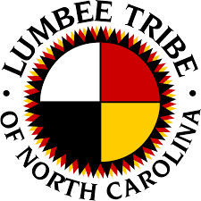
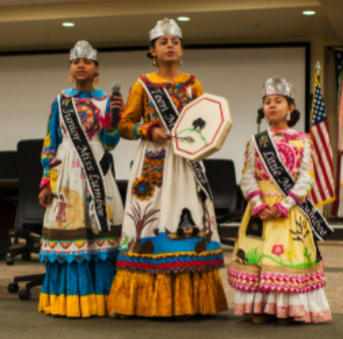
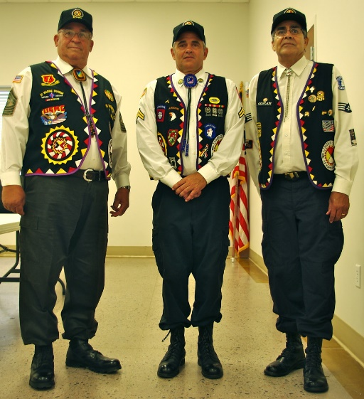
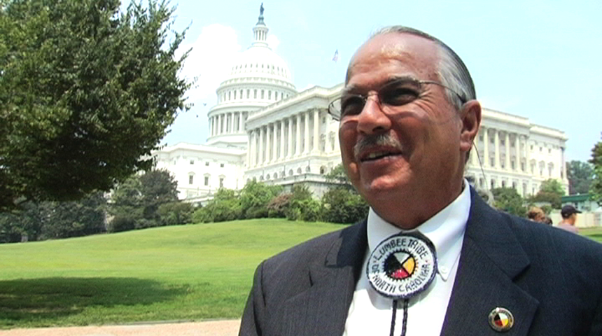
Lumbee Tribe
of North Carolina
Largest tribe in North Carolina; Descendants of the Cheraw and other Siouan-speaking Indians.
Name originates from the Lumbee River. The river is an important historical, cultural and spiritual symbol for many tribal members.
Figure 31.
Figure 29.
Figure 30.
Notes:
The Lumbee are the largest tribe in North Carolina. They are the descendants of an American Indian group called the Cheraw and other Siouan-speaking groups. The tribe's name originates from the Lumbee River which remains a revered symbol among tribal members.
Upper left image: Lumbee tribal seal
Upper right image: Tribal youths performing traditional music at an event for US service men
Middle image: Lumbee veterans
Lower right image: Tribal chairman Jimmy Goins

Slide 22
Meherrin
https://ncadmin.nc.gov/public/american-indians/map-nc-tribal-communities
Notes:
Next, we will talk about the Meherrin Nation of Hertford County.

Slide 23
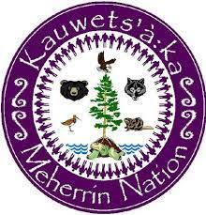
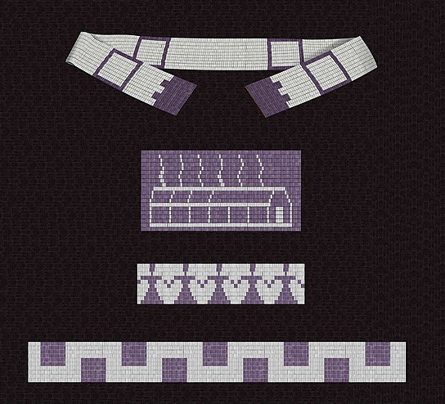
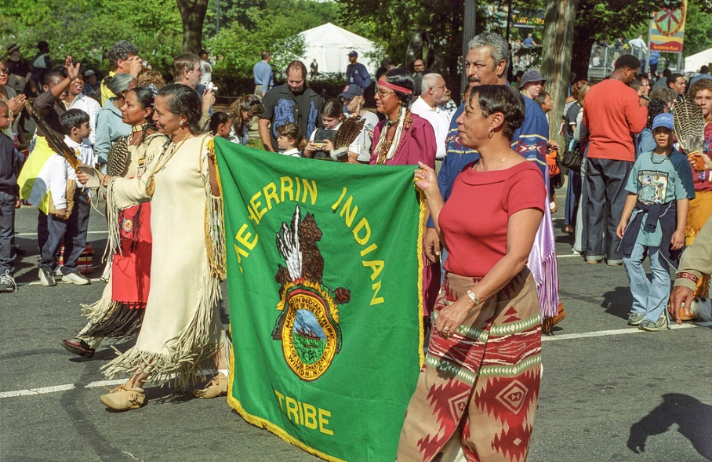
Figure 32.
Meherrin Nation
They refer to themselves as Kauwets’a:ka or People of the Water.
An Iroquois Nation and share allegiance, culture, traditions, and language with the Tuscarora, Nottoway, and Cherokee.
Practice many of the traditions of their ancestors including farming, hunting, and fishing.
Figure 33.
Notes:
The Meherrin Nation refer to themselves as Kauwets’a:ka or People of the Water. They are an Iroquois Nation and share allegiance, culture, traditions and language with the Tuscarora, Nottoway, and Cherokee. Tribal members continue to practice many of the traditions of their ancestors including farming, hunting and fishing. Wampum beads (figure 32) and the color purple remain important among the Meherrin.
Upper left image: Meherrin Nation tribal seal
Upper image: Wampum bead treaty belts
Lower image: Tribal members with a Meherrin flag.

Slide 24
Occaneechi
https://ncadmin.nc.gov/public/american-indians/map-nc-tribal-communities
Notes:
Next, we will discuss the Occaneechi Band of the Saponi Nation located in Orange and Alamance counties.

Slide 25
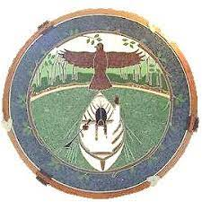
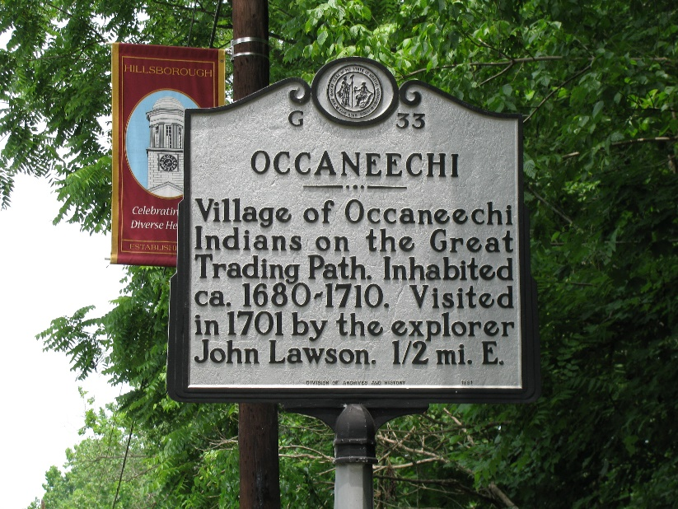
Occaneechi Band of the Saponi Nation
Descendants of several small Siouan-speaking tribes.
Reside in Alamance and Orange Counties where their ancestors once lived as craftsman and farmers
Figure 34.
Notes:
The Occaneechi Band of the Saponi are descendants of several Siouan-speaking tribes. They reside predominately in Alamance and Orange Counties where their ancestors once resided as hunter-gathers, craftsman, and farmers.
Upper left image: Occaneechi Band of the Saponi tribal seal
Lower right image: State historical marker of the Occaneechi village in Hillsborough, NC

Slide 26
Sappony
https://ncadmin.nc.gov/public/american-indians/map-nc-tribal-communities
Notes:
Next, the Sappony of Person County.

Slide 27
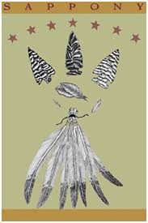
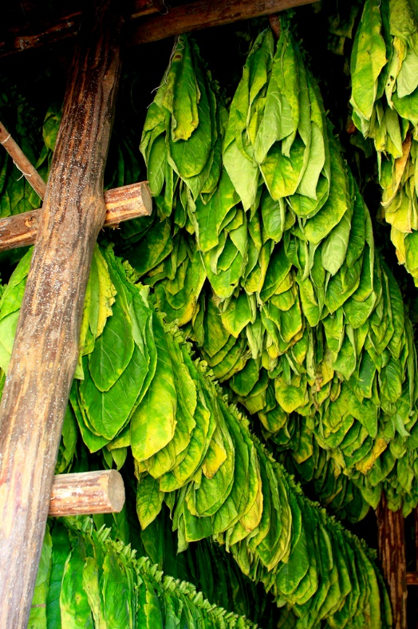
Sappony
Lived in the Piedmont Highlands of Person County for countless generations.
Still carry their traditional way of governing; an elected representative from each of the seven families that live in the High Plains settlement form a council.
Lives changed as times changed — from hunters and farmers to trading partners with the English to farmers and a contemporary Indian people.
Figure 35.
Above: Tobacco remains an important crop to the Sappony
Notes:
The Sappony tribe has lived predominantly in the Piedmont Highlands of Person County for countless generations. The Tribe still carries on their traditional way of governing, with elected representatives from each of the seven families that make up the High Plains settlement forming a council. Sappony history is the history of a people whose lives changed with the changing of times – from hunters and farmers of pre-contact days to trading partners with the English, and from rural American farmers to a contemporary Indian people.
Upper left image: Sappony tribal seal
Lower right image: Tobacco grown by the tribe

Slide 28
Waccamaw Siouan
https://ncadmin.nc.gov/public/american-indians/map-nc-tribal-communities
Notes:
Finally, there is the Waccamaw Siouan tribe of Bladen and Columbus counties.

Slide 29
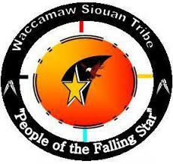
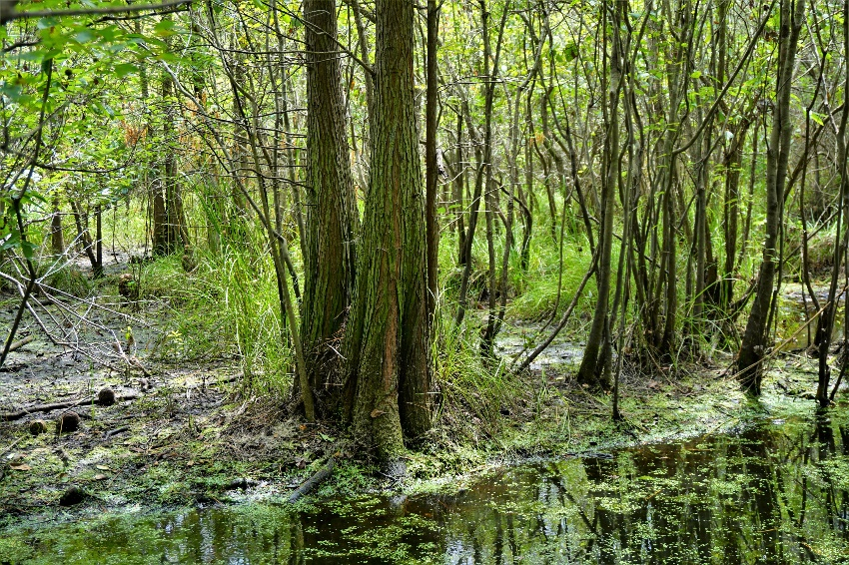
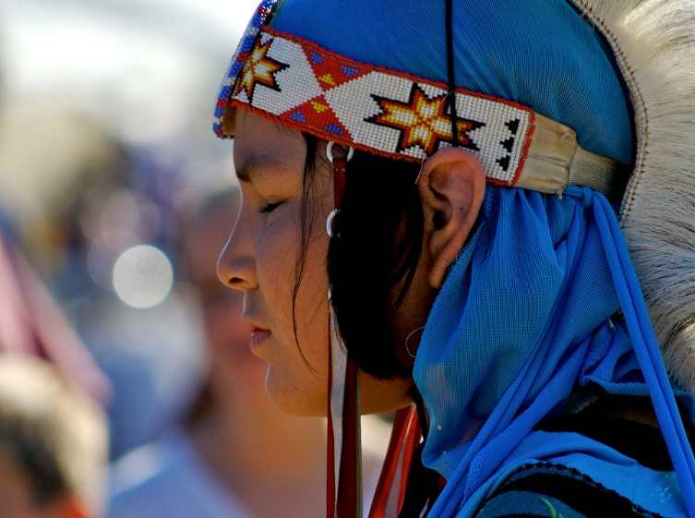
Waccamaw Siouan
Known as “the people of the falling star."
After wars and relocation, sought refuge in swamplands in southeastern North Carolina
Figure 36.
Figure 37.
Notes:
The Waccamaw Siouan Indian tribe are known as “the people of the falling star". After wars and relocation, they sought refuge in swamplands located in southeastern North Carolina. The swamplands remain important to the tribe.
Upper left image: Waccamaw Siouan tribal seal
Lower left image: An image of the swamplands
Upper right image: Waccamaw Siouan youth in regalia at a tribal pow wow

Slide 30
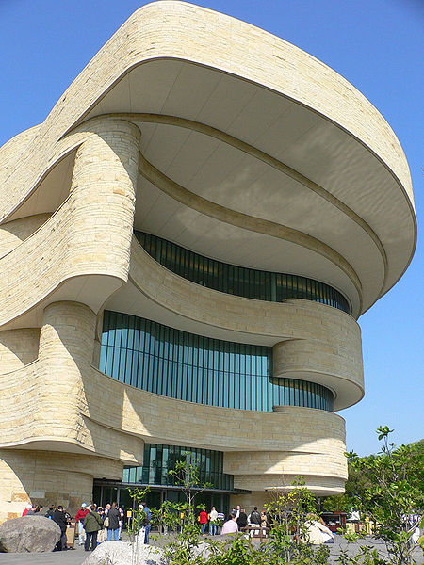
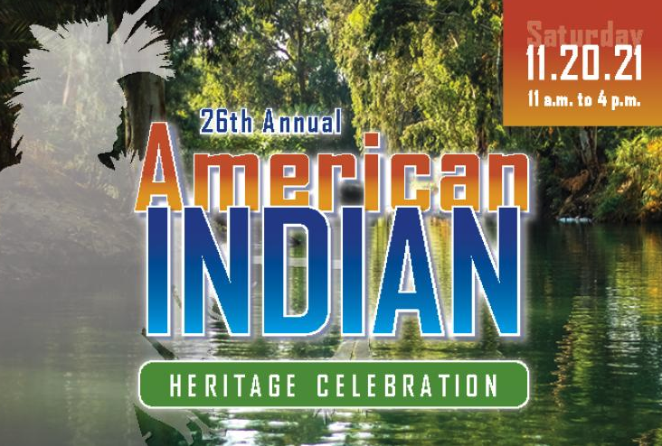
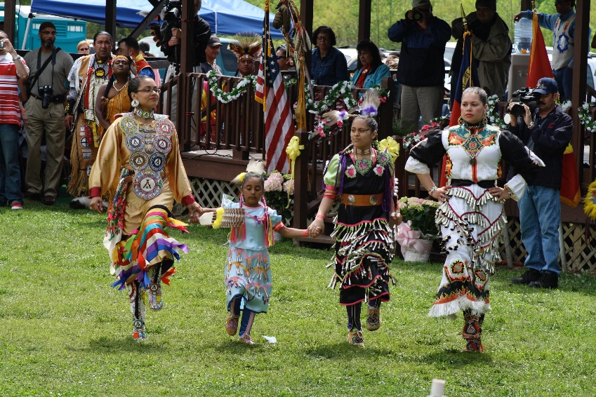
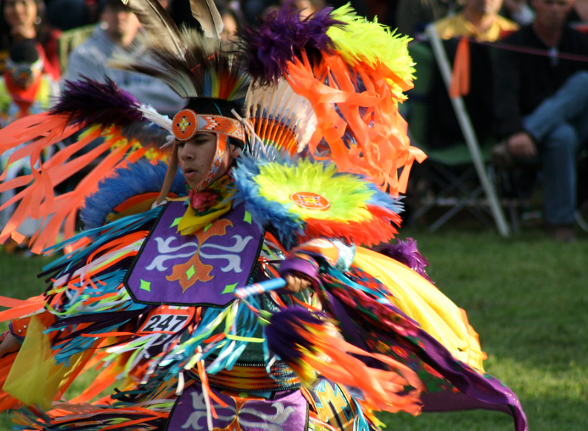
Where to go to learn more?
Figure 40.
Figure 39.
Figure 38.
Figure 41.
Notes:
For more information about contemporary American Indians, you might attend local pow wows (https://calendar.powwows.com/) or heritage celebrations hosted by museums. Check out additional resources on the North Carolina Commission of Indian Affairs website (https://ncadmin.nc.gov/about-doa/divisions/commission-of-indian-affairs).

Slide 31
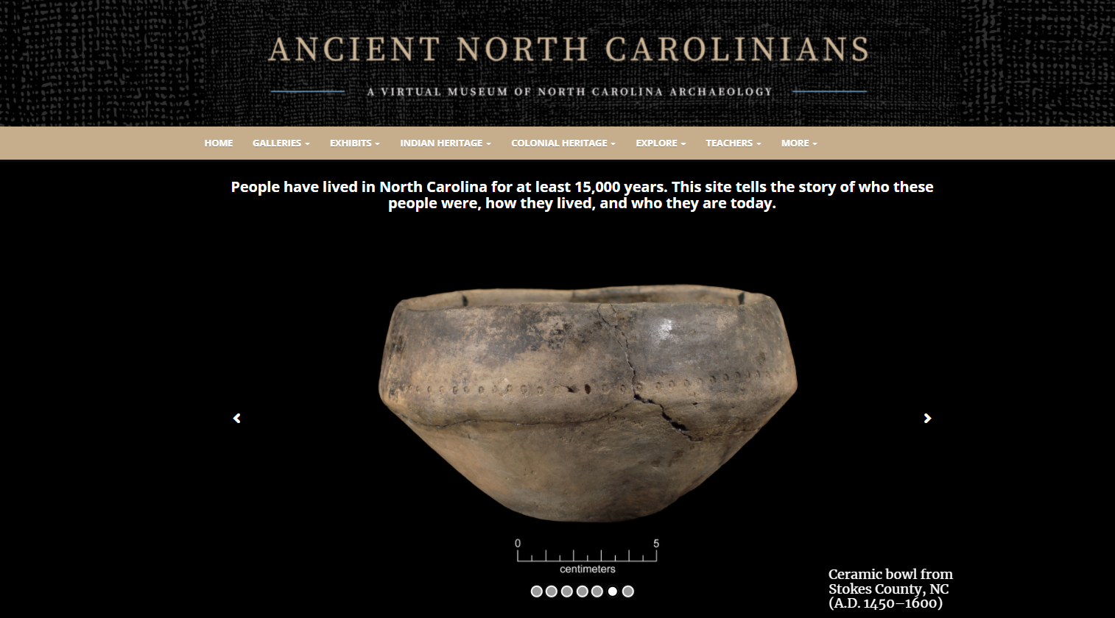
Figure 42.
https://ancientnc.web.unc.edu
Notes:
Students can learn about North Carolina’s Indigenous cultures through the Ancient North Carolinians: A Virtual Museum of North Carolina Archaeology website (https://ancientnc.web.unc.edu/). This website, developed by UNC’s Research Laboratories of Archaeology, tells the story of the people who lived in North Carolina from 15,000 years ago to the early eighteenth century—the ancestors of today’s American Indians. Educators and students can discover archaeology in their part of the state, learn about American Indian and Colonial heritage, explore driving trails of archaeological and historical sites, and much more. Galleries feature videos on a variety of topics and 3D models of ancient objects, from stone spearheads and knives, to ceramic pots, to animal bone tools and ornaments. This virtual museum is a valuable resource for educators.

Slide 32
Image Credits
Figure 1: "Dream Catcher" by AyelVee is licensed under CC BY-NC 2.0.
Figure 2: https://commons.wikimedia.org/wiki/File:Three_Sisters_4.jpg by Garlan Miles. This file is licensed under the Creative Commons Attribution-Share Alike 4.0 International license.
Figure 3: https://commons.wikimedia.org/wiki/File:The_First_Thanksgiving_Jean_Louis_Gerome_Ferris.png by Jean Leon Gerome Ferris. This work is in the public domain in its country of origin and other countries and areas where the copyright term is the author's life plus 70 years or fewer. Figure 4: https://pixabay.com/photos/first-nation-headdress-feather-908604/. This image is listed as CCO Public Domain and is free for commercial use. Terms: https://pixabay.com/en/service/terms/#usage
Figure 5: https://pixabay.com/photos/indian-basket-american-2824520/. This image is listed as CCO Public Domain and is free for commercial use. Terms: https://pixabay.com/en/service/terms/#usage.
Figure 6: “Protest against Washington football team name” by Fibonacci Blue is marked by CC BY 2.0.
Figure 7: “March to the stadium to protest against the Washington football team name” by Fibonacci Blue is marked by CC BY 2.0.
https://ancientnc.web.unc.edu

Slide 33
Image Credits
Figure 8: https://commons.wikimedia.org/wiki/File:Tommy_Orange_2018.jpg by Larry D. Moore. This file is licensed under the Creative Commons Attribution-Share Alike 4.0 International license.
Figure 9: https://commons.wikimedia.org/wiki/File:20190606SM155-Edit_(48092158562).jpg by Library of Congress Life. This file is made available under the Creative Commons CC0 1.0 Universal Public Domain Dedication.
Figure 10: “Museum London- Kent Monkman” by Appaloosa is licensed by CC BY-NC-ND 2.0.
Figure 11: https://commons.wikimedia.org/wiki/File:Zahn_McClarnon_2016.png by thepaparazzigamer. This file is licensed under the Creative Commons Attribution 3.0 Unported license.
Figure 12: https://commons.wikimedia.org/wiki/File:Jim_Pepper_-_Portrait_by_Gert_Chesi.jpg by Gert Chesi. This file is licensed under the Creative Commons Attribution-Share Alike 4.0 International license.
Figure 13: https://commons.wikimedia.org/wiki/File:Amber_Midthunder_-_2019_(46801505974)_(cropped).jpg by Gage Skidmore. This file is licensed under the Creative Commons Attribution-Share Alike 2.0 Generic license.

Slide 34
Image Credits
Figure 14: "Braiding Sweetgrass: Indigenous Wisdom, Scientific Knowledge, and the Teachings of Plants" by Vernon Barford School Library is licensed under CC BY-NC-ND 2.0.
Figure 15: https://commons.wikimedia.org/wiki/File:BegayFred.jpg by LeRoy N. Sanchez, Los Alamos National Laboratory. This work is in the public domain in the United States because it is a work prepared by an officer or employee of the United States Government as part of that person’s official duties under the terms of Title 17, Chapter 1, Section 105 of the US Code.
Figure 16: https://commons.wikimedia.org/wiki/File:Herrington.jpg by NASA. This file is in the public domain in the United States because it was solely created by NASA.
Figure 17: https://commons.wikimedia.org/wiki/File:Sharice_Davids.jpg by Kristie Boyd, U.S. House Office of Photography. This work is in the public domain in the United States because it is a work prepared by an officer or employee of the United States Government as part of that person’s official duties under the terms of Title 17, Chapter 1, Section 105 of the US Code.

Slide 35
Image Credits
Figure 18: https://commons.wikimedia.org/wiki/File:Cherokee_Nation_Vice_President_of_Government_Relations_Kimberly_Teehee,_commenting_on_her_nomination_as_a_delegate_to_the_U.S._Congress,_Tahlequah,_Oklahoma,_Aug._22,_2019.jpg by Voice of America. This work is in the public domain in the United States because it is a work prepared by an officer or employee of the United States Government as part of that person’s official duties under the terms of Title 17, Chapter 1, Section 105 of the US Code.
Figure 19: https://commons.wikimedia.org/wiki/File:Deb_Haaland,_official_portrait,_116th_Congress.jpg by Franmarie Metzler. This United States Congress image is in the public domain.
Figure 20: https://commons.wikimedia.org/wiki/File:Indigenous_Americans_by_state.svg by Abbasi786786. This file is licensed under the Creative Commons Attribution-Share Alike 4.0 International license.
Figure 21: https://commons.wikimedia.org/wiki/File:Cherokee_Indian_Reservation_sign,_NC.jpg by Sogospelman. This work has been released into the public domain by its author, Sogospelman at English Wikipedia.

Slide 36
Image Credits
Figure 22: https://mapsmith.net/work/a-modern-map-of-native-american-lands/. Author provided free download to any and all and “hassle-free”.
Figure 23: https://commons.wikimedia.org/wiki/File:The_Croatan_Indians_of_Sampson_County,_North_Carolina_-_their_origin_and_racial_status_-_a_plea_for_separate_schools_(1916)_(14776338124).jpg. This image was originally posted to Flickr by Internet Archive Book Images. at https://flickr.com/photos/126377022@N07/14776338124. It was reviewed on 11 October 2015 by FlickreviewR and was confirmed to be licensed under the terms of the No known copyright restrictions.
Figure 24: "Miss Coharie" by Arne Handt is marked with CC BY-NC-SA 2.0
Figure 25: https://commons.wikimedia.org/wiki/File:Cherokee_Indian_Reservation_sign,_NC.jpg by Sogospelman. This work has been released into the public domain by its author, Sogospelman at English Wikipedia.
Figure 26: “Carving at The Museum of the Cherokee Indian” by Judy Baxter is licensed under CC BY-NC-SA 2.0.

Slide 37
Image Credits
Figure 27: “IMG_7741” by Allison Fender is licensed under CC BY-ND 2.0.
Figure 28: “IMG_7633” by Allison Fender is licensed under CC BY-ND 2.0.
Figure 29: "Lumbee Nation Comrades" by North Carolina National Guard is marked with CC BY-ND 2.0.
Figure 30: “Tribal Chairman Jimmy Goins” by Rhett and Link is licensed under CC BY-ND 2.0.
Figure 31: https://nara.getarchive.net/media/kyla-leigh-ann-jarrett-left-kaitlyn-marie-deal-center-4b8608. U.S. Army photo by Timothy L. Hale/Released. Public Domain Dedication. Public Use Notice of Limitations: https://www.dvidshub.net/about/copyright
Figure 32: https://commons.wikimedia.org/wiki/File:Wuampu.jpg by Museuvalenciaetnologia. This file is licensed under the Creative Commons Attribution-Share Alike 4.0 International license.
Figure 33: "Native Nations Procession, Washington, D.C." by taoboy49 is licensed under CC BY-NC-SA 2.0.
Figure 34: ”Occaneechi” by The Alliance for Historic Hillsborough is licensed under CC BY 2.0.
Figure 35: "Drying tobacco leaves" by jzielcke is licensed under CC BY-NC-ND 2.0.
Figure 36: “Scene Columbus County Game Land ncwetlands KG” by NC Wetlands is licensed under CC0 1.0 Universal (CC0 1.0) Public Domain Dedication.

Slide 38
Image Credits
Figure 37: "MG_5361.jpg" by The Life of Bryan is licensed under CC BY-NC 2.0.
Figure 38: “IMG_7250” by Allison Fender is licensed under CC BY-ND 2.0.
Figure 39: North Carolina Museum of History, Press Release.
Figure 40: https://commons.wikimedia.org/wiki/File:National_Museum_of_the_American_Indian.jpg by Raulbot. This file is licensed under the Creative Commons Attribution-Share Alike 3.0 Unported license.
Figure 41: “IMG_7653” by Allison Fender is licensed under CC BY-ND 2.0.
Figure 42: Research Laboratories of Archaeology, University of North Carolina

