Slide 1
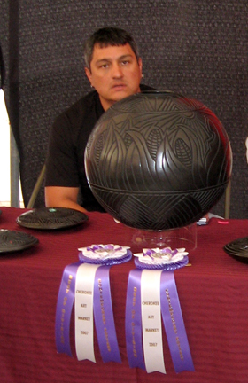
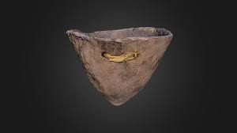
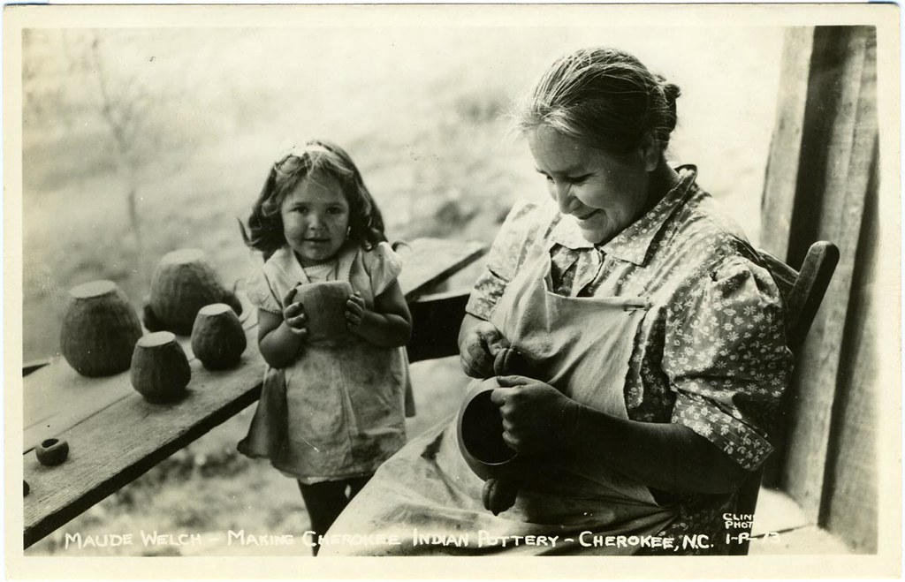
American Indian Pottery of NC: Past & Present
Image 1 courtesy of the Research Laboratories of Archaeology at UNC, Image 2 source: Maude Welch – Making Cherokee Indian Pottery – Cherokee, NC by unclibraries_commons is marked with a CC PDM 1.0 https://www.flickr.com/photos/122654055@N06/23072990806 Image 3 source: https://commons.wikimedia.org/wiki/File:Joel_queen_e_band_cwy.jpg Image in the public domain.

Slide 2
What do you know about American Indians in North Carolina or elsewhere in North America?
Notes:
Ask students: Where have you learned about American Indians?

Slide 3
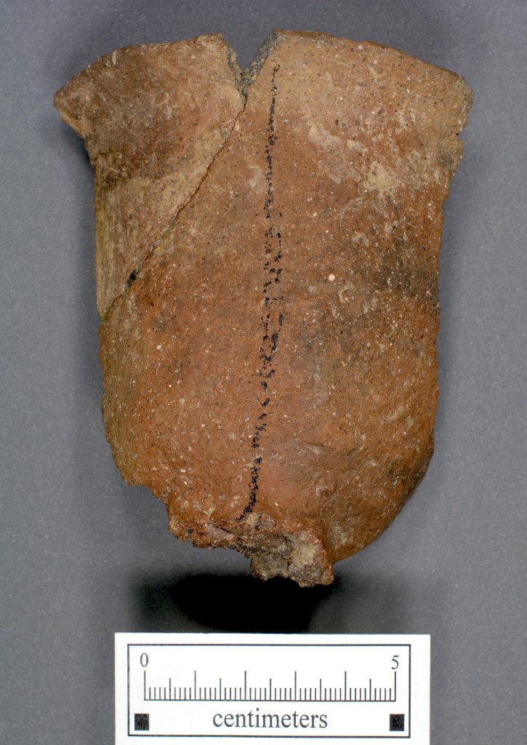
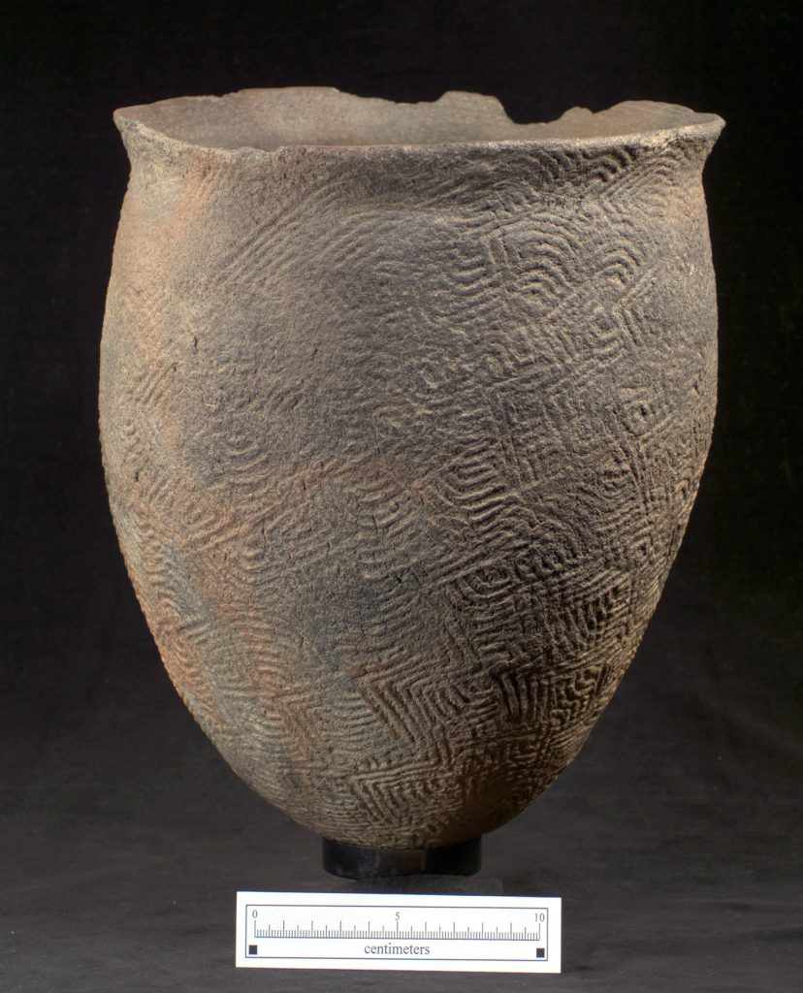
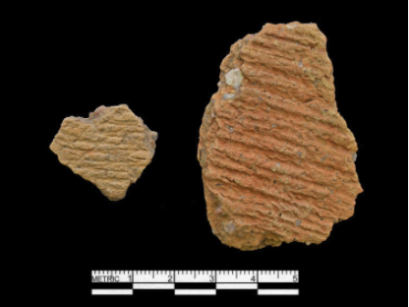
One of the most common artifacts found by archaeologist is pottery!
Images courtesy of the Research Laboratories of Archaeology at UNC
Notes:
These fragments are called sherds!
Wall Site, AD 1400-1600
Cord marked sherds from Southside, VA dating 600-1200 AD

Slide 4
Because of its chemical and physical properties clay doesn’t decompose like other organic materials.
Notes:
Why?
Preservation/sturdiness
Abundance of uses (next slide)

Slide 5
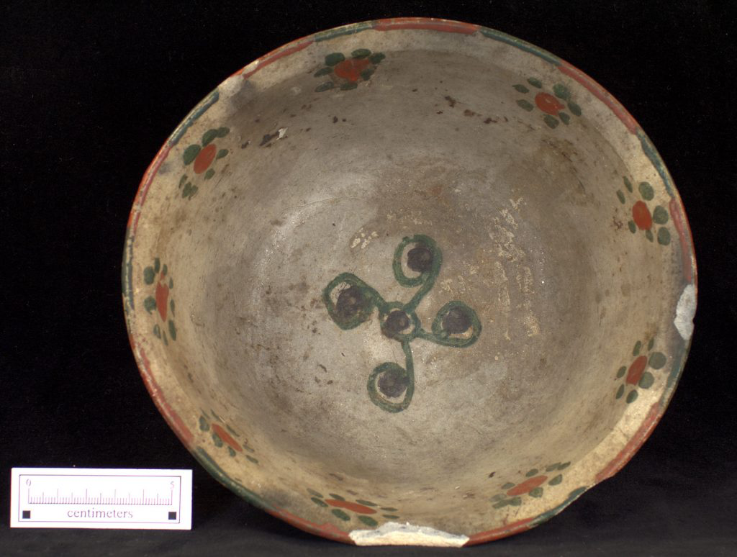
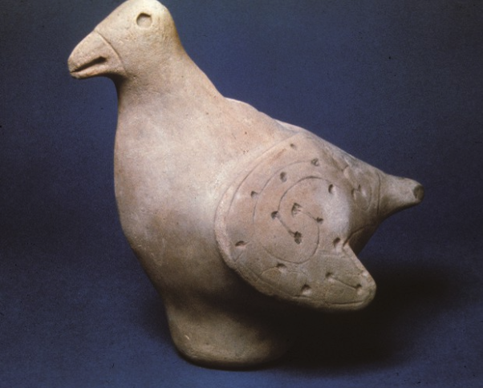
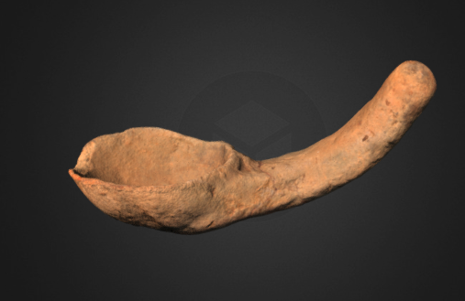
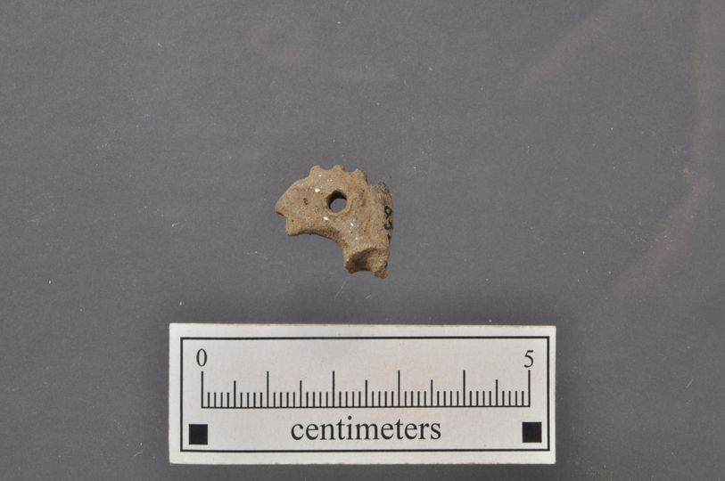
American Indians used clay to create lots of different types of ceramics. Jars, jugs, bowls, animals, pipes, and more!
Images courtesy of the Research Laboratories of Archaeology at UNC
Notes:
Sometimes archaeologists find complete vessels and other times fragments.
Europeans/ Euro-Americans did this too before the invention of plastic. Although they did have more material options like glass and iron, but those materials could be expensive, delicate, or heavy.

Slide 6
Archaeologists can look at the different broken parts of a ceramic vessel and tell where different pieces are from.
Notes:
If they have enough pieces, they can put it back together!

Slide 7
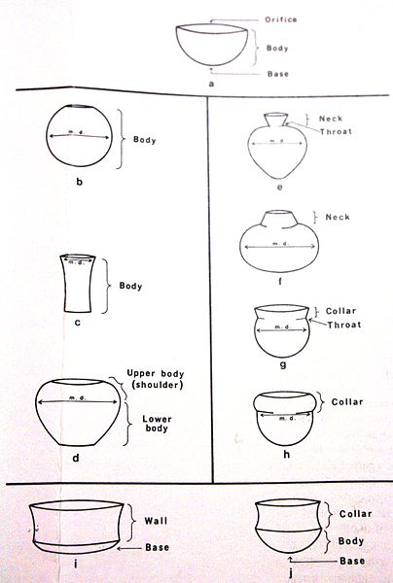
Image source: https://commons.wikimedia.org/wiki/File:Anatomy_of_a_Vessel.jpg Photoluvr 2011 creative commons 3.0

Slide 8
Which part of a pot are these sherds from?
The lip or rim!
Image courtesy of the Research Laboratories of Archaeology at UNC
Notes:
Lip/rim pieces

Slide 9
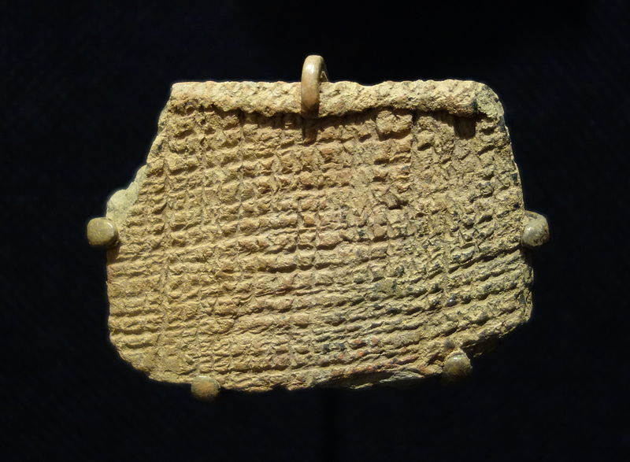
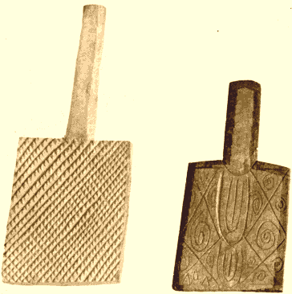
Archaeologists are also interested in the designs found on pottery
Cord-marked pottery
Cherokee paddle stamps for pottery
Image 1 source: https://commons.wikimedia.org/wiki/File:Cord_marked_pottery_sherd,_St._Catherine%27s_Period,_AD_800-1300_- _Fernbank_Museum_of_Natural_History_-_DSC00183.JPG Daderot, CC0, via Wikimedia Commons
Image 2 source: https://commons.wikimedia.org/wiki/File:Cherokeestampingpaddles.png Image is in the public domain.

Slide 10
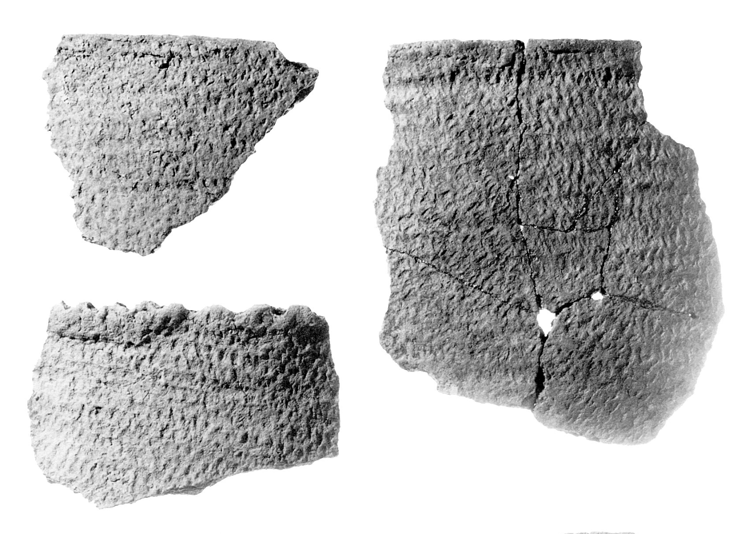
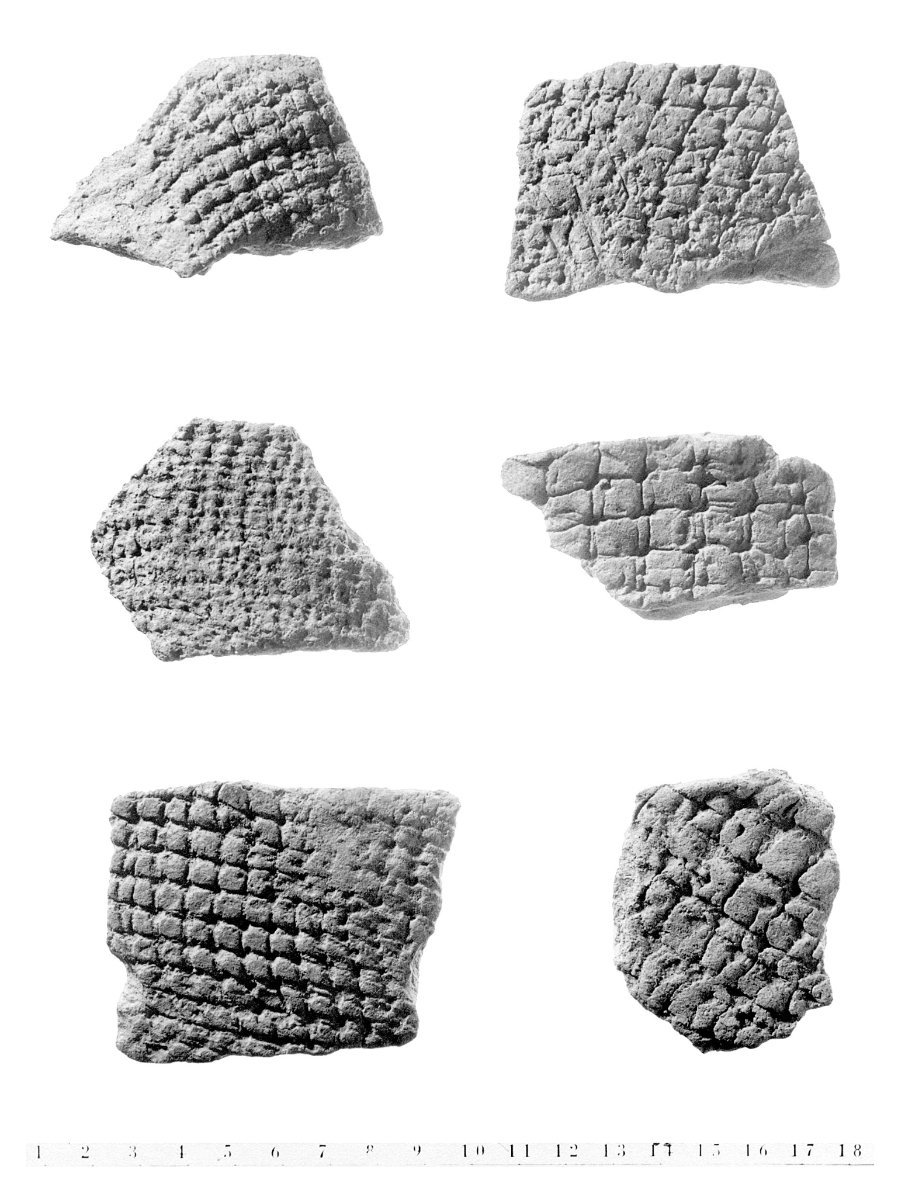
Some pottery has decorations created from impressing objects or stamping designs into the wet clay
Fabric Impressed pottery fragments
Net impressed pottery fragments
Gaston Simple Stamped pottery fragments
Image courtesy of the Research Laboratories of Archaeology at UNC
Notes:
American Indians used paddles, corn cobs, nets, rope, fabric, sticks, and other materials to add texture to their ceramics.

Slide 11
Today, many American Indians continue to create items in the same ways and styles as their ancestors.

Slide 12
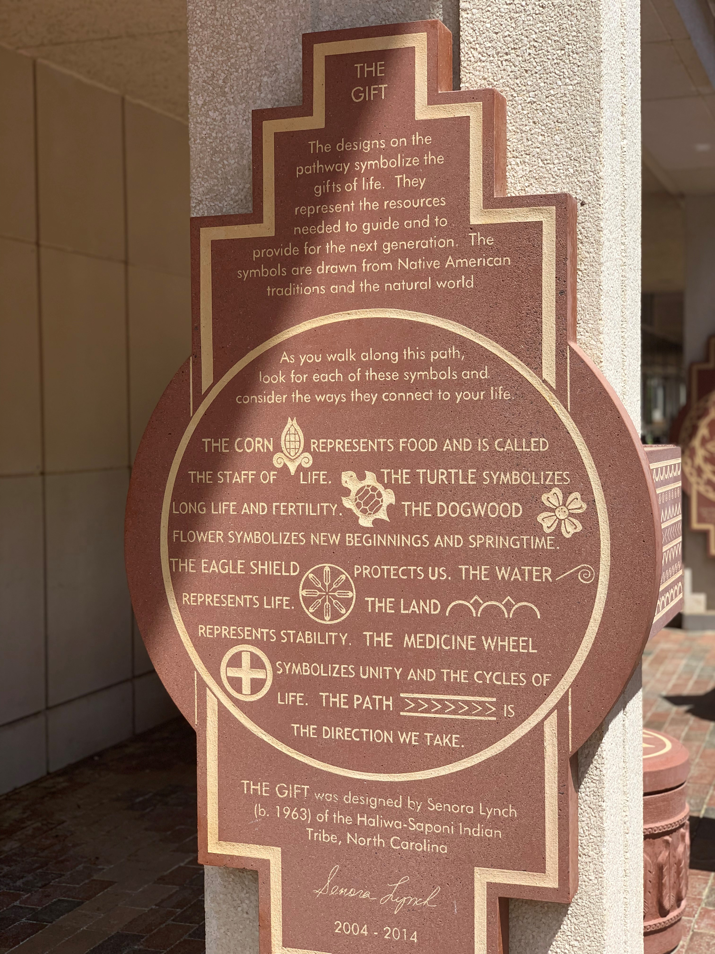
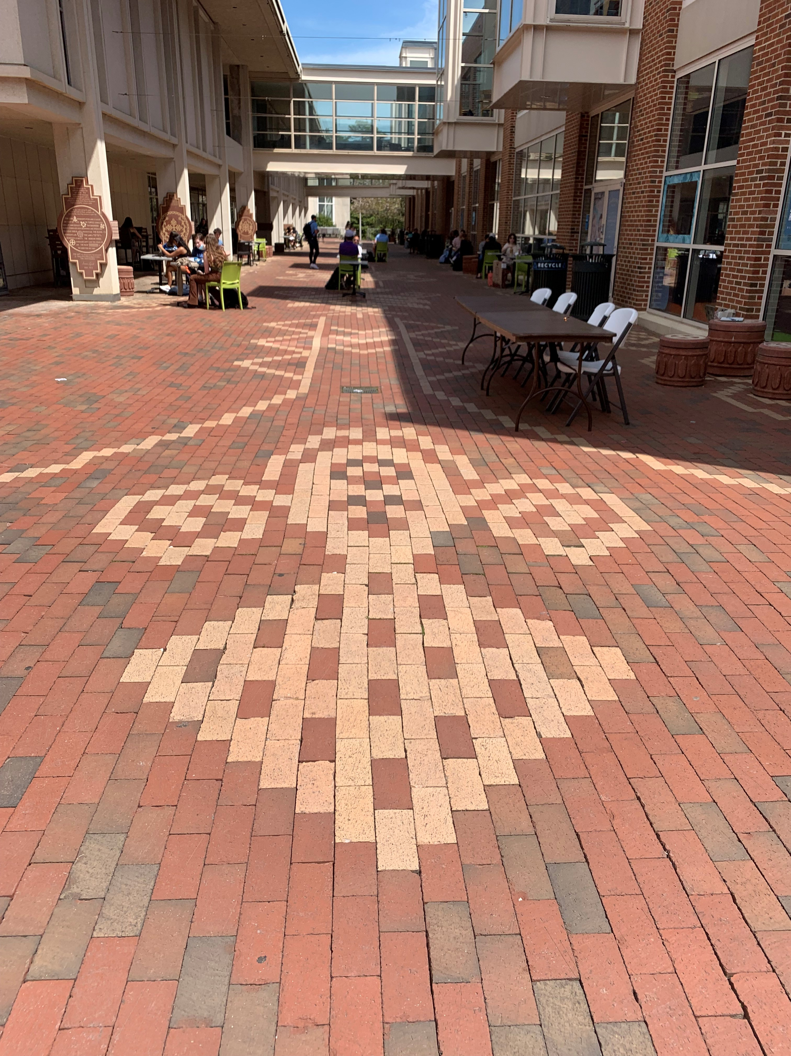
Senora Lynch is a member of the Haliwa-Saponi tribe and an award-winning potter. Lynch is also skilled at weaving, leatherwork, and beadwork. Lynch learned these crafts from her family and tribal elders.
Image source: permission granted by the photographer
Notes:
https://youtu.be/MYUiYM78_kY
Lynch’s art incorporates many animals and symbols from Haliwa-Saponi folklore and oral history

Slide 13
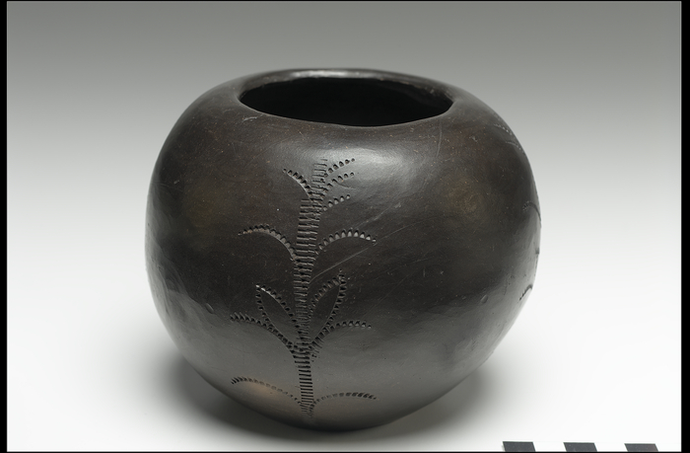
Herman Oxendine is a member of the Lumbee tribe in Robeson County who also continues the traditions of his ancestors. He is a potter, painter and pine needle basket maker.
Handmade coiled and stamped pot by Herman Oxendine, the National Museum of the American Indian
Image Source: https://americanindian.si.edu/collections-search/objects/NMAI_280811 Jar, by Herman I. Oxendine, Lumbee National Museum of the American Indian
Notes:
Herman Oxendine, gets his clay from the banks of the Lumbee river, then shapes his pottery and fires in in a pit. He leaves the pottery its natural color. He also weaves pine needle baskets and paints gourds.

Slide 14
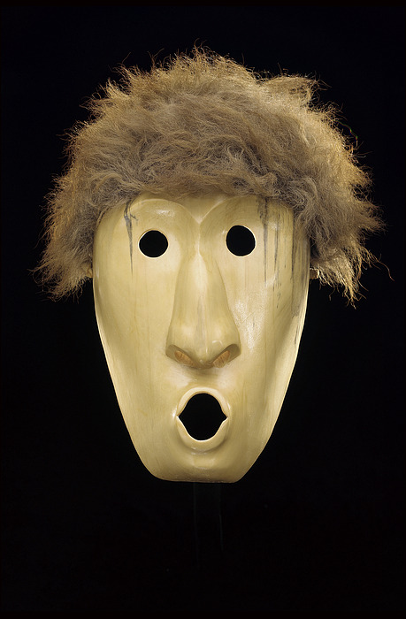
Davy Arch is a Cherokee storyteller, historian, and folk artist. He learned the value of traditional Cherokee culture and crafts from his grandfather and other elders. Arch is also skilled at woodcarving and mask-making.
Mask made of buckeye wood and horsehair and leather, Davy Arch, 1985
.
Image source: https://www.si.edu/object/mask%3ANMAI_271086 Mask by Davy Arch, National Museum of the American Indian
Notes:
Davy Arch is an avid local historian in the Cherokee community. He and other scholars in the community theorized and experimented with reproducing the ancient Cherokee coil pots. They realized that the native Cherokees made the pots very thin and textured the outsides so that the pots could expand and contract in the cooking fires without fear of cracking. Patterns related directly to the culture and had symbolic significance in the religion.

Slide 15
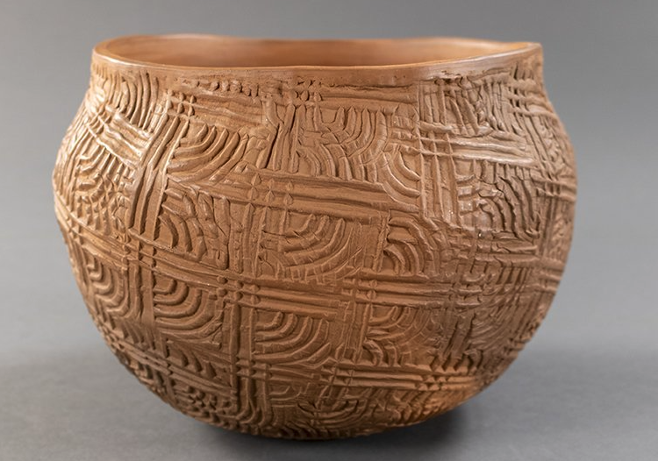
Bernadine George was a Cherokee potter, with a specialty in paddle-stamped designs. Bernadine George (1944-2016) learned to make pots from her mother and sister-in-law.
“Complicated Stamped Pot”, Bernadine George, 2003
Image source: Courtesy McClung Museum of Natural History & Culture, The University of Tennessee, Knoxville, [2019.15]” mcclungmuseum.utk.edu.”
Notes:
While some Cherokee potters use stamped designs that are directly from their ancestors, others like Bernadine George have used the stamped techniques to express their own creative vision.

Slide 16
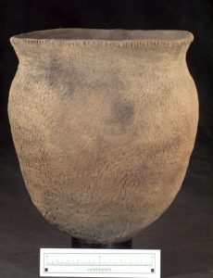
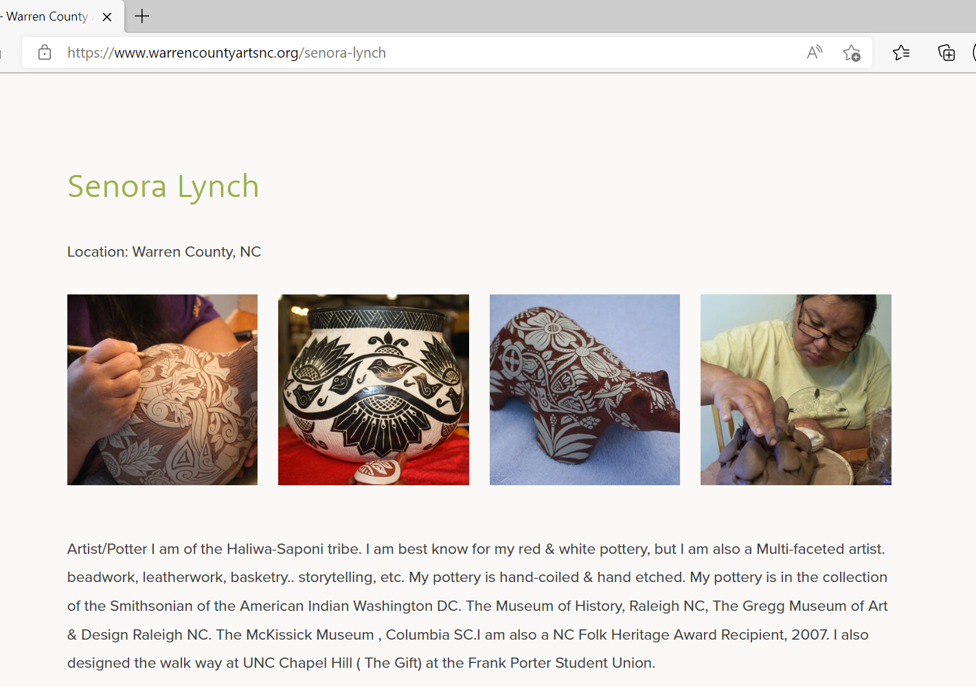
Compare and Contrast
Click here to view pottery by Senora Lynch: https://www.warrencountyartsnc.org/senora-lynch
Hillsboro Corncob Impressed Jar from the Wall site in Orange County, NC
Image 1 source: UNC Research Laboratories of Archaeology https://ancientnc.web.unc.edu/a_d_2115_central-piedmont-orange/

Slide 17
References:
Ancient North Carolinians. (nd). https://ancientnc.web.unc.edu/
Peterson, S. (2009). Contemporary Pottery from North Carolina’s American Indian Communities. https://goosepenpress.com/uploads/files/Contemporary_Pottery_from_North_Carolina's_American_Indian_Communities_sample_pages.pdf
NCMOH AIHC. (2020). Senora Lynch, Artist, Potter. (Video). Youtube. https://youtu.be/MYUiYM78_kY
Lynch, S. (2003). Woodland People. (Pottery). Lake Gaston Gazette-Observer. https://www.lakegastongazette-observer.com/news/art
icle_8ebd36be-771b-11e9-8a54-23e46b9d4539.html
Hanna, J. (2014). Washington Redskins Trademark Registration Cancelled. (digital image). https://www.lawinsport.com/blogs/sports-law-insider/item/washington-redskins-trademark-registration-cancelled
Peteandco. (nd). Pocahontas. (digital image). https://www.fanpop.com/clubs/pocahontas/images/12924522/title/pocahontas-photo
Nzeemin. (2012). Relief map of Alaska, USA. (png. graphic).
https://en.wikipedia.org/wiki/Module:Location_map/data/USA_Alaska/doc
North America Physical Map. (nd). https://www.geographicguide.com/maps-america.htm
Smith, T. (2017). Pembroke Artists Keep Traditions Alive. (photograph). https://www.robesonian.com/features/96586/pembroke-artists-keep-traditions-alive
Pellicer, L. (2017). A Life Dedicated to Keeping Cherokee Culture, Meet Davy Arch. (photograph). https://www.wunc.org/arts-culture/2017-10-02/a-life-dedicated-to-keeping-cherokee-culture-meet-davy-arch
Ostendorf, J. (2010). Museum helps tell Cherokee tribe’s story. (photograph).
https://archive.knoxnews.com/news/state/museum-helps-tell-cherokee-tribes-story-ep-408268462-358680381.html/
George, B. (1996). Indian Pot Paddle Stamped. (pottery). https://www.worthpoint.com/worthopedia/1996-bernadine-george-cherokee-1840557777
Arch, D. (2005). Gumby Pot. (Pottery). https://www.wcu.edu/bardo-arts-center/fine-art-museum/exhibitions/2017-exhibits/ancient-forms_modern-minds.aspx
Notes:
https://www.robesonian.com/features/96586/pembroke-artists-keep-traditions-alive

