Slide 1
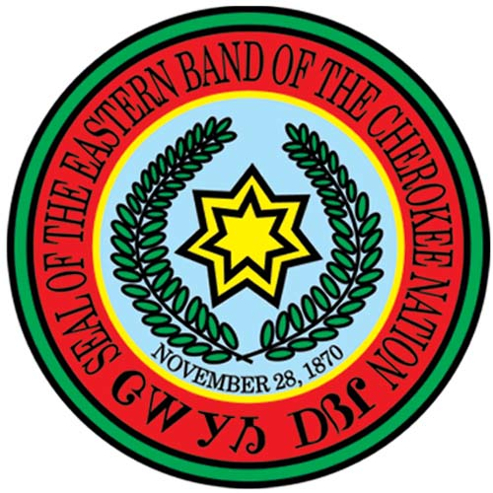
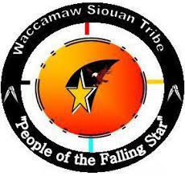
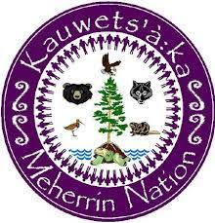
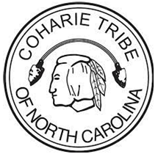
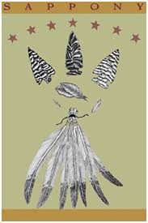
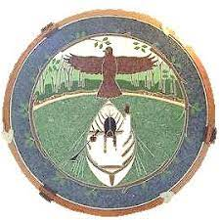
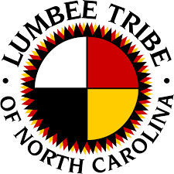
Tribal Seals of the American Indians of North Carolina

Slide 2
What is a seal? What entities or organizations have seals?

Slide 3
Historically, a seal was a device that was used to stamp an impression on a document, clay or other medium. It was meant to authenticate the material. Families, businesses, individuals, nations, branches of the military, and other government officials use and have used seals.

Slide 4
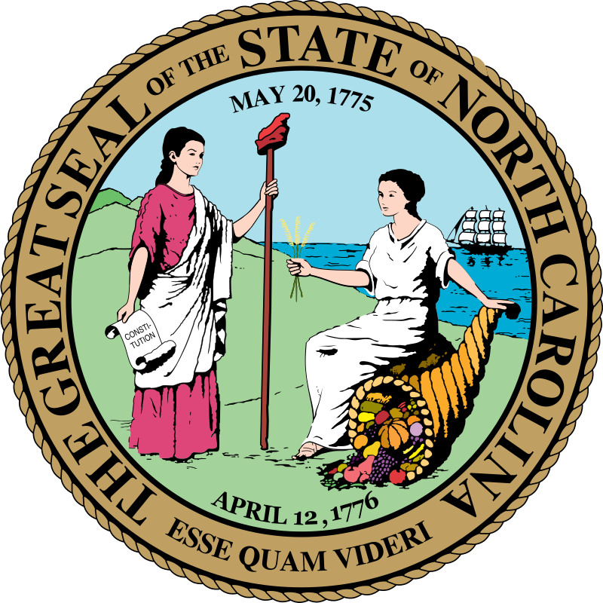
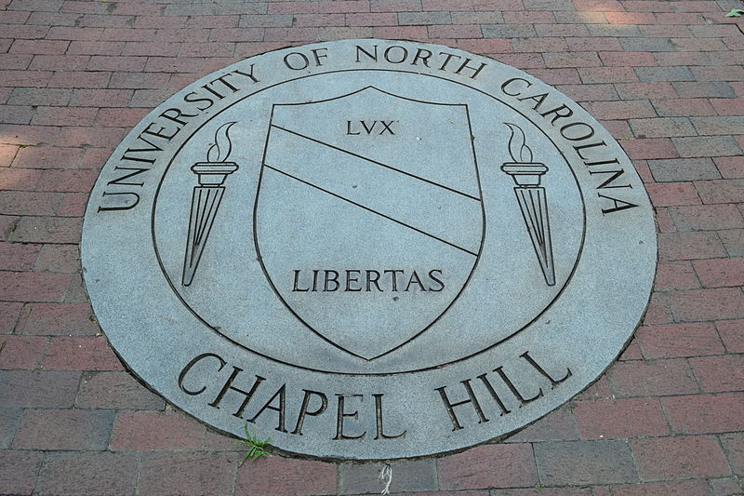
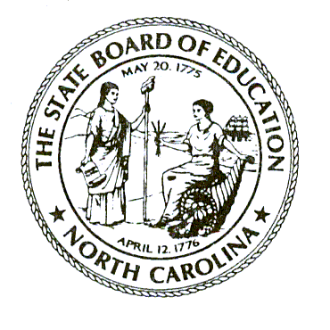
The State of North Carolina
University of North Carolina at Chapel Hill
Seal Examples
Image sources:
1.https://en.wikipedia.org/wiki/Seal_of_North_Carolina (Image is in the public domain)
2. https://commons.wikimedia.org/wiki/File:UNC_Seal.JPG (Creative Commons 3.0 Yeungb 2013.
3.https://en.wikipedia.org/wiki/North_Carolina_State_Board_of_Education (Image is in the public domain)
The NC State Board of Education
The University of North Carolina at Chapel Hill
Notes:
Where do you think you would see these seals? What type of material would be need verification?

Slide 5
The United States has a great seal with two sides. Do you know what symbols it features?

Slide 6
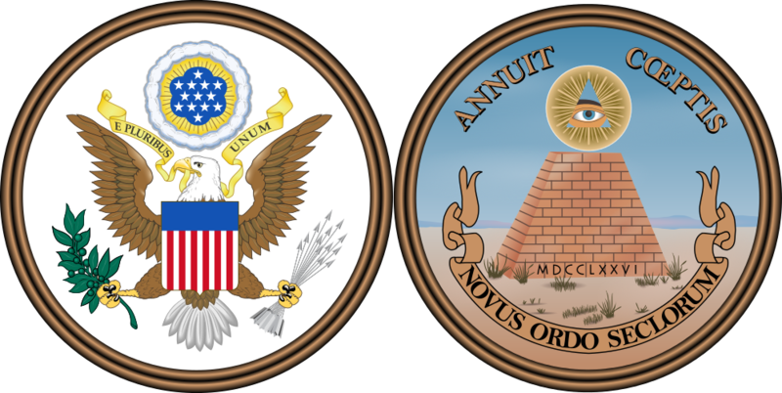
Image Source:https://commons.wikimedia.org/wiki/File:Great_Seal_of_the_United_States_(obverse_and_reverse).png This work is in the public domain in the United States because it is a work prepared by an officer or employee of the United States Government as part of that person’s official duties under the terms of Title 17, Chapter 1, Section 105 of the US Code.

Slide 7
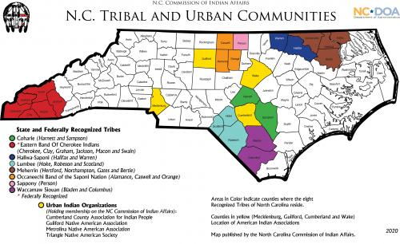
Today in North Carolina, there are 8 state recognized tribes, one of which is also federally recognized Each tribe has their own seal
Image source: https://ncadmin.nc.gov/public/american-indians/map-nc-tribal-communities

Slide 8
The Coharie Tribe:
This seal represents the past, present and the future of the never ending pride in the heritage and survival of the Coharie Tribe.
The half-moon arrow represents the protection of the Coharie Tribe by the Great Spirit.
The feathers represent the freedom and beauty of our people’s never ending existence.
Everything contained on this Logo represents the love, humbleness, and strength that have and will continue to exist among our proud Indian people.
Image source: https://www.facebook.com/CohariePeople/

Slide 9
Definitions
Clans- groups of related people; family groups
Wampum- Shell beads used for ceremonies and sometimes exchange

Slide 10
The Eastern Band of Cherokee Indians (EBCI)
This seal, designed to embrace the early governmental structure, and the eternal endurance of the Cherokee Indians
The 7-pointed star symbolizes the seven clans of the Cherokees and the 7 characters of Sequoyah's syllabary meaning "Cherokee Nation (pronounced "Tsa-la-gi-hi A-yi-li)
The date is for the adoption of the Constitution of the Cherokee Nation West.
The wreath of oak leaves symbolizes the sacred fire which the Cherokees have always kept burning in their land.
Oak was the wood traditionally burned and is native to both North Carolina and Georgia as well as in the Indian Territory in Oklahoma to which the Cherokees removed in the early 1800s.
Image source: https://ebci.com/

Slide 11
The Haliwa-Saponi Tribe
1953- The year the people reorganized themselves and again came together as a tribe.
1965- The year the Haliwa-Saponi Tribe were granted state recognition by the N.C. General Assembly.
Tobacco is used socially, smoked with friends as a greeting and given as a special gift. It is also used in ceremonies and prayers for unity and agreement.
The clouds, home of the Creator, to whom the Haliwa-Saponi pray for rain, to bring life from the corn and tobacco and all living things.
Corn is given as a gift from the Creator and is a main staple of their diet.
The black snake, common to the area is a symbol of medicine and power. It is often left in barns to keep out rodents and to protect the harvest in storage there.
Image source: https://www.haliwa-saponi.org/

Slide 12
The Lumbee Tribe
The circular shape of the tribal seal is symbolic of the circle of life. Along with the circle, the four equal parts and colors of the medicine wheel represent the lifespan of man: birth (red), growth (yellow), maturity (black) and death (white). But, as the circle has no end so there can be no end to life but only another beginning. In addition, the colors represent the four qualities of a balanced life: the spiritual, the emotional, the physical and the intellect.
The colors and their location on the wheel also represent: the four directions: east, south, west, and north and the four seasons: spring, summer, fall and winter.
The Lumbee Pinecone Patchwork surrounding the circle of life represents the pride, power and will of the Lumbee Tribe.
The circle, the four equal parts with corresponding colors and the Lumbee Pinecone Patchwork come together to form a symbol representative of the Lumbee Tribe.
Image source: https://www.lumbeetribe.com/

Slide 13
The Meherrin Nation
The Seal of the Meherrin Nation is primarily made up of purple and white - the colors of the wampum.
Our people are standing in an unbroken circle; the ancestors, our people today, and future generations of Meherrin.
All of the clan animals of the Meherrin Nation are present in the center of the circle.
On the back of the Great Turtle, or Turtle Island (North America) stands the Tree of Peace, symbolizing our nation following the Great Binding Law set forth by Deganawida, the Peacemaker.
The water surrounding the turtle symbolizes our name - Kaywets’a:ka (People of the Water)
Image source: http://meherrinnation.org/

Slide 14
The Occaneechi Band of the Saponi Nation
The tribal seal incorporated a red tailed hawk, soaring above an Occaneechi ancestor in a canoe on the Eno River.
As a registered trademark, the Occaneechi seal is used on all official tribal documents and general correspondence.
The seal was created in 1986.
Image source: https://obsn.org/

Slide 15
The Sappony Tribe
The 7 stars represent the 7 families watched over by God.
The 7 feathers also represent the 7 families tied together.
The 3 arrowheads echo a historical Sappony trading symbol
Tobacco was an important crop for the Sappony.
Corn and wheat were two other crops that formed the base of Sappony agriculture.
Image source: https://www.sappony.org/

Slide 16
The Waccamaw Siouan Tribe
The circle represents the circle of life
The falling star represents a legend that told of a ball of fire that knocked into the earth and created Lake Waccamaw the homeland of the Waccamaw Siouan known today as “The People of the Falling Star”
The colors of red and orange within the circle represents the flames of the ball of fire as it created Lake Waccamaw.
A Medicine Wheel is in the background which represents the many and continued blessings from the Great Spirit to the Waccamaw Siouan.
An Eagle perches at the top of the falling star depicting the strength and longevity of the Waccamaw Siouan Tribe.
Image source: https://www.facebook.com/WaccamawSiouanTribe

Slide 17
Why do you think these American Indian tribes have official seals?

Slide 18
What symbols would you put on your seal?
Notes:
Activity

