Slide 1
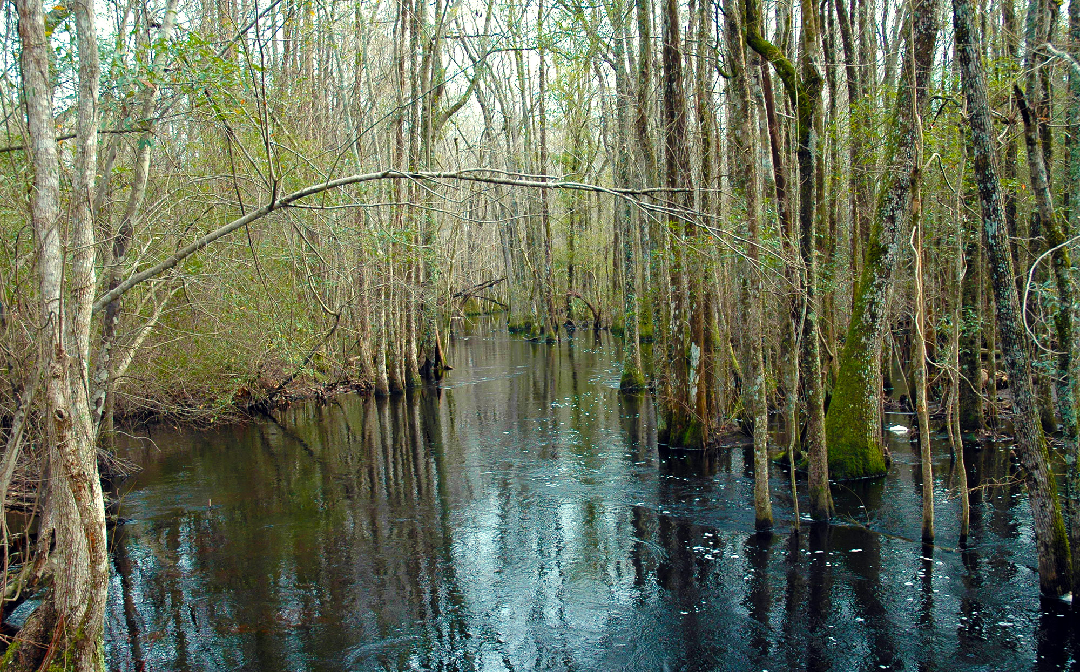
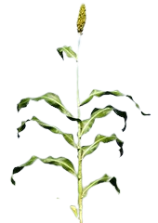
Coharie
Learn about the Coharie Tribe of North Carolina through the official tribal website.
Learn about The Great Coharie River Initiative, and how the community is working to conserve and restore the river which has historically served as the lifeblood of the Coharie People and their ancestors.
Watch Our People: The Coharie to discover the history, culture, and programs related to the Coharie Tribe.
Explore Coharie culture through the video Coharie Ancestors Keep Traditions Alive, by North Carolina Weekend on PBS NC.
Notes:
Our People The Coharie dancer - Permission given by Visit Sampson CVB
https://www.visitsampsonnc.com/wp-content/uploads/Coharie-Indian-Cultural-Pow-Wow.jpg
https://www.visitsampsonnc.com/events/coharie-pow-wow-festival/
Sorghum -
"Sorghum" by Global Crop Diversity Trust is licensed under CC BY-NC-ND 2.0.
"Sorghum Molasses" by ninepennies is licensed under CC BY-SA 2.0.
Canoe - https://scienceviews.com/ebooks/AmericanIndiansFrederickStar/index.html e-Book digitized from American Indians by Frederick Starr, DC Heath & Co Publishers, 1898
River background -
https://ncseagrant.ncsu.edu/currents/2019/03/coharie-and-lumbee-communities-host-guided-kayak-tours/
The Lumbee River, by Gary-Dincer, CC-BY-SA-2.0

