Slide 1
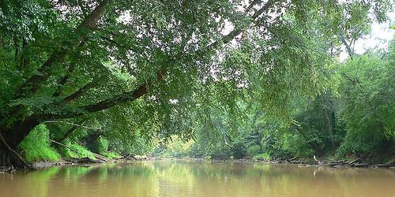
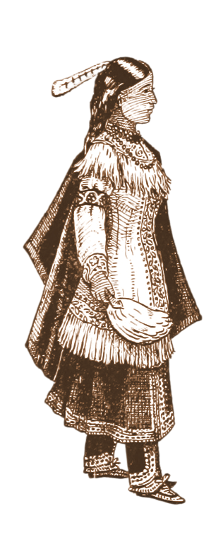
Meherrin
Visit the official website of the Meherrin Indian Tribe.
Experience the beautiful singing and dancing associated with the Meherrin Powwow.
Explore traditional longhouses that Iroquoian Peoples, like the Meherrin, might have constructed.
Notes:
Eagle - "Bald Eagle (Haliaeetus leucocephalus)" by steveberardi is licensed under CC BY-NC-SA 2.0.
Longhouse - https://commons.wikimedia.org/wiki/File:Woodland_Indian_Hamlet.jpg
Dancer - "Image taken from page 85 of 'The People of the Longhouse [i.e. the Iroquois Indians]'" by mechanicalcurator is licensed under CC BY 2.0.
Background - "Neuse River, North Carolina" by eutrophication&hypoxia is licensed under CC BY 2.0.

