Slide 1
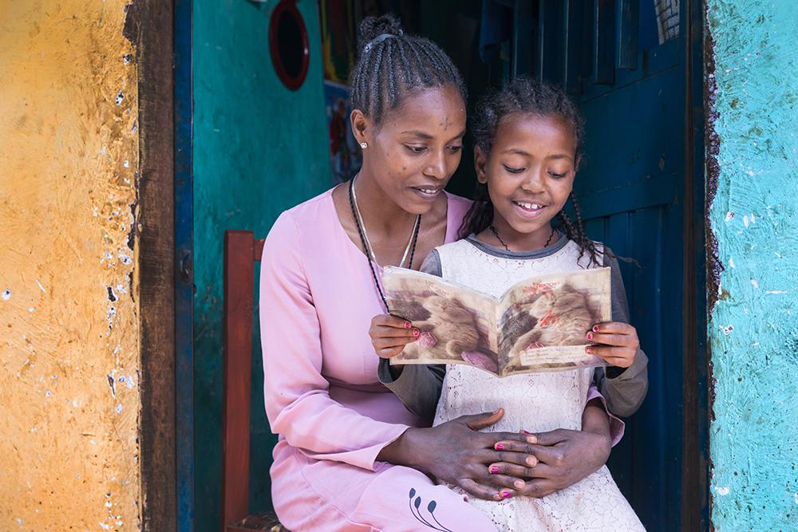
Teje: Ethiopia
This document is supplemental material to Welcome to My Life, a lesson plan created by Alissa McElreath of Dillard Drive Magnet Middle School as part of the 2022-2023 UNC World View Global Fellows Program. For more information about the program, please visit http://worldview.unc.edu/.

Slide 2
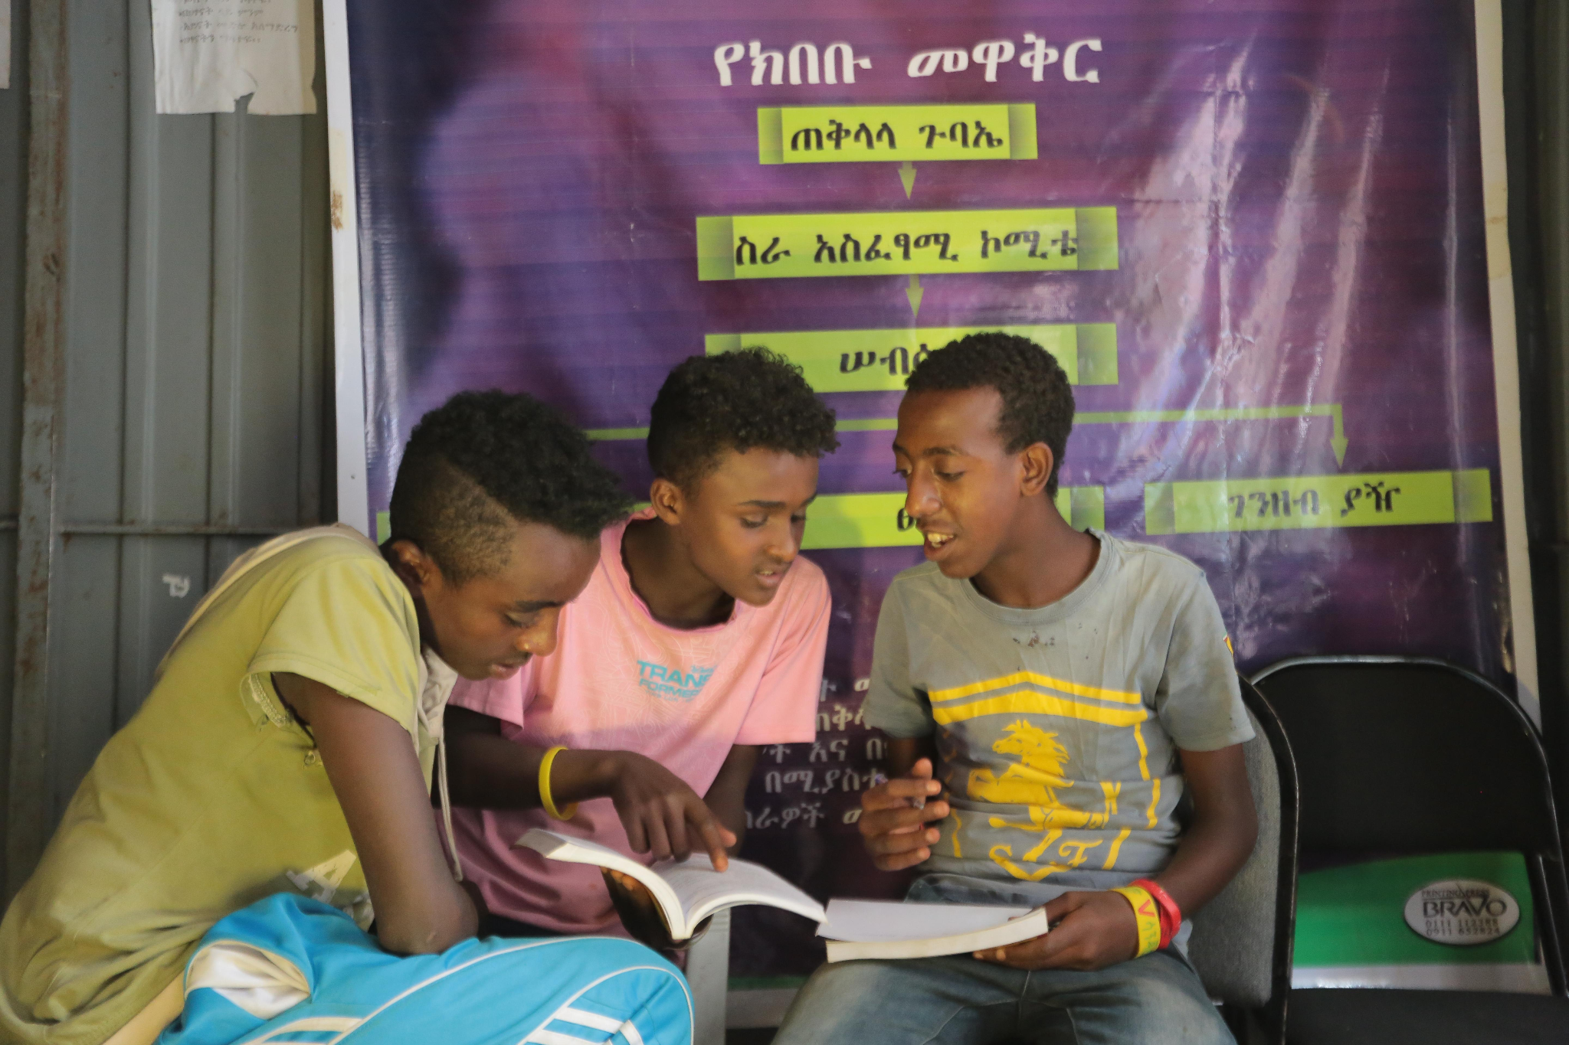
Afework: Ethiopia
This document is supplemental material to Welcome to My Life, a lesson plan created by Alissa McElreath of Dillard Drive Magnet Middle School as part of the 2022-2023 UNC World View Global Fellows Program. For more information about the program, please visit http://worldview.unc.edu/.

Slide 3
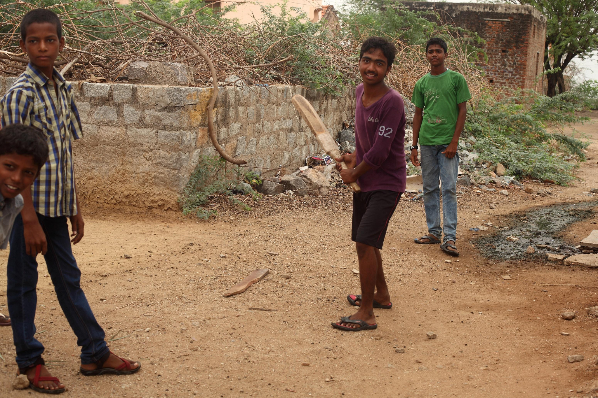
This document is supplemental material to Welcome to My Life, a lesson plan created by Alissa McElreath of Dillard Drive Magnet Middle School as part of the 2022-2023 UNC World View Global Fellows Program. For more information about the program, please visit http://worldview.unc.edu/.
Notes:
India

Slide 4
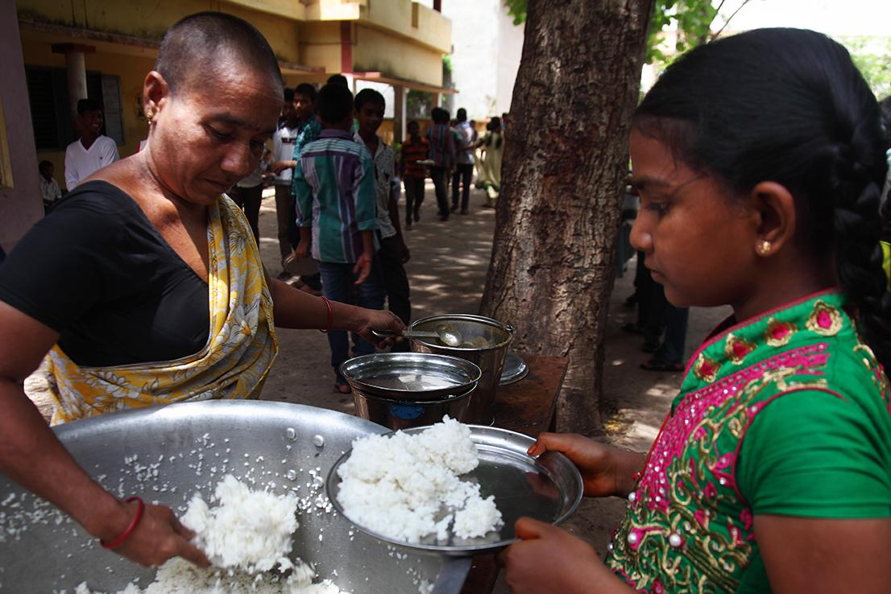
Harika: India
This document is supplemental material to Welcome to My Life, a lesson plan created by Alissa McElreath of Dillard Drive Magnet Middle School as part of the 2022-2023 UNC World View Global Fellows Program. For more information about the program, please visit http://worldview.unc.edu/.
Notes:
India

Slide 5
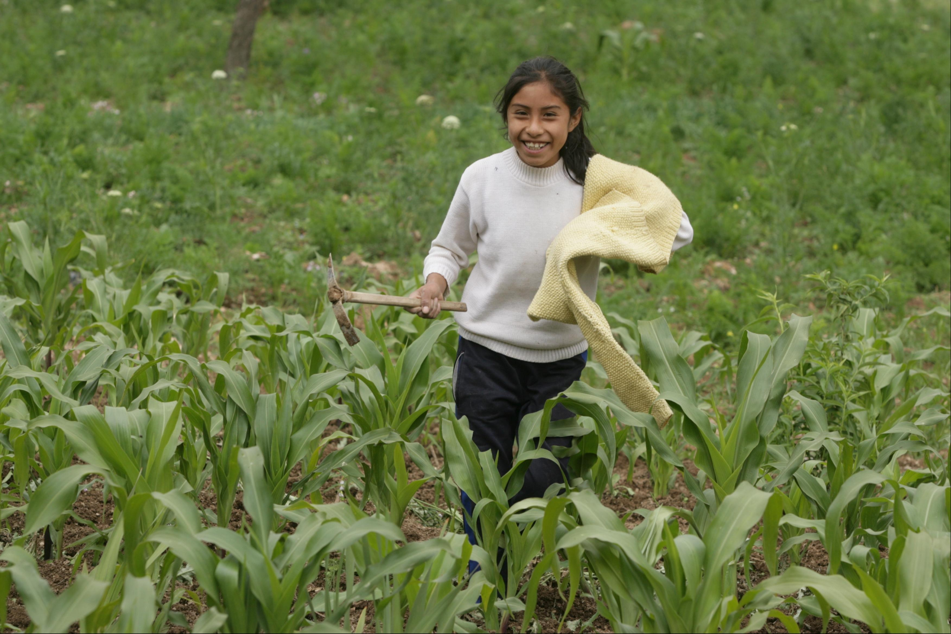
Luz: Peru
This document is supplemental material to Welcome to My Life, a lesson plan created by Alissa McElreath of Dillard Drive Magnet Middle School as part of the 2022-2023 UNC World View Global Fellows Program. For more information about the program, please visit http://worldview.unc.edu/.

Slide 6
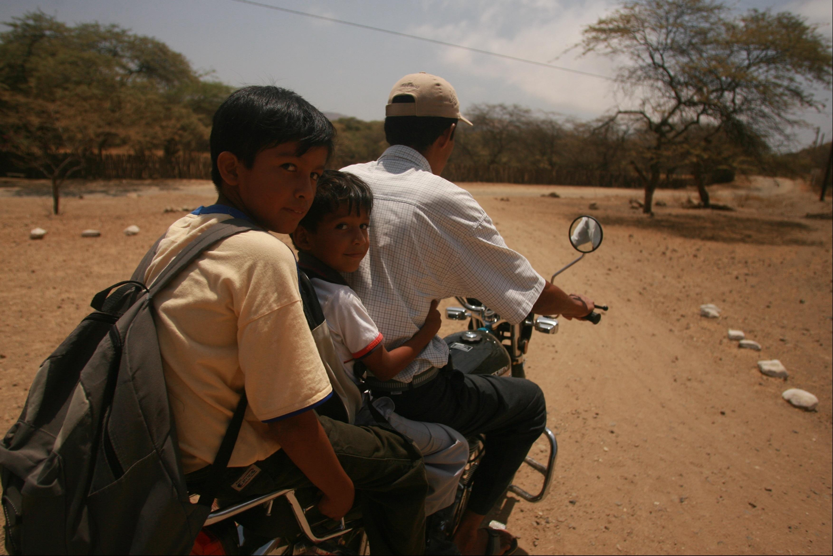
Elmer: Peru
This document is supplemental material to Welcome to My Life, a lesson plan created by Alissa McElreath of Dillard Drive Magnet Middle School as part of the 2022-2023 UNC World View Global Fellows Program. For more information about the program, please visit http://worldview.unc.edu/.

Slide 7
Lien: Vietnam
This document is supplemental material to Welcome to My Life, a lesson plan created by Alissa McElreath of Dillard Drive Magnet Middle School as part of the 2022-2023 UNC World View Global Fellows Program. For more information about the program, please visit http://worldview.unc.edu/.

