Slide 1
BIO 168 PROLOGUE TO THE STUDY OF BODY SYSTEMS

Slide 2
ANATOMY, PHYSIOLOGY, AND EVOLUTION
As we begin our study of the systems of the body, it is important to understand that physical traits are shaped by evolutionary processes that improve the chance of survival
Physical traits include
Hair, skin, and eye color
Blood types
Bone structure
Lactase persistence

Slide 3
EVOLUTION
A gradual change in inherited traits of populations over successive generations
Evolution is experienced by every level of the biologic hierarchy and every type of life-humans, bacteria, animals, viruses,
Changes that increase survival persist; changes that decrease the chance of survival decrease and are often removed from populations
In science, a theory is a well supported explanation. It is NOT a hung or guess. Theories stand because they have not been disproven. Evolution is supported by biochemistry/DNA, bones and fossils, comparative anatomy, modern experiments and computer modeling (Ashraf and Sarfraz, 2016)

Slide 4
EVOLUTION
Evolution occurs through different mechanisms
Natural selection “Survival of the fittest”
Individuals who have traits better suited to the environment they live in, are more likely to survive
Genetic drift
Random adaptations in a limited population, causing some alleles to increase or decrease in frequency
Gene flow
Genes move with individual as they move to different geographic locations and interbreed with different populations

Slide 5
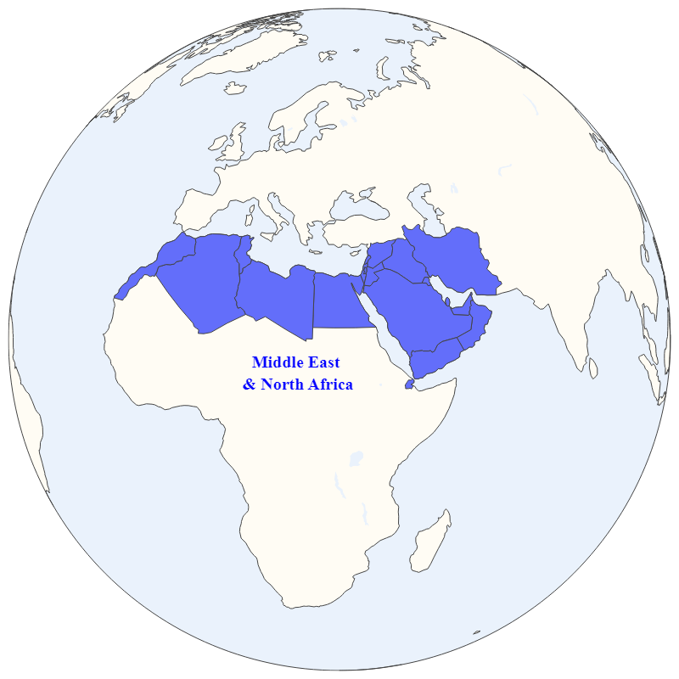
BIRTHPLACE OF HUMANITY MIDDLE EAST AND NORTH AFRICA (MENA)
Scientists have traced human origins to Africa based on
Fossil evidence
The oldest human fossils are found in this region
Tracking DNA and mutations
Genetic diversity
The greatest genetic diversity is found in this region

Slide 6
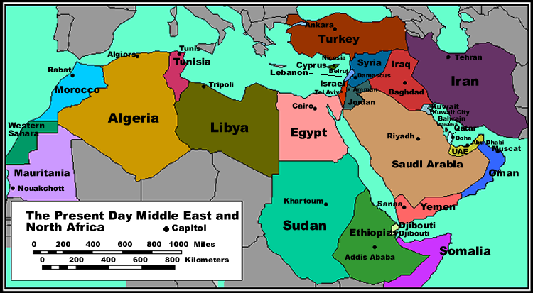
MENA: BIRTHPLACE OF HUMANITY
This region encompasses modern countries of;
Algeria
Egypt
Ethiopia
Iran
Iraq
Israel
Jordan
Libya
Mauritania
Morocco
Oman
Saudi Arabia
Somalia
Sudan
Syria
Tunisia
Turkey
United Arab Emirates
Yemen

Slide 7
MENA: BIRTHPLACE OF HUMANITY
The current day demographics of this region include
Languages
Arabic
French
Hebrew
Persian/Farsi
Portuguese
Somali
Spanish
Swahili
Turkish
Twi
Religions
Christianity
Islam
Judaism

Slide 8
MENA: BIRTHPLACE OF HUMANITY
Climate of MENA
130,000-90,000 years ago, MENA was a warm and wet climate, with rainforests and lots of vegetation
90,000- 70,000 years ago, the climate in the MENA became colder and drier, prompting some early humans to migrate out of MENA, into Eurasia

Slide 9
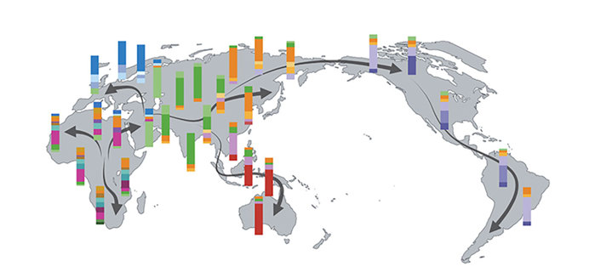
MENA: BIRTHPLACE OF HUMANITY
The genome of all modern-day humans is >99.9% identical
Mutations occur randomly, but at a constant rate over time. We can trace human migration by looking at diversity and similarly of genetic markers

Slide 10
BIRTHPLACE OF HUMANITY
This map shows the greatest diversity in Africa and that overtime genes changed to increase survival rate in the new environments

Slide 11
BIRTHPLACE OF HUMANITY
This map shows the greatest diversity in Africa and that overtime genes changed to increase survival rate in the new environments

Slide 12
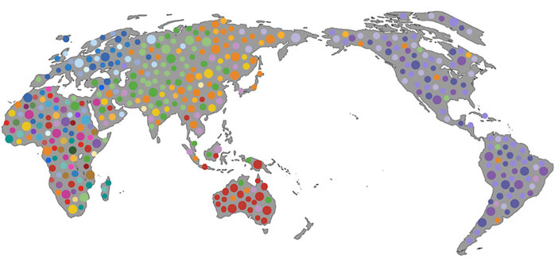
BIRTHPLACE OF HUMANITY
The second greatest center of genetic diversity if found in the middle east and then populations migrated in distant directions as evidence of patterns of colors that represent genes.

Slide 13
MENA: BIRTHPLACE OF HUMANITY
On the next three slides, review the UV Index World Map, Global Hair Texture Map, and Skin Color Map of Indigenous People
Write a hypothesis statement about the relationship between UV Index and Integumentary structures in indigenous people of equatorial Northern Africa

Slide 14
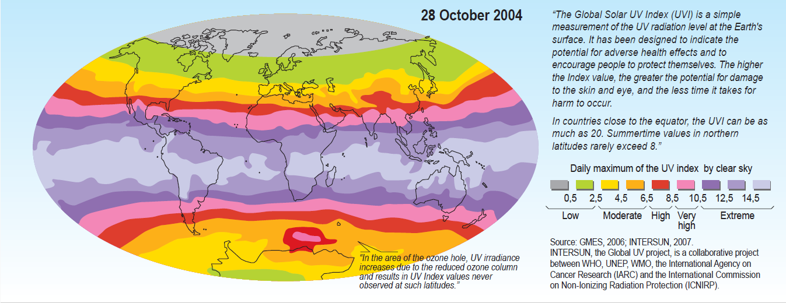
GLOBAL SOLAR UV INDEX

Slide 15
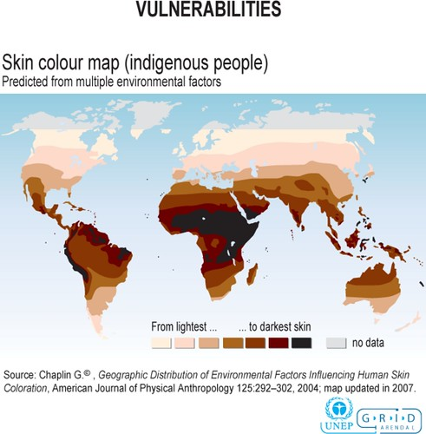
SKIN COLOR OF INDIGENOUS PEOPLE

Slide 16
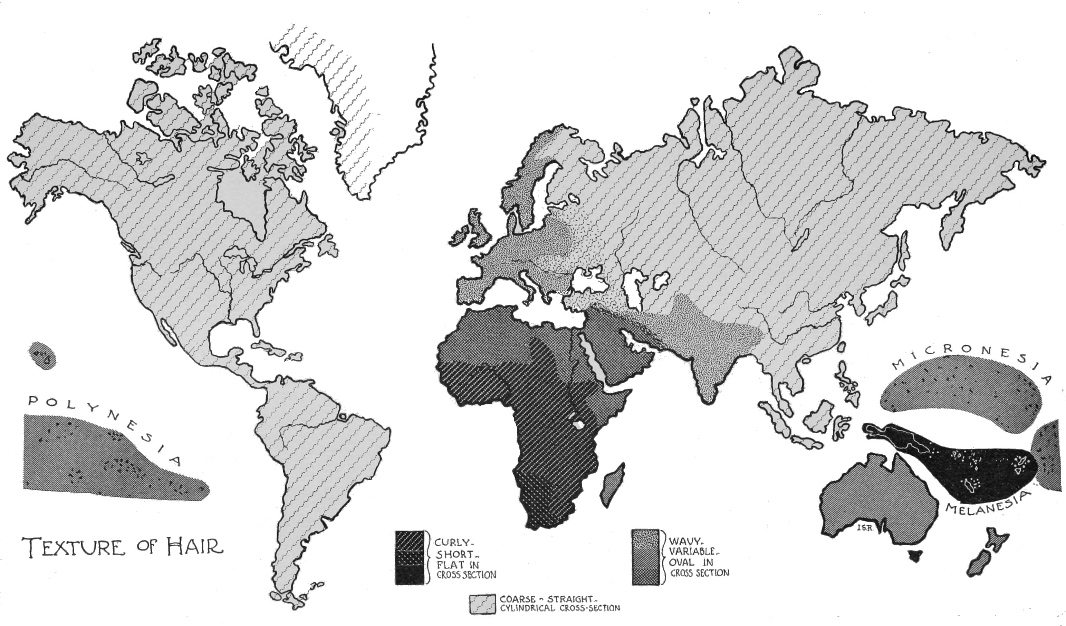
GLOBAL HAIR TEXTURE MAP

